Slide 1
Apostrophes and Commonly Confused Words
By: Joel, Carson, Kyle, John, and Zach

Slide 2
When to Use Apostrophes (or not)
Used to show possession Ex - Carson’s hockey stick.
Can be used to shorten words through contractions Ex - I don’t want to die.
Used in abbreviations Ex - They all received their PhD’s.
When using single letters Ex - I only take L’s.
DO NOT USE THEM when using numerals
WRONG Ex - I was born in the 2000’s.
RIGHT Ex– I was born in the 2000s.

Slide 3
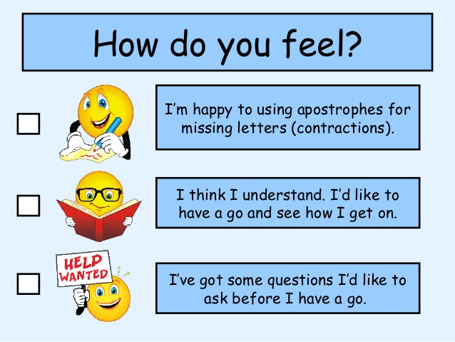
Possession vs. Contraction
You can use apostrophes to show the possession of a noun. They can be put at the end of a word along with an “s” to show that it owns what it is describing.
Example: The dog’s toy is red.
An apostrophe can also be used to form contractions, which shorten two words such as could not, could have, or should have.
Example: I couldn’t have possibly moved that box.

Slide 4
Plural Apostrophes
An apostrophe and s do not necessarily make a noun plural.
For example : I use many apostrophe’s. (This is using “apostrophes” in a possessive case)
I use many apostrophes. (This uses the correct plural form)
Also, uncommon plural words such as “children” are already plural. So, “childrens’” is not correct and should be “children’s”.

Slide 5
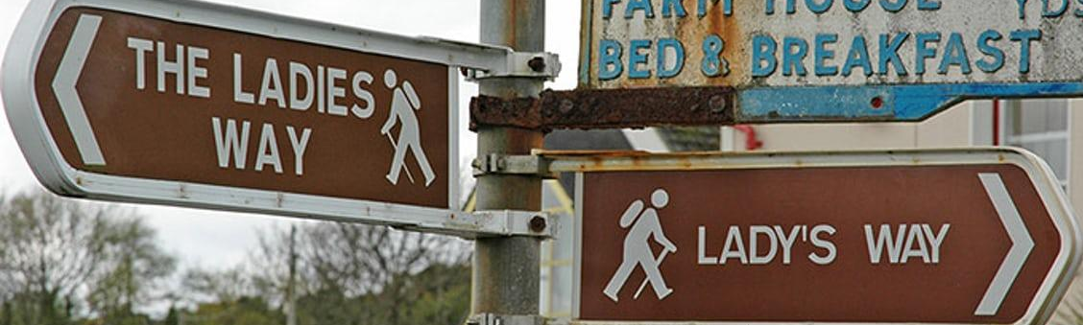
Using Apostrophes with words that end in “s”
There is no real “correct” way to show possession from words that end in “s”. Some believe there should simply be an apostrophe added to the end, while some think there should be an apostrophe and “s”.
Example 1: They believe in Jesus’ death and resurrection. OR Example 2: They believe in Jesus’s death and resurrection.
Remember that no matter what, if it is a noun that is formed by adding an “s”, putting the apostrophe before the “s” will be a singular possession while an apostrophe after the “s” will show plural possession.
Example 1: I like the boy’s hair. (A singular boy’s hair) Example 2: I like the boys’ hair. (Multiple boys’ hair)

Slide 6
Plural Possessive Apostrophes
To show possession in a proper, plural name add an “es” and an apostrophe. This will often result in an awkward looking word, nevertheless, this is the correct way to signify a possessive, plural, proper name.
Ex: If you wanted to talk about the house of a family with the last name Jones, you would say: The Joneses’ house
(Jones + es + apostrophe)
Incorrect: The Jones’ house

Slide 7
It’s and Its
People often misuse its and it’s because the apostrophe rule for its and it’s is the opposite of the normal apostrophe rules.
With its and it’s, the lack of an apostrophe shows possession and the use of an apostrophe means “it is”.
Example 1: “It’s wrong to say mean things about other people.”
Example 2: “The baby was all alone; its mother was long gone.”

Slide 8
Farther vs. Further
Farther is used in reference to a large physical distance.
Ex: My locker is farther from the office than yours.
Further is used to refer to a figurative distance or something that is additional.
Ex 1: We have much further to go before we arrive home.
Ex 2: He had no further comments.

Slide 9
Fewer vs. Less
Fewer means “not as many” and is used in reference to a countable noun.
Ex: Sally spent fewer hours on homework than me.
Less means “not as much” and is used in reference to an uncountable noun.
Ex: Bill made less money than Tom.

Slide 10
Apart vs. a part
Apart means to be separated by a distance or by a certain amount of space.
Ex: The children stood an arm’s length apart from each other.
A part is a piece or section of something.
Ex: I want to be a part of the group that gets a bad grade on this project.

Slide 11
Then vs. Than
Then is used as a transition in a sentence, indicating ones intentions/ actions after a first intention/ action is completed.
Ex: I will go to the store to get groceries, then I will stop to get gas.
Than is used to show preference when using a comparison of two things.
Ex: I would rather have a 93% in this class than a 90%.

Slide 12
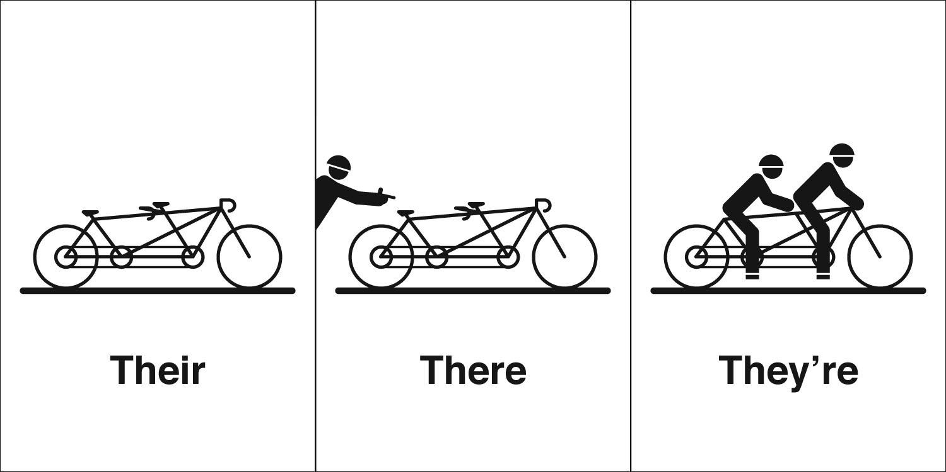
There, Their, and They’re
These three words are commonly misused because they all sound the same no matter how they are used.
“There” is used to reference a place or location, “their” is used to show possession, and “they’re” is used to say “they are”.
There: “Go over there and sit in the corner.”
Their: “Their dogs have rabies.”
They’re: “They’re going to the beach later.”

Slide 13
You’re and Your
You’re is a contraction for “you are”.
Ex: You’re good at chemistry.
Your is the possessive form of “you”.
Ex: Your shoe is untied.

Slide 14
Affect and Effect
Affect is a verb
Ex: “He was heavily affected by the devastating news.”
Effect is a noun
Ex: “The effects of the attack will take a long time to fix.”

Slide 15
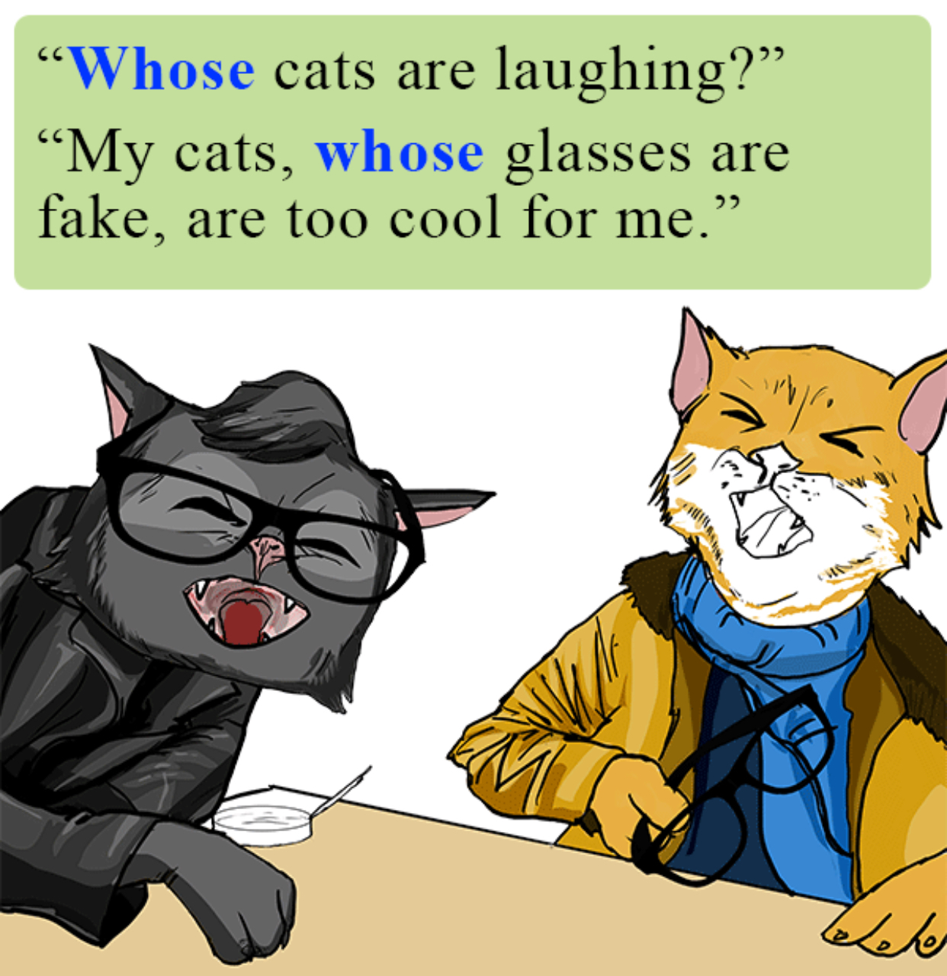
Who’s vs Whose
Who’s is a contraction meaning “who is” or “who has”.
Ex: Who’s ready for summer?
Whose is the possessive form of who.
Ex: Whose fault was the accident?

Slide 16
Quizzes and Helpful Links
Helpful Links:
http://www.classywriting.com/commonly-confused-words-apostrophes/
https://www.hamilton.edu/academics/centers/writing/seven-sins-of-writing/4
Games:
https://www.grammarbook.com/grammar_quiz/apostrophes_1.asp
https://www.ecenglish.com/learnenglish/lessons/take-apostrophe-quiz
https://journalism.ku.edu/node/276/take/1
https://www.tolearnenglish.com/exercises/exercise-english-2/exercise-english-105767.php

Slide 17
Quizzes and Helpful Links (Continued)
https://www.proprofs.com/quiz-school/story.php?title=use-apostrophes-2

