Slide 1
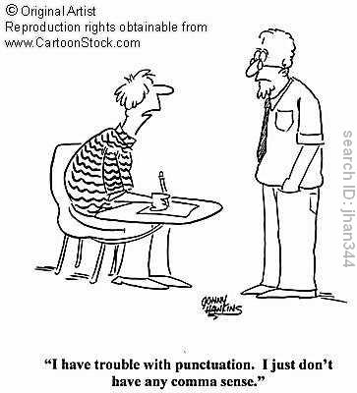
How To use commas
By: The greatest Group Ever

Slide 2
Common mistakes
Commas seem to be a touchy subject. Oftentimes students overuse or underuse commas because they don’t understand the rules that comes with it.
Unnecessary comma:
Pepe the frog, went to the store.
There is no reason to add a comma in this sentence.
Comma splice:
Tom read the novel, his friend saw the movie
Two separate clauses, use a different form of punctuation or a conjunction.
Too many commas:
I, went to the store, yesterday, to get some water, for my flowers, Bob and Jim.
Every instance where a comma is used equals the death of an innocent sentence. There is no reason to add a comma to any part of this sentence.
What on God’s green earth?:
T,o,d,a,y,,I,,W,e,n,t,,f,I,s,h,I,n,g,,.
Commas are not used as spaces or letter separation.

Slide 3
What makes commas so hard to utilize?
Commas serve the purpose of separating, introducing, omitting, and emphasizing.
Rules regarding commas can often be very flexible, however they almost always follow specific rules. Using a comma the wrong way, is annoying like in this sentence.
The most useful aspect of the comma is to join two or more kinds of clauses together.
Often times, students simply create run on sentences, or even worse: use the comma incorrectly.
When separating two thoughts sometimes people put a comma before and after the conjunction. Using a comma in this way is rare, and well, annoying. (That previous sentence is an exception.) We have three words for this: “Could you not?”

Slide 4
How to use Commas
Ex #1:
Let’s eat, grandma. OR Let’s eat grandma.
In this example, the comma separates the verb from the object/audience.
Ex #2:
I like cake, strawberries and icing. OR I like cake, strawberries, and icing.
This example uses the oxford comma. The oxford comma separates unlike things in a list.
Ex #3:
John Cena may be a fake wrestler, but he makes a good meme.
In this example the comma is used to separate two complete thoughts with a conjunction.
These are known as independent clauses. (Remember F.A.N.B.O.Y.S)
Ex #4:
Gah, there’s nothing to do!
Whenever you use an interjection always follow it with its proper punctuation. This example uses a comma but it might not necessarily use one.
A good tip for commas is to say it aloud. Pause for a second to hear how it sounds in your head.

Slide 5
How to use commas: Comma Splices
Comma splices are the incorrect way of joining two independent clauses.
Ex: It is nearly half past five, we cannot reach town before dark.
Instead of using a stronger form of punctuation, like a semicolon, colon, or dash, we simply place a comma between the two and hope for the best.
The correct way to punctuate this example is to either to add a coordinating conjunction or put a different punctuation in its place. (Reminder: Coordinating conjunctions are for, and, nor, but, yet, so) (Different punctuation can be a period, semi-colon, colon, or dash.)
Corrected: It is nearly half past five; we cannot reach town before dark.
It is nearly half past five. We won’t reach town before dark.
It is nearly half past five, so we cannot reach town before dark.

Slide 6
How to avoid using commas
If you don’t do something; you won’t mess up. This is a boring approach, but effective nonetheless.
1) Simply use a period between two independent clauses:
Jordan is going to whip some fools, then she will go eat some ice-cream.
Jordan is going to whip some fools. She will then go eat some ice-cream.
2) Offsetting the dependent clause:
She jogged for 30 minutes, and she walked for 20 minutes.
She jogged and walked for 50 minutes.
3) Use more apt punctuation:
I will not go to the dinner party, everyone will make fun of me.
I will not go to the dinner party; everyone will make fun of me.
I will not go to the dinner party for this reason: everyone will make fun of me.
I will not go to the dinner party. Everyone will make fun of me.

Slide 7
Parentheticals and clauses
A parenthetical is additional information that adds to a sentence. You can remove it and the sentence do not losing much besides details.
Kanye West, a famous pop icon, is running for president in 2020.
Clauses also tend to be messy. An independent clause is a complete thought that can stand by itself as a sentence. Dependent clauses are not complete thoughts and rely on an independent clause to facilitate them.
This is one independent clause. This is another independent clause.
You can’t stump the Trump™, but you can feel the Bern©.*
This is a dependent clause and a parenthetical.
Broccoli, which people often leave uneaten, is very nutritious.
This last sentence also serves as a parenthetical.
*Disclaimer: This sentence is TOTALLY not sponsored in any way whatsoever. On a non-related note: vote Donald Trump!

Slide 8
Practice
Put a comma in the right spot.
One does not simply walk into Mordor but Frodo did it anyway.
People lace up your roller skates.
Who would cross the Bridge of Death must answer these questions three ere the other side he see.
Join two clauses with a comma and conjunction. (Remember F.A.N.B.O.Y.S.)
Henry said it’s game day. Jacquelyn ignored him because her Sims needed her.
Douglas lost his sketchbook. He doesn’t give up hope.
John-Parker is a meme lord. He also owns the rarest Pepe.
Create your own conjunction sentence.

Slide 9
Possible Answers
1) One does not simply walk into Mordor, but Frodo did it anyway.
2) People, lace up your roller skates.
3) Who would cross the Bridge of Death must answer these questions three, ere the other side he see.
4) Henry said it’s game day, but Jacquelyn ignored him because her Sims needed her.
5) Douglas lost his sketchbook, yet he doesn’t give up hope.
6) John-Parker is a meme lord, and he also owns the rarest Pepe.

Slide 10
Where will you see this on the Psat? Pt. 1
There are sections in the PSAT devoted entirely to the proper use of commas. Here are some examples:
Select the underlined word or phrase that needs to be changed to make the sentence correct.
Anna, questioning her decision, looked to her brother, however he wouldn’t meet her eye. No error.
Possible answers:
Anna, questioning
Decision, looked
Brother, however
No error
Wouldn’t meet
Correct answer: C) Brother, however. Explanation: The clause, “however, he wouldn’t meet her eye,” is an independent clause and must be separated by a semicolon or a coordinating conjunction.

Slide 11
Where will you see this on the Psat? Pt. 2
Choose the option that best reflects the proper usage of the comma in the sentence.
“Oh I forgot to bring the cookies.”
A. Oh,
B. I, forgot
C. to, bring
D. No error
Answer: A: A comma should follow an interjection like "Oh" at the beginning of a sentence. (In some sentences, other punctuation like an exclamation point is acceptable.) A comma between subject and verb (B) is incorrect. A comma in the middle of an infinitive (C) is incorrect.

Slide 12
Where will we see this on the PSAT Pt. 3
Choose the option that best reflects the proper usage of the comma in the sentence.
This fishing pole Nathan, has seen better days.
A. pole, Nathan,
B. has, seen
C. Nathan
D. No error
Answer: A: The comma after "Nathan" is correct, but there should also be another comma before it. When an address to someone by name is inserted mid-sentence-here between subject and object-it should be set off by commas on both sides. There should not be a comma between auxiliary verb and verb (B). Having no commas to set off the inserted name (C) is incorrect.

Slide 13
Where will we see this on the PSAT Pt.4
Choose the option that best reflects the proper usage of the comma in the sentence.
For the Thanksgiving reunion, relatives were sitting in the dining room, on the porch, and in the carport.
A. Thanksgiving, reunion
B. were, sitting
C. porch and
D. No error
Answer: D: No error. There is a comma after the initial modifying prepositional phrase and after the first and second modifying prepositional phrases in the series of three. No comma belongs between an adjective and the noun it modifies (A), or between an auxiliary verb and verb (B). Omitting the second comma setting off the first modifying prepositional phrase (C) is wrong.

Slide 14
Where Will we see this on the PSAT PT. 5
Choose the option that best reflects the proper usage of the comma in the sentence.
The badger, a shy animal sometimes makes friends with a coyote.
A. sometimes, makes
B. friends, with
C. a shy animal,
D. No error
Answer: C: A modifying phrase between subject and predicate should be set off by commas on both sides. Putting a comma between adverb and verb (A) or between object and preposition (B) is incorrect.

Slide 15
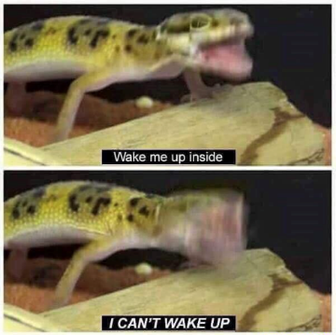
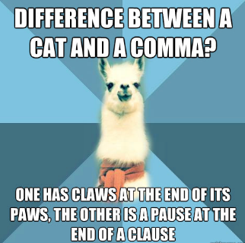
Helpful Links
http://www.softschools.com/quizzes/language_arts/punctuation_comma/quiz2140.html
http://www.sheppardsoftware.com/grammar/punctuation.html
http://www.savethecomma.com/game
http://www.quia.com/rr/82028.html
http://www.grammarbook.com/punctuation/comma.asp

