Slide 1
Pronouns & Antecedents
Kristen Price, Reid Erps, Kalin Tenbarge, Haley King, and Jana Riley

Slide 2
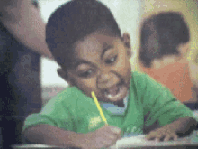
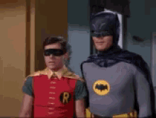
Pronouns and Antecedents
Pronouns are words
Ex: she, you, his, their, etc.
Antecedents are what the pronouns refer
Ex: Kate takes her pencil to school. (Pronoun: her; Antecedent: Kate)
Ex: Bill hates Kate’s hair. He thinks it's ugly. (Pronoun: He; Antecedent: Bill) (Pronoun: Her; Antecendent: Kate)
Error: The pronouns and antecedents are unclear or don't match up

Slide 3
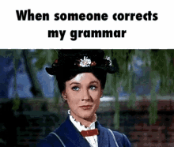
Errors
Error: Too many antecedents
Wrong: George ate Bill’s apple. He was sad.
Correct: George ate Bill’s apple. Bill was sad.
Why: some pronouns are confusing if they can refer to multiple antecedents (so don’t use a pronoun)
Error: Pronoun disagrees with antecedent in gender
Wrong: Shelby made his own card.
Correct: Shelby made her own card.
Why: Shelby is a girl
Pronoun and antecedent disagree in number
Wrong: Shelby or Carol got their husband.
Correct: Shelby or Carol got her husband.
Why: The “or” makes the pronoun for husband singular because only one of them got her husband

Slide 4
FYI– (an important tip for ACT)
indefinite pronouns anyone, anybody, everyone, everybody, someone, somebody, no one, and nobody are always singular
Incorrect:
Everyone wanted their paper to be its best.
Correct:
Everyone wanted his or her paper to be its best.

Slide 5
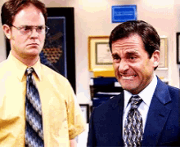
Group Practice

Slide 6
Identify the Pronoun and the Antecedent
Luke threw his staples at Wyatt.

Slide 7
Correct Answer
Luke threw his staples at Wyatt.
Pronoun: his
Antecedent: Luke

Slide 8
Identify the Pronoun and the Antecedent
Andrew twirled his earbuds while he talked about Spider-Man.

Slide 9
Correct Answer
Andrew twirled his earbuds while he talked about Spider-Man.
Pronoun: his, he
Antecedent: Andrew

Slide 10
Identify the Pronoun and the Antecedent
Kristen and Jana got their part of Mrs. Potts.

Slide 11
Correct Answer
Kristen and Jana got their part of Mrs. Potts.
Pronoun: their
Antecedent: Kristen, Jana

Slide 12
Identify the Pronoun and the Antecedent
John ate Jack’s pizza. Jack is sad.

Slide 13
Correct Answer
John ate Jack’s pizza. Jack is sad.
Pronoun: None!
Antecedent: None!

Slide 14
Identify the Pronoun and the Antecedent
Lauren likes her bracelet.

Slide 15
Correct Answer
Lauren likes her bracelet.
Pronoun: her
Antecedent: Lauren

Slide 16
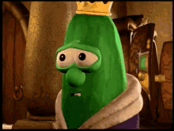
Helpful Resources

Slide 17
Helpful Links (Informational)
http://grammar.yourdictionary.com/parts-of-speech/pronouns/pronoun-antecedent.html
https://webapps.towson.edu/ows/pro_antagree.htm
http://englishplus.com/grammar/00000027.htm
Second link works best!

Slide 18
Quizzes!
https://www.khanacademy.org/humanities/grammar/syntax-conventions-of-standard-english/subject-verb-agreement-and-pronoun-antecedent-agreement/e/pronoun-antecedent-agreement
https://www.oupcanada.com/higher_education/companion/literature/9780195425154/eng_135/quiz_subject_verb.html
https://webapps.towson.edu/ows/exercises/Pronoun%20-%20Antecedent%20Agreement%20-%20Exercise01.aspx
https://www.proprofs.com/quiz-school/story.php?title=pronoun-antecedent-agreement_2
https://www.quia.com/quiz/3051576.html

Slide 19
Game Time!
Kahoot link:
https://play.kahoot.it/#/?quizId=66e6ce12-75ec-4c7b-8851-70062951707a

Slide 20
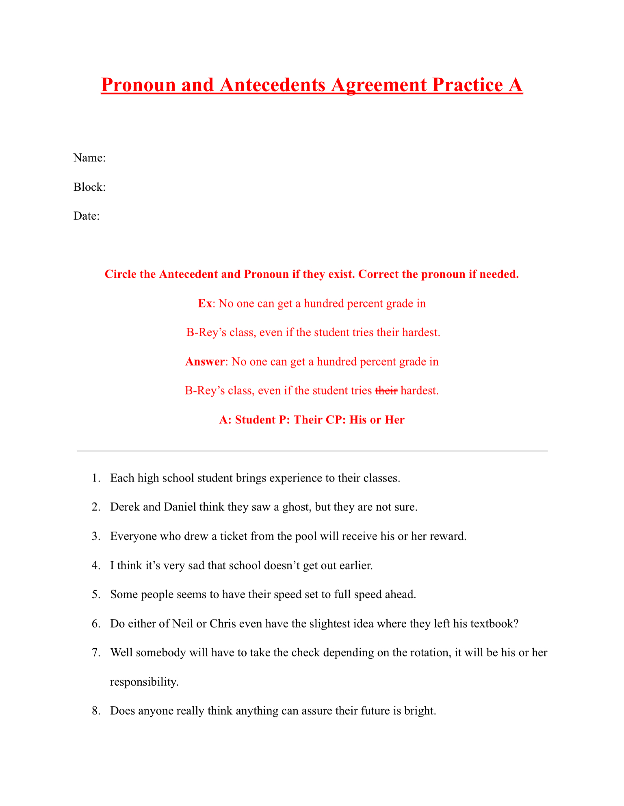
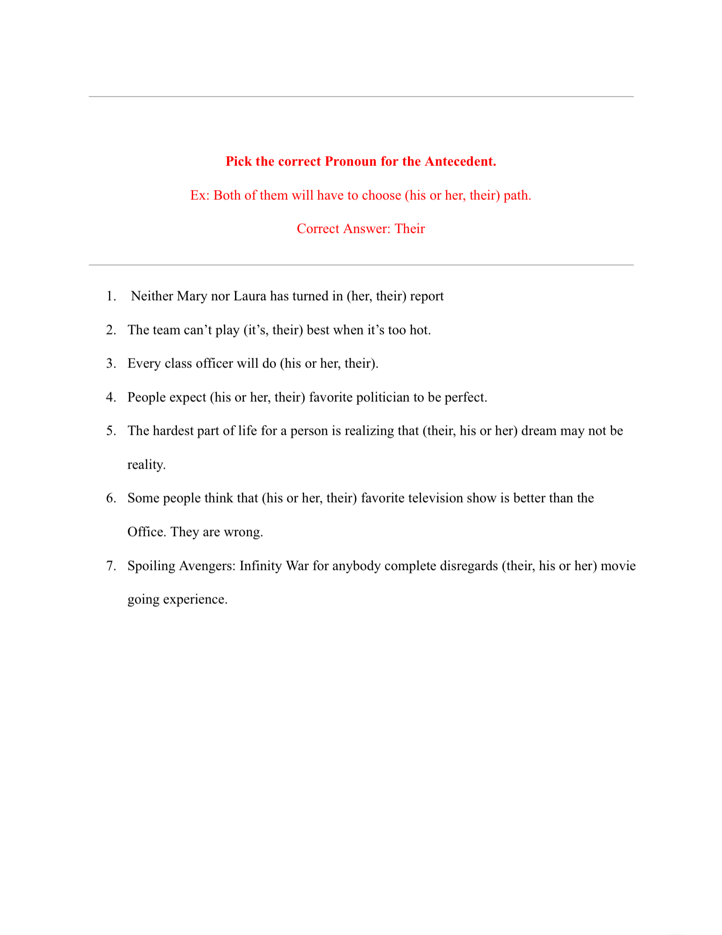
Worksheets Part 1

Slide 21
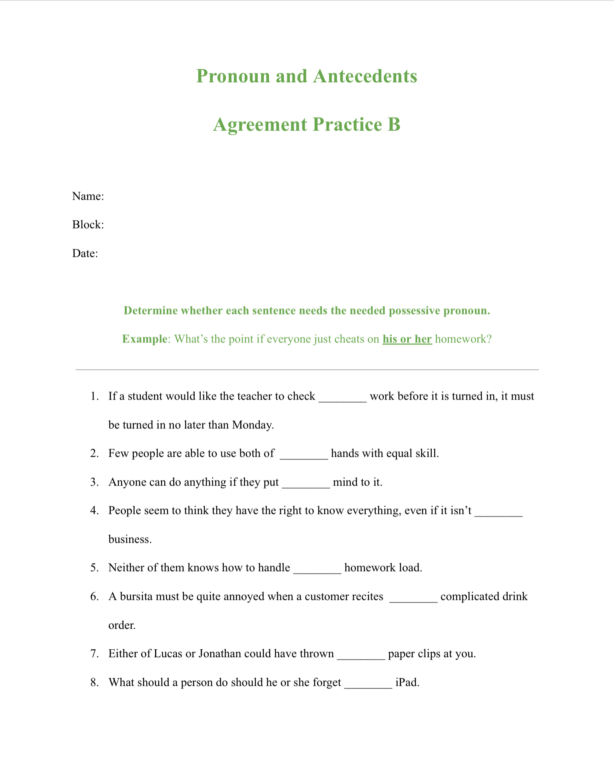
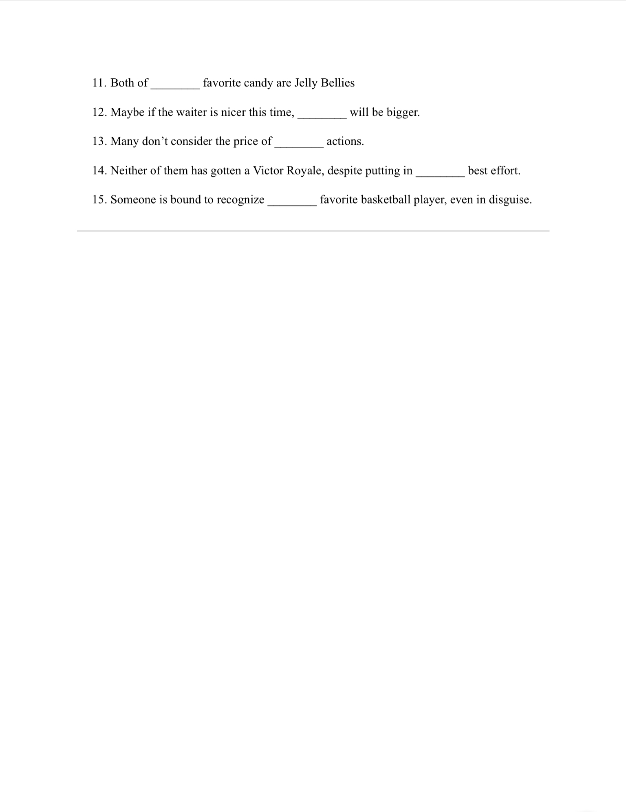
Worksheets Part 2

Slide 22
Sources (Worksheets)
https://lfcc.edu/wp-content/uploads/2014/08/Pronoun-Antecedent-Agreement-Worksheet.pdf
http://www.aurora-schools.org/userfiles/638/pronouns_and_antecedents.pdf

Slide 23
Sources (Pictures)
https://tenor.com/view/batman-grammar-gif-10470328
https://tenor.com/view/eye-roll-stfu-when-someone-corrects-my-grammar-worry-bout-you-worry-about-you-gif-5708824
https://tenor.com/view/veggietales-grammar-king-larry-larrythecucumber-gif-4974023
https://tenor.com/view/school-paper-exam-board-gif-8766184

