Slide 1
Pronouns and antecedents
Noah, Rachel, Caroline, Maura
Ryan

Slide 2
Error? Why?
When the pronoun and the antecedent don't match because one is plural and the other is singular
Plural nouns require plural pronouns and singular nouns require singular pronouns
When one or the other is in first person while the other is in third person. They need to be corresponding to be correct
You can't switch between first and third person mid sentence

Slide 3
Example
If a student parks a car on campus, they need to buy a parking pass. (Wrong)
If a student parks a car on campus, he or she needs to buy a parking pass. (Right)
Needs to agree in number

Slide 4
Example
When a person comes to class, you need to have your homework ready.
When a person comes to class, he or she should have his or her homework ready.
Needs to agree in person

Slide 5
Example
Julie almost forgot their backpack this morning. Wrong
because Julie is singular, while their is plural.
Julie almost forgot my backpack this morning. Wrong
because Julie is in 3rd person and my is in 1st person.
What is something we could change to make the pronoun and antecedent match?

Slide 6
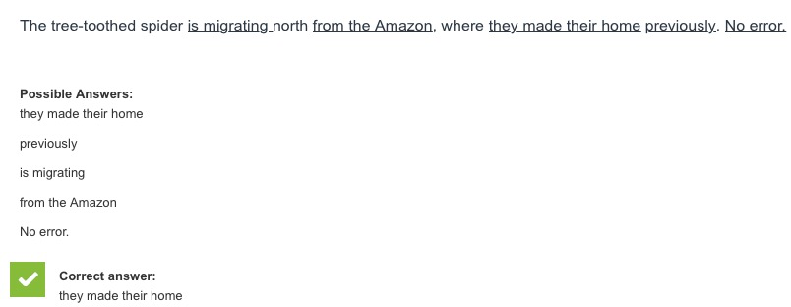
Practice #1

Slide 8
Practice #2

Slide 10
Practice #3

Slide 12
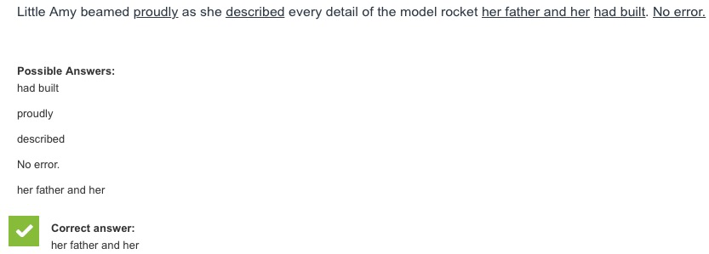
Practice #4

Slide 13
This is more subjective vs. nominative pronouns
there are more than just Two pronoun/antecedent errors on psat/sat

Slide 14
Helpful Links
Information-
http://blog.prepscholar.com/pronoun-agreement-on-sat-writing-tips-and-practice
http://www.varsitytutors.com/psat_writing-help/correcting-pronoun-antecedent-agreement-errors
Games/Quizzes-
http://www.varsitytutors.com/psat_writing-identifying-pronoun-antecedent-agreement-errors-practice-test
https://www.oupcanada.com/higher_education/companion/literature/9780195425154/eng_135/quiz_subject_verb.html
https://www.kennesaw.edu/elearning/proseprep/grammar/pronounantecedent.htm

