Slide 1
Dangling & Misplaced Modifiers
Brooke, Lexy, Allie, Alera, Madeline

Slide 2
Examples

Slide 3
What is the error?
A misplaced modifier is a phrase, clause, or word that is incorrectly separated from the word it modifies. This phrase or clause is placed awkwardly in a sentence so that it appears to modify or refer to an unintended word.
https://www.scribendi.com/advice/misplaced_modifier_examples.en.html

Slide 4
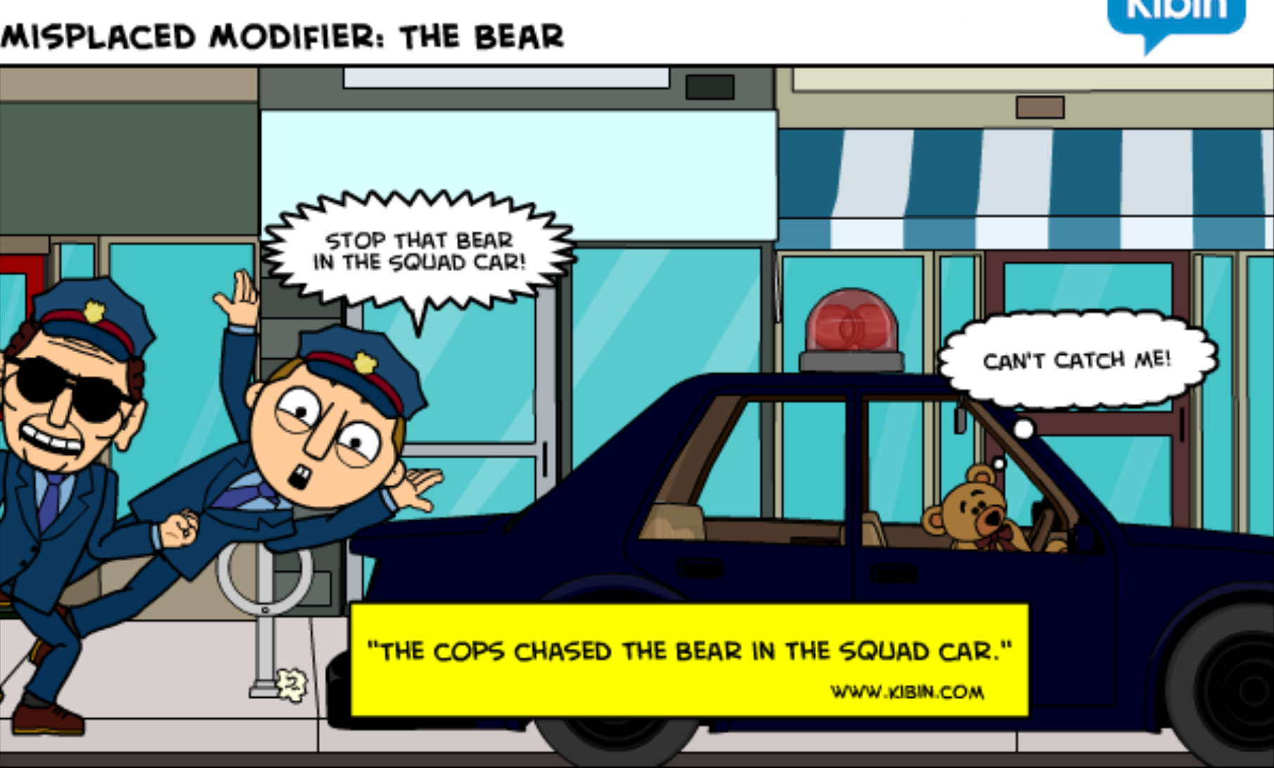
When does it occur?
It occurs when the modifier has no clear referent, often causing confusion and twisting the meaning of words in an unintended fashion
How can you fix this sentence?

Slide 5
Examples of Misplaced Modifiers

Slide 6
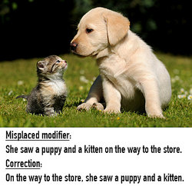
Example 1

Slide 7
Example 2
The example above suggests that the man is gold.
It can be corrected by moving the modifier to a more sensible place, generally next to the word it modifies.

Slide 8
Example 3

Slide 9
Dangling Modifiers

Slide 10
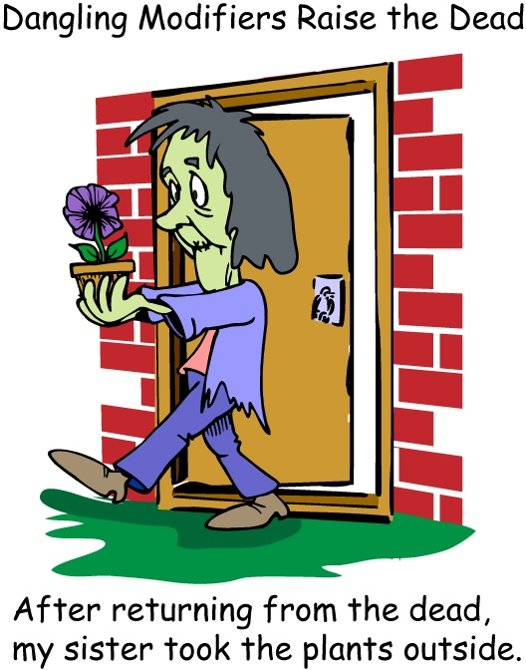
What is the error?
A dangling modifier is a word or phrase that modifies a word not clearly stated in the sentence. A modifier describes, clarifies, or gives more detail about a concept.

Slide 11
When does it occur?
You use dangling modifiers when a word or phrase is modifying a word not clearly stated in the sentence.

Slide 12
Example of Dangling Modifiers

Slide 13
Example 1
Incorrect: Having finished the assignment, the TV was turned on.
The doer of the action isn't the TV Since the doer of the action expressed in the participle has not been clearly stated, the participial phrase is said to be a dangling modifier.
Correct: Having finished the assignment, Jill turned on the TV.

Slide 14
Example 2
Incorrect: Having arrived late for practice, a written excuse was needed.
This sentence says a written excuse arrived late.
Correct: Having arrived late for practice, the team captain needed a written excuse.
To fix it decide who arrived late

Slide 15
Example 3
Incorrect: To improve his results, the experiment was done again.
This sentence says the experiment improved its results
Correct: He improved his results by doing the experiment again.
To fix combine the phrase and the main clause into one sentence.

Slide 16
Information Pages
http://open.lib.umn.edu/writingforsuccess/chapter/2-7-misplaced-and-dangling-modifiers/
https://m.youtube.com/watch?v=txK_5awcCnE&scrlybrkr=c29045aa
Misplaced and Dangling Modifiers

Slide 17
Dangling and Misplaced Modifier Quizzes
http://www.softschools.com/quizzes/grammar/misplaced_modifiers/quiz4690.html
http://www.chompchomp.com/modifiers01/modifiers01.02.htm
http://www.btb.termiumplus.gc.ca/tpv2guides/guides/pep/index-eng.html?lang=eng&page=grammar_5_excuse_me_quiz
https://www.khanacademy.org/humanities/grammar/syntax-conventions-of-standard-english/dangling-modifiers-and-parallel-structure/e/dangling-modifiers
http://www.mhhe.com/socscience/english/langan/sentence_skills/exercises/ch16/p4exi.htm
https://www.proprofs.com/quiz-school/story.php?title=grammar-dangling-modifiers

Slide 18
Parallel Structure

Slide 19
What is the error?
Repetition of the same pattern of words or phrases within a sentence or passage to show that two or more ideas have the same level of importance.
These elements are not parallel. Used in a sentence, they create a jarring effect and produce writing with unclear emphasis and meaning. We call such an error "faulty parallelism."

Slide 20
When Does it Occur?
This grammatical form can be used with a variety of structures including infinitives, words, clauses and lists.
Parallel structure should be used when you connect clauses with a coordinating conjunction such as: for, and, nor, or, but, so, or yet
Correct: Every morning, we make our bed, eat breakfast and feed the dog.
Incorrect: Every morning, we make our bed, eating breakfast and feed the dog.
Correct: I will not sing a song, nor will I dance.
Incorrect: I will not sing a song, nor dance.

Slide 21
Examples of Parallel Structure

Slide 22
Example 1
Not Parallel: Mary likes hiking, swimming, and to ride a bicycle. Parallel: Mary likes hiking, swimming, and riding a bicycle
Don't mix forms, you should use the same pattern of words.

Slide 23
Example 2
Not Parallel: The coach told the players that they should get a lot of sleep, that they should not eat too much, and to do some warm-up exercises before the game. Parallel: The coach told the players that they should get a lot of sleep, that they should not eat too much, and that they should do some warm-up exercises before the game.
A parallel structure that begins with clauses must keep on with clauses. Changing to another pattern or changing the voice of the verb will break the parallelism.

Slide 24
Example 3
Not Parallel: The dictionary can be used to find these: word meanings, pronunciations, correct spellings, and looking up irregular verbs. Parallel: The dictionary can be used to find these: word meanings, pronunciations, correct spellings, and irregular verb.
After a colon he sure to keep all elements in a list in the same form.

Slide 25
Information Page
https://m.youtube.com/watch?v=n2zc_wCBHtA&scrlybrkr=c29045aa
http://udleditions.cast.org/craft_ld_parallel.html
Parallel structure

Slide 26
Games
Jeopardy about Parallel Structure:https://jeopardylabs.com/play/parallel-structure-74
Kahoot (over everything): https://create.kahoot.it/l/#user/037a22a0-eb90-4db4-b7d2-88164690db27/kahoots/created

Slide 27
Parallel Structure Quizzes
https://www.khanacademy.org/humanities/grammar/syntax-conventions-of-standard-english/dangling-modifiers-and-parallel-structure/e/parallel-structure
https://www.quia.com/quiz/3511543.html?AP_rand=378058353
https://www.proprofs.com/quiz-school/story.php?title=parallel-structure-quiz_1
http://www.mhhe.com/socscience/english/langan/sentence_skills/exercises/ch17/p4exj.htm
https://quizizz.com/admin/quiz/583cf3f66b40c44a3bf1ae22

