Slide 1
Commas
Maddie, Jessica,Josephine,
jack-Harold, Lauren,& Carlos

Slide 2
Explanation of grammatical errors
1.) Two independent clauses (complete sentences) joined with a conjunction can sometimes have a missing comma. When this occurs, we have a grammatical error.
A way to fix this error is to not have a sentence that includes two independent clauses and a conjunction without a comma preceding the conjunction.
2.) Comma Splices also are grammatical mistake. A comma splice occurs when one places only a comma in between two independent clauses.
Ways to fix this error would be to add a conjunction, place a period in between two independent clauses, take one clause and reword it to make a subordinate clause, or change the comma into a semicolon.

Slide 3
Example 1
Incorrect: I like this class, it is very interesting.
Correct: I like this class, and it is very interesting.
One way a grammatical error can be fixed with commas is to use a comma, then use a conjunction to correctly combine two independent clauses.

Slide 4
Example 2
Incorrect: We went to the park, we ate ice cream there.
Correct: We went to the park; we ate ice cream there.
Another way to fix a comma splice is to put a semi-colon between two independent clauses.

Slide 5
Example 3
Incorrect: We headed up to the lake, we wanted to fish.
Correct: Because we wanted to fish, we headed up to the lake.
Lastly, you can flip the sentence and put the conjunction before the sentence as long as the second is explaining the first.

Slide 6
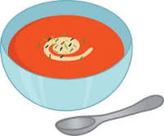
Group practice visual 1
Fix with a semi-colon
Incorrect: We ate soup, we went shopping.
Answer: We ate soup; we went shopping.

Slide 7
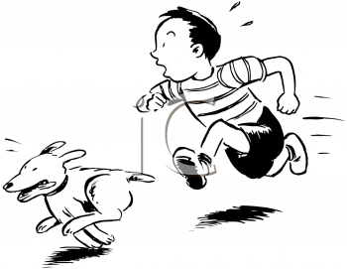
Group practice visual 2
Fix with comma and conjunction
Incorrect: The boy ran fast, he caught his dog
Answer: The boy ran fast, and he caught his dog.

Slide 8
Group practice visual 3
The sentence can be fixed by turning one phrase into a subordinate clause.
Incorrect: We worked hard, we had a nutritious meal.
Correct: Because we had a nutritious meal, we worked out hard.

Slide 9
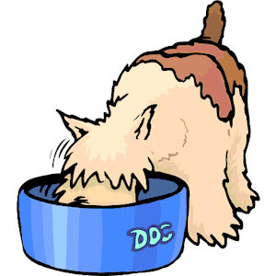
Error on ACT, psat, and sat 1
Select the word or phrase that needs to be changed to make the sentence grammatically correct.
The eldest, male dog became awfully selfish during feeding time, he would not even let his own pups get a scrap of food.
Possible answers:
awfully no error time, he eldest feeding
Correct Answer:
time, he
Explanation:
Two independent clauses that can each stand alone must be separated by a period, a semi-colon, or connected by a comma followed by conjunction. Because this sentence does not include a conjunction like "and" after the comma, it is incorrect. Known as a 'comma splice'.

Slide 10
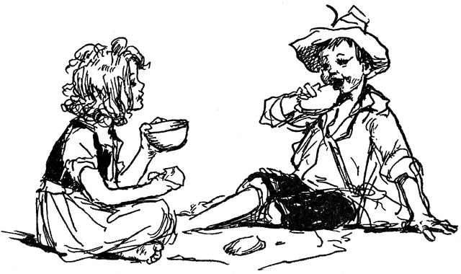
Error on act, psat, and sat 2
Select the word or phrase that needs to be changed to make the sentence grammatically correct.
Anna, questioning her decision, looked to her brother, however he wouldn't meet her eye.
Possible answers:
Anna, questioning no error wouldn't meet decision looked brother, however
Correct answer:
brother, however
Explanation:
The clause 'however he wouldn't meet her eye' is an independent clause and must be separated by a semi-colon or a coordinating conjunction.

Slide 11
Error on act, psat, and sat 3
Select the word or phrase that needs to be changed to make the sentence grammatically correct
I stayed up late last night baking chocolate chip cookies, this morning when I woke up the house smelled so good that it made me hungry.
Possible answers:
baking smelled so good no error stayed up late cookies, this
Correct answer:
cookies, this
Explanation:
This is a run-on sentence. The two independent clauses need to be split into two sentences or separated by a semi-colon.

Slide 12
Helpful links
Informational pages-
owl.english.purdue.edu
-gives a definition of comma spices
-gives clear ways to fix a comma between two independent clauses
-gives examples of comma slices in sentences and the clear ways to fix them
Write.com
-gives reasons why commas are misused and how they are misused
- gives examples of incorrect sentences in using commas

Slide 13
3 game/quiz links
http://www2ivcc.edu/eng1002/practicecommaquiz.htm
Http://m.grammerbook.com/grammar-quizzes/commas_1.asp
http://www.varsitytutors.com/sat-writing-practice-tests

Slide 14
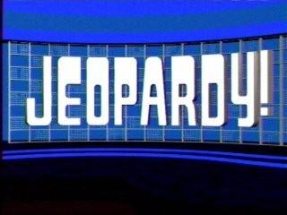
In-class game
https://jeopardylabs.com/play/comma-rules-review-game

