Slide 1
Run On Sentences
Splice Girls
Gabi, Ellie, Joci, Abbie

Slide 2
Comma Splices: Here’s Where You Go Wrong
What’s a Comma Splice?
A comma splice is a run-on sentence with two independent clauses only separated by a comma.
EX: Julie hates the ocean, she is scared of sharks.
This is a problem because it’s an incorrect way to connect the clauses.

Slide 3
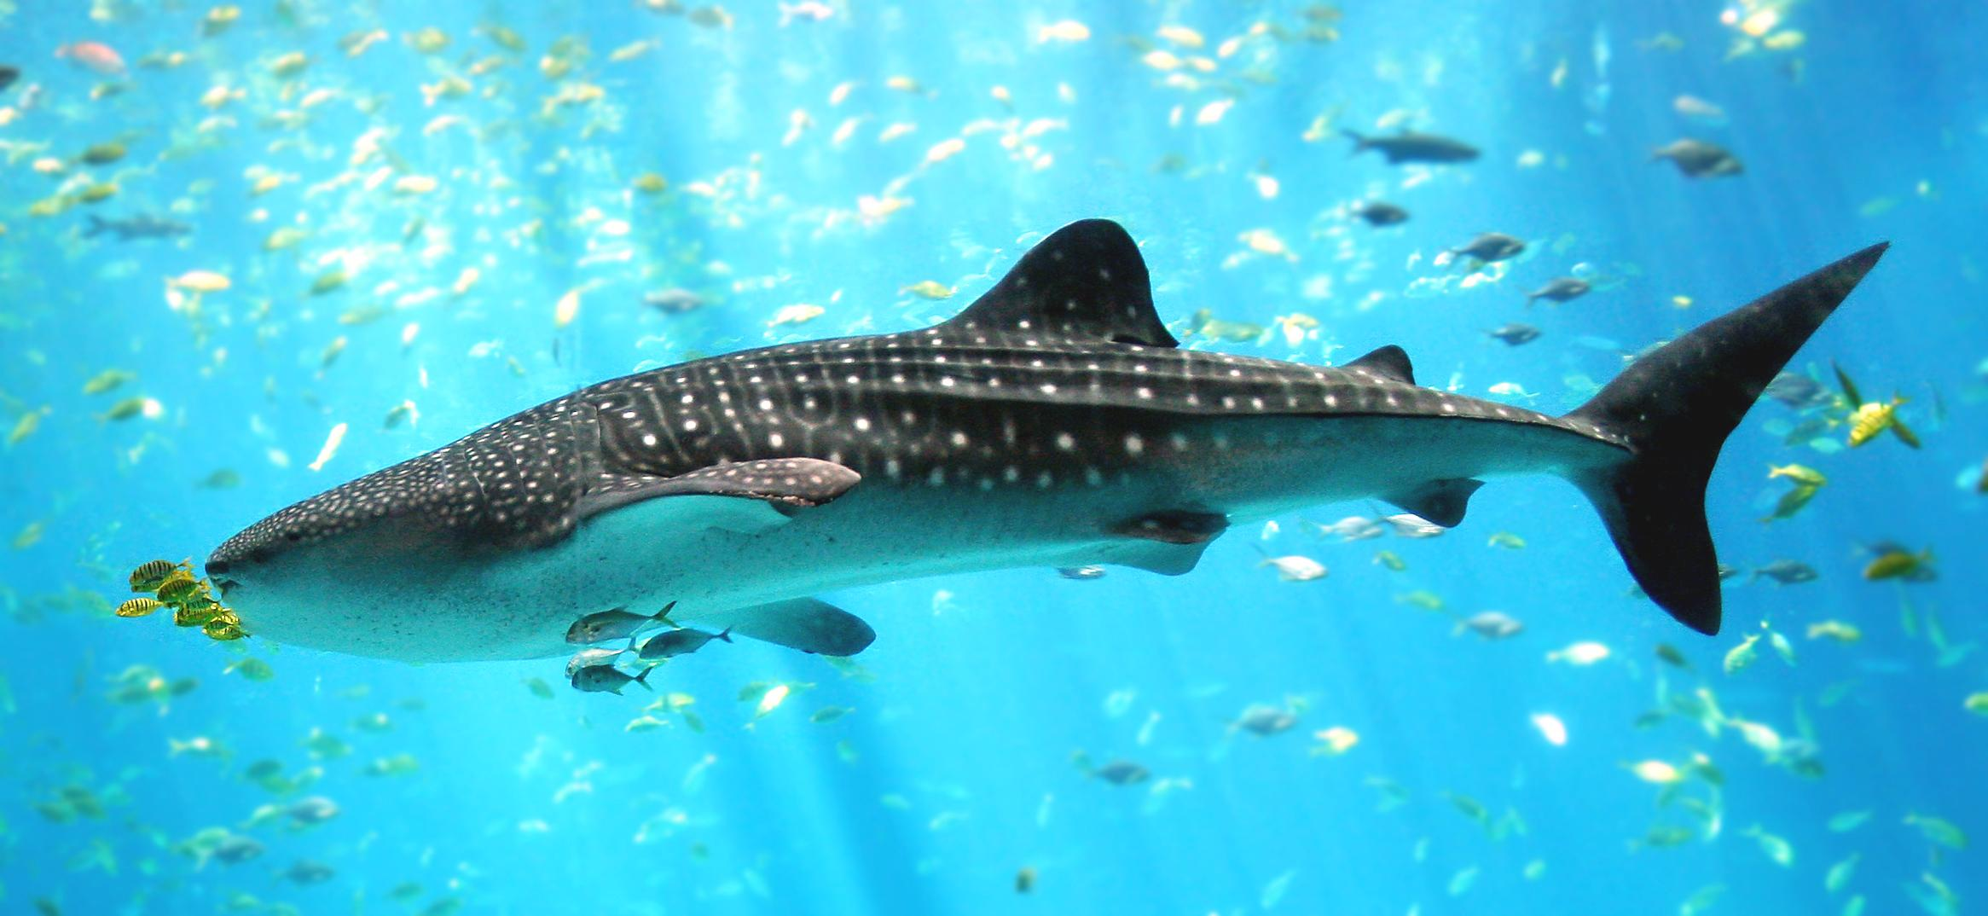
Fused Sentences: This is the Problem
What’s a Fused Sentence?
A fused sentence is a run-on sentence with two independent clauses that are joined without any punctuation or connecting word between them.
EX: Julie hates the ocean she is scared of sharks.
This is a problem because

Slide 4
Get it Together, Julie!
NO: Julie hates the ocean, she is scared of sharks.
ALSO NO: Julie hates the ocean she is scared of sharks.
YES: Julie hates the ocean because she is scared of sharks
ALSO YES: Julie hates the ocean. She is scared of sharks.

Slide 5
No Phones at Family Movie Night!!
NO: My family watches movies together every Friday night, we then eat popcorn.
ALSO NO: My family watches movies together every Friday night we then eat popcorn.
YES: My family watches movies together every Friday night. We then eat popcorn.
ALSO YES: My family watches movies together every Friday night and then we eat popcorn.

Slide 6
If you wanna be a splice girl, you gotta pass this test
I love to play with my cats and take them on long walks in parks while we eat Cheetos and watch the ducks swim around in the pond because ducks are so cute since they have so many feathers and their babies are even cuter.
I love to play with my cats. Our favorite thing to do is go to the park.
My cats love. The park and enjoy.
My cats love to walk at the park, I like to eat Cheetos and watch ducks.

Slide 7
The Answer is ….
B!!!! If you answered correctly, then congrats! You are now a splice girl:-)

Slide 8
If the splice girls didn’t splice up your knowledge...
http://chompchomp.com/csfs01/
https://webapps.towson.edu/ows/modulecs_fs.htm

Slide 9
Splice it up with these splicey quizzes!!
https://www.quia.com/quiz/1054512.html?AP_rand=471419810
http://wps.prenhall.com/chet_smith_english_10/108/27805/7118326.cw/content/index.html
https://www.proprofs.com/quiz-school/story.php?title=runons-comma-splices-fragments

Slide 10
Continued...
http://depts.dyc.edu/learningcenter/owl/exercises/comma_splices_ex1.htm
http://www.wwnorton.com/college/english/write/little-seagull-handbook-2/quizengine/main.aspx?ch=Comma%20Splices%20Fused%20Sentences1&fd=../section/exercises

Slide 11
The end my little baby splices!!!

