Slide 1
Pronoun and antecedent issues
By: Nicole Davis, Connor bates, Erica Oakley, Natalia Bosch, Rachel Shelton

Slide 2
What is the error? Why is it an error?
Error: The pronoun doesn't agree with the antecedent in number
Ex: Elephants are the largest land animals on Earth; these mammals live primarily on the African continent where it primarily eats grasses, bamboo, bark, and leaves for survival.
Why: it does not match the antecedent elephants, you would have to say their
Error: To many or no antecedents
Ex (to many): when Mathilda lost Mary Ann's manuscript, she was upset.
Why: who was upset? It could be Mathilda or Mary Ann
Ex (none): when mark went in for his physical exam, they needed to take a blood sample.
Why: who are they? They could be anyone.

Slide 3
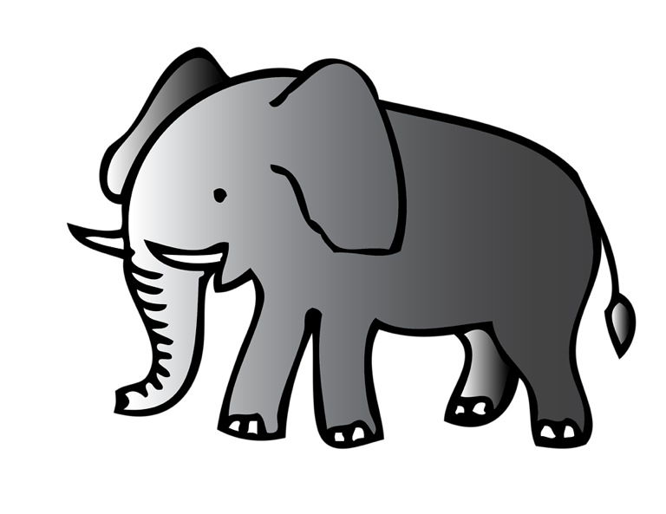
3 examples of grammatical errors and methods for fixing
Ex 1: Elephants are the largest land animals on Earth; these mammals live primarily on the African continent where it primarily eats grasses, bamboo, bark, and leaves for survival.
Fixing method: Double-check whether the subject is singular or plural before using an antecedent. Elephants are the largest land animals on Earth; these mammals live primarily on the African continent where they primarily eats grasses, bamboo, bark, and leaves for survival.

Slide 4
3 examples of grammatical errors and methods for fixing
Ex 2: When Mathilda lost Mary Ann's manuscript, she was upset.
Fixing method: Replace the antecedent with a proper noun to specify whether it is Mathilda or Mary Ann who is upset. When Mathilda lost Mary Ann's manuscript, Mary Ann was upset.

Slide 5
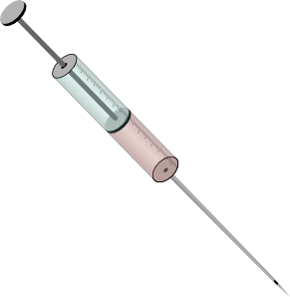
3 examples of grammatical errors and methods for fixing
Ex 3: When Mark went in for his physical exam, they needed to take a blood sample.
Fixing method: Specify who 'they' is to make the sentence and setting clearer. When Mark went in for his physical exam, the doctors needed to take a blood sample.

Slide 6
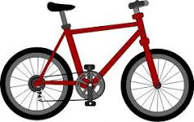
3 group practice questions
Find the Antecedent and Pronoun or The Mistake:
He and John have his bike.
Antecedent: He, John
Pronoun: his
Mistake: unclear antecedent

Slide 7
3 group practice questions
Rachel loves their bird, Haven.
Antecedent: Rachel
Pronoun: Their
Mistake: improper amount

Slide 8
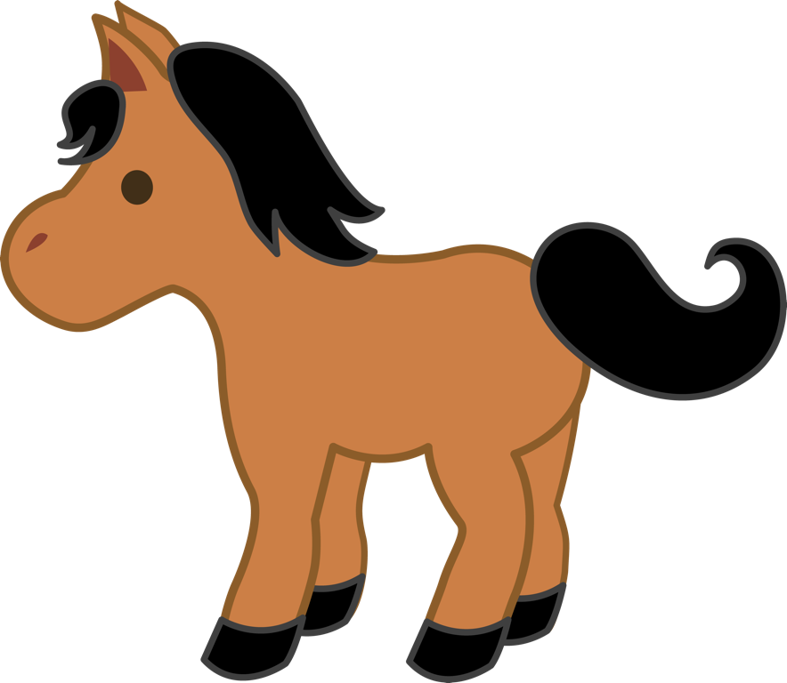
3 group practice questions
Erica rides her pony.
Antecedent: Erica
Pronoun: her
Mistake: none

Slide 9
How we might see this on the psat or act
Example 1: What change should occur in the following sentence?
"When any one of these changes occur, it is likely the result of careful analysis conducted by transportation planners."
A.) No Change
B.) occur, they are
C.) occurs, they are
D.) occurs, it is

Slide 10
How we might see this on the psat or act
Example 2: What word(s) should be changed to make the sentence correct?
"The woolly mammoth, a relative of the elephant, roamed through northern Eurasia and North America before their extinction."
A.) a relative of the elephant
B.) roamed through
C.) and
D.) their
E.) no change

Slide 11
How we might see this on the psat or act
Example 3: What word(s) should be changed to make the sentence correct?
"The ruby-tailed tree crawler is a rare species of a caterpillar; they only live in isolated sections of the Amazon jungle."
A.) a rare species
B.) they
C.) live in
D.) isolated sections
E.) no error

Slide 12
Informational websites
http://www.myteacherpages.com/webpages/ewevodau/sat.cfm?subpage=910847
http://www.veritasprep.com/blog/2013/08/sat-tip-of-the-week-3-types-of-antecedent-errors/

Slide 13
Games or quiz websites
https://www.oupcanada.com/higher_education/companion/literature/9780195425154/eng_135/quiz_subject_verb.html
https://depts.dyc.edu/learningcenter/owl/exercises/agreement_pa_ex2.htm
http://www.varsitytutors.com/psat_writing-identifying-pronoun-antecedent-agreement-errors-practice-test

Slide 14
Class activity
With a partner write a story with each sentence containing a pronoun and antecedent. Make sure they are properly used.

Slide 15
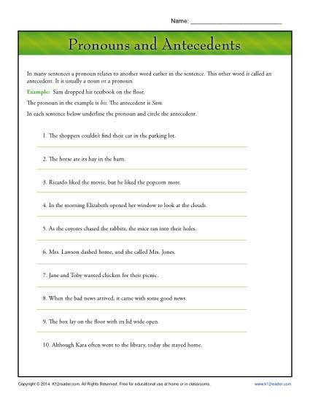
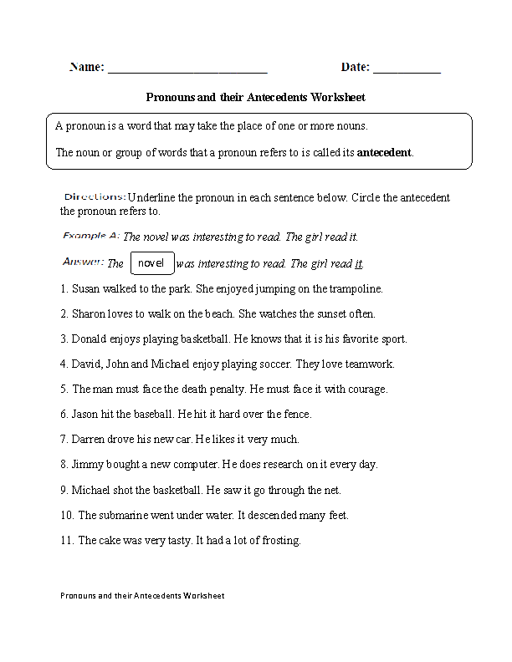
Worksheets

