Slide 1
Pronouns/Antecedent Issues and Redundancy
Grace, Olivia, Carey, Brooke, and Avery

Slide 2
The Problem is...
Antecedent and pronoun:
A common problem for writers is being unsure about a pronoun’s antecedent. Some errors writers make are unclear pronoun references, the anonymous “they”, the“mysterious it”, and differing pronoun numbers.

Slide 3
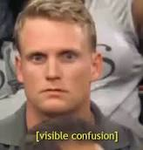
The Error (Pronoun and Antecedent)
~unclear pronoun reference
~different pronoun numbers
~the anonymous “they”
~mysterious “it”

Slide 4
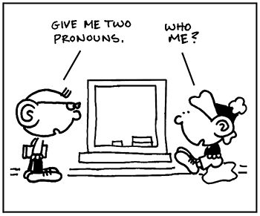
Examples
(Pronouns)
~Wrong: Both Santa and Stuart loved his gift.
Correct: Both Santa and Stuart loved Stuart’s gift.
~Wrong: The bears hate his or her own laziness.
Correct: The bears hate their own laziness.
~Wrong: They should definitely not date.
Correct: The swimmer and Jill should definitely not date.
~Wrong: When Alma and Penelope went to see Star Wars a third time, it means they love it.
~Correct: Because Alma and Penelope loved Star Wars, they went to see it a third time.

Slide 5
The Problem is...
Redundancy
Often times writers create extensive sentences, in hopes to show impressive vocabulary and knowledge on a chosen topic. Unfortunately, these writers commonly stumble into the same problem, the use of needless repetition. What some do not understand is that redundant expressions only make writing longer, not better. Writers should be on the lookout for needless repetition that adds nothing to what they have already said. When they come across these particular mistakes they should eliminate them, so as to be grammatically correct.

Slide 6
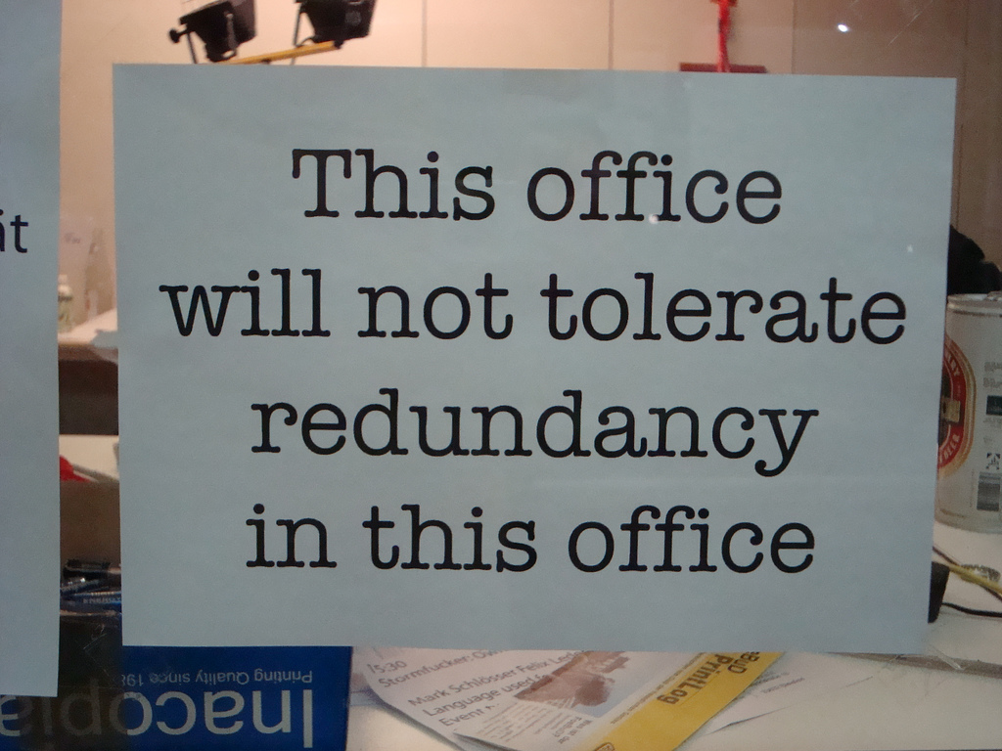
The Error (Redundancy)
~ needless repetition and redundant expressions

Slide 7
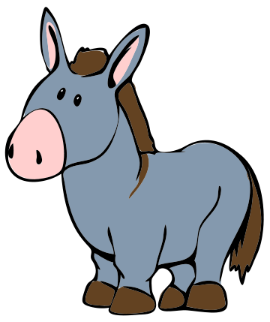
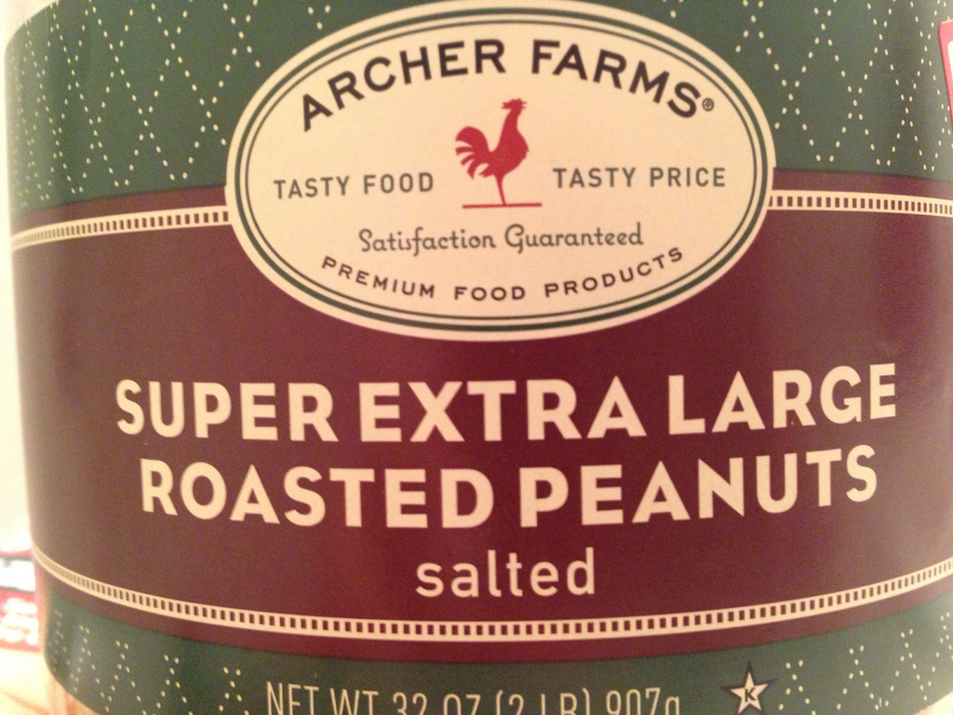
Examples
(Redundancy)
~The donkey fell down when he pranced around the barn.
~Eugene added up the numbers in math class.
~Gentlemen empty out the trash with a good attitude.
~The cat was a free gift from B-Reyes.

Slide 8
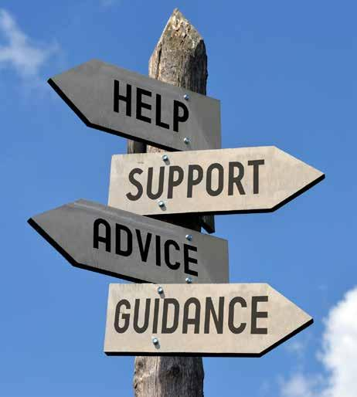
Helpful Links
~ https://www.proprofs.com/quiz-school/story.php?title=pronoun-antecedent-agreement_2
~ http://www.superteachertools.us/jeopardyx/jeopardy-review-game.php?gamefile=2431316#.WuB0OCQpChA
~ https://www.sporcle.com/games/slipkid/just-ask-colonel-jessep
~ https://www.quia.com/quiz/3051576.html
~ https://www.proprofs.com/quiz-school/story.php?title=pronoun-antecedent-agreement_2
~ https://www.khanacademy.org/humanities/grammar/syntax-conventions-of-standard-english/subject-verb-agreement-and-pronoun-antecedent-agreement/e/pronoun-antecedent-agreement

Slide 9
Sources
~http://bethune.yorku.ca/writing/pronoun/
~http://www.shawnee.edu/offices/writing-center/errors/pronoun-errors.aspx
~http://grammarist.com/redundancies/?scrlybrkr=f9e55d03
~https://www.thoughtco.com/common-redundancies-in-english-1692776
~http://blog.writeathome.com/index.php/2013/03/4-pronoun-mistakes-to-avoid/

