Slide 1
Run-on sentences and Redundancy
By: Jackson Donovan, Christian Kornegay, Caleb Anderson, Jake Bennett

Slide 2
What is a run-on sentence?
A run-on sentence is a sentence in which two or more independent clauses are joined without an appropriate punctuation or conjunction.

Slide 3
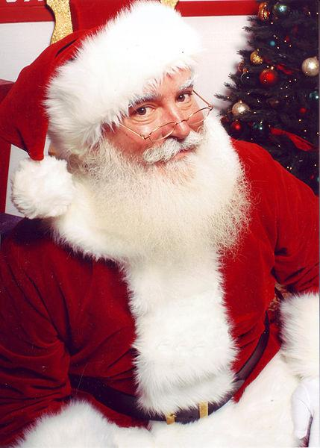
Why is it an error?
When there are two or more independent clauses (clauses that can form a simple sentence), there should be a conjunction or punctuation dividing them.

Slide 4
Methods of correction
Add periods to separate ideas into different sentences
Add commas to combine words into lists
Add conjunction to separate thoughts

Slide 5
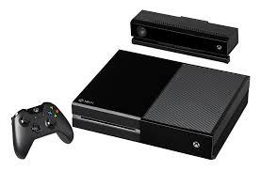
Run-on sentence example 1
Johnson gave Justin the food when he came to his house and then Justin ate it in the kitchen, and then they hung out afterwards and played X-box.

Slide 6
Example 1 Corrected
Johnson gave the food to Justin when he came to his house. Justin ate it in the kitchen, and afterwords they hung out whilst playing X-Box.

Slide 7
Run-on example 2
Jake went to hang out with Jackson and then they went to the movies and then they to get ice cream and then they traveled to Jake's house to spend the night.

Slide 8
Example 2 Corrected
Jake went to hang out with Jackson. They went to the movies, got ice cream, and then traveled to Jake's house to spend the night.

Slide 9
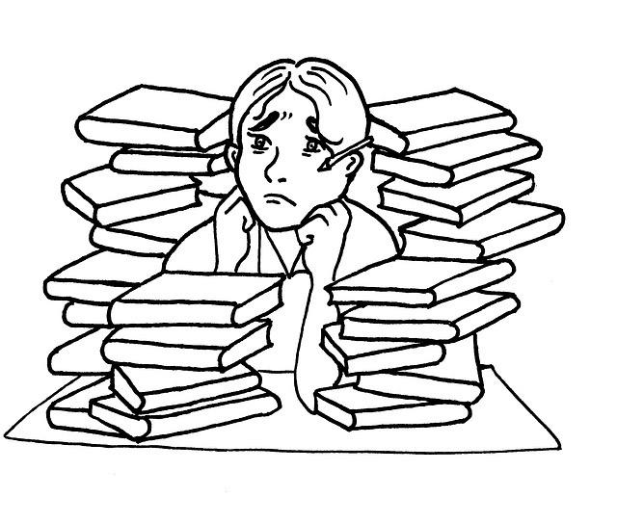
Run-on example 3
Christian had a lot of homework he had to do he had English homework and he had math homework and he had science homework and he had bible homework.

Slide 10
Example 3 Corrected
Christian had a lot of homework. He had assignments in English, Math, Science, and Bible class.

Slide 11
What is Redundancy?
The act of using a word, phrase, etc., that repeats something else and is therefore unnecessary.

Slide 12
Why is it an error?
It is unnecessary and can cause confusion for the reader.

Slide 13
Methods of Correction
Identify words that are used multiple times
Condense ideas that have similar or congruent topics
Identify synonymous words and reduce them to one word
Substitute better vocabulary to clearify and/or combine words

Slide 14
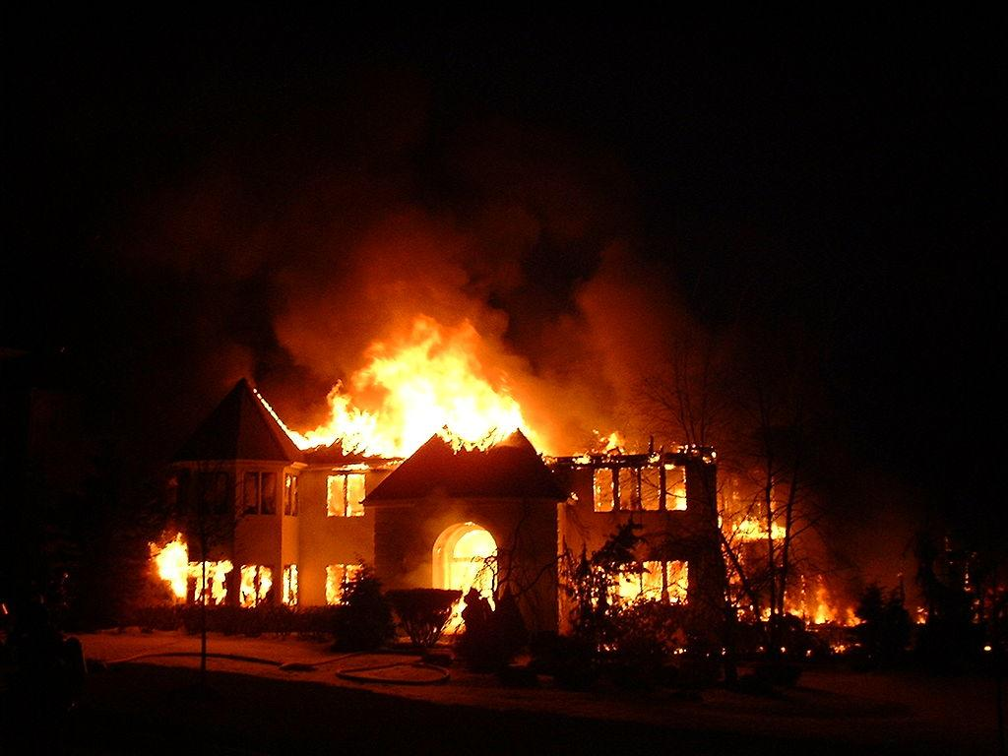
Redundancy example 1
Four people died in a fire today in a house fire that killed four people on this very day.

Slide 15
Example 1 Corrected
Today, four people were killed in a house fire.

Slide 16
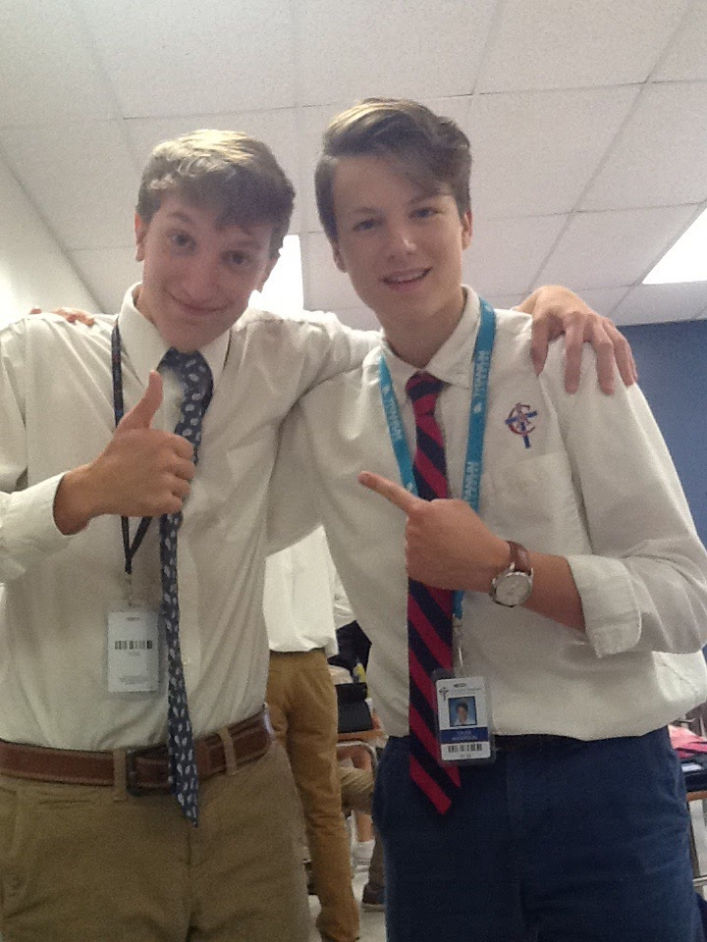
Redundancy example 2
Caleb and Christian hung out and went to the movies to hang out while they went to the movies.

Slide 17
Example 2 Corrected
Caleb and Christian went to the movies to hang out.

Slide 18
Redundancy Example 3
The guys played basketball together with each other at Southeast because there were good and nice courts at southeast.

Slide 19
Example 3 Corrected
The guys played basketball together at Southeast because it had excellent courts.

Slide 20
Redundancy Practice
Are these phrases redundant?
1.) Actual fact
2.) Forever and ever
3.) Major breakthrough

Slide 21
Run-on sentences Practice
Are these sentences run-on?
1.) Rebecca, the chef, struggles to find fresh mozzarella in the stores.
2.) Rebecca, who was a fantastic chef skilled in making pasta and pizzas.
3.) After working in a restaurant for ten years, Rebecca opened her own Italian cafe, it was called “Mi Piace.”

Slide 22
Answers
Redundancy:
Actual fact – A fact is by definition something that has already been confirmed to have happened.
Forever and ever – Ever is completely unnecessary as it just serves as a duplicate of forever.
Major breakthrough – A breakthrough is already major and significant. There is no reason to say that it is major.
Run-on:
1. No; 2. No; 3. Run-on

Slide 23
ACT example of Run-on sentence
1.
A. NO CHANGE B. town they stopped at
C. town. They stopped at
D. town they stopped. At
2.
F. NO CHANGE G. Then they rode to the zoo they
H. Then, they rode to the zoo they J. Then they rode to the zoo, they
1. Mark and Laura rode their bikes into town, they stopped at
2. the ice-cream store for a cone. Then they rode to the zoo; they did not go inside.

Slide 24
Answers
1. C.
2. F.

Slide 25
ACT example of redundancy
A. NO CHANGE B. However, in spite of it, C. Yet it is the alternating case that D. However,
“However, on the other hand, this new generation will not migrate as caterpillars, thus repeating the cycle.

Slide 26
Answer
D.

Slide 27
SAT example of Redundancy
A. have fallen so low that the owner closed the speedway B. have fallen so that the owner closed the speedway
C. caused the owner to close the speedway
D. are falling so low that the owner closed the speedway E. having fallen, the owner closed the speedway
10. Despite the increase in positive feedback, the plummeting attendance figures have fallen so low that the owner closed the speedway.

Slide 28
Answer
C.

Slide 29
Links
Games/quizzes:
www.quibblo.com/quiz/7-FXP00/Redundancy
http://study.com/academy/practice/quiz-worksheet-avoiding-redundancy-in-writing.html
http://www.quia.com/pop/35933.html
Info pages:
http://capitalcc.edu/grammar/runons.htm
http://www.dailywritingtips.com/50-redundant-phrases-to-avoid/

