Slide 1
OzoBot Lab 2
Content-Objective:
Learn robot programming using color code sequences
Language-Objective:
Program OzoBot robots to “Bowl” using color code sequences

Slide 2
Do today’s Starter Quiz! (in Canvas)

Slide 3
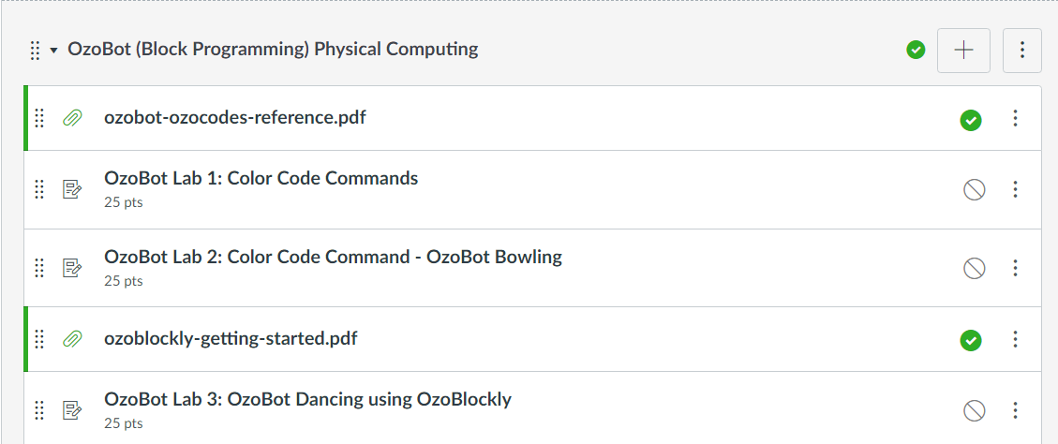
OzoBot (Block Programming) OzoBot Lab 2: Color Code Command – OzoBot Bowling

Slide 4
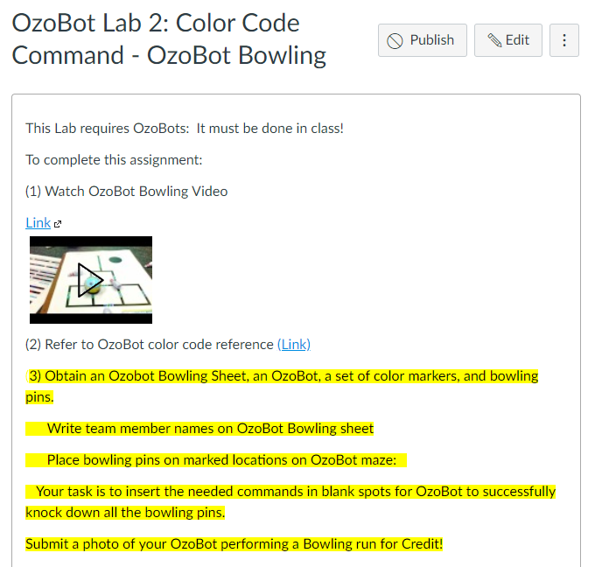
Step 1: Tutorial Video OzoBot Lab 2: OzoBot Bowling

Slide 5
Today’s Task Code OzoBot using using color code sequences to play Bowling game Note: Main Task Program OzoBot’s to navigate maze knocking over Bowling pins.

Slide 6
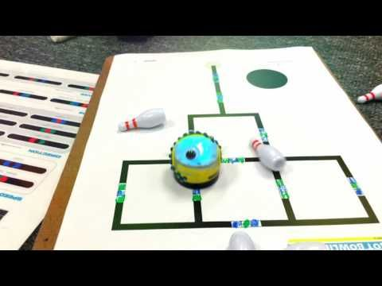
Work with a partner Obtain Supplies OzoBot, Maze sheets, Markers, 5 Bowling pins

Slide 7
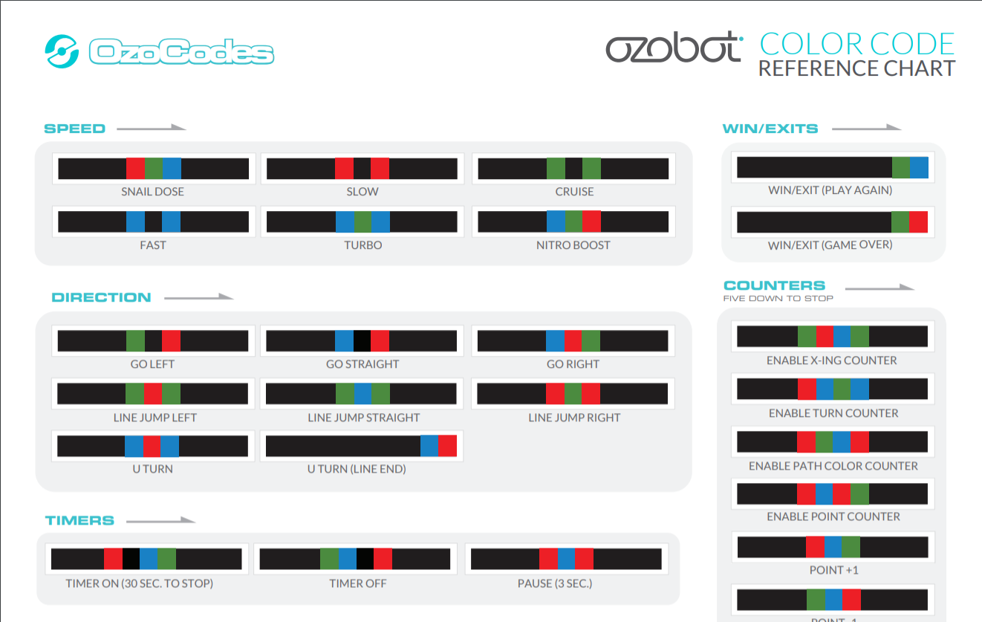
Open OzoBot Color Code reference Chart (on lab PC)

Slide 8
Color Code Sequences Go in set of 3 blank spots on Maze

Slide 9
Practice Coding Ozobot Task 1: Have OzoBots Knock over Bowling pins using Right – left – reverse turns at Junctions

Slide 10
Practice Coding Ozobot Task 2: Use creativity with commands and Have OzoBot Complete Maze Bowling in a dancing style.

Slide 11
Report Success Level in Canvas: If possible submit photos of OzoBot running your maze.

