Slide 1
Zenbo Lab 3
Content-Objective:
Learn Zenbo robot programming using Zenbo Lab web-site
Language-Objective:
Program Zenbo robot Sensors and Line Following) inputs using Zenbo Lab

Slide 2
Do today’s Starter Quiz! (in Canvas)

Slide 3
Zenbo Programming (Block Programming -Python) Zenbo Lab 3: Inputs

Slide 4
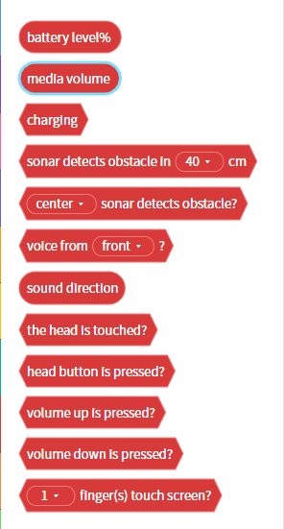
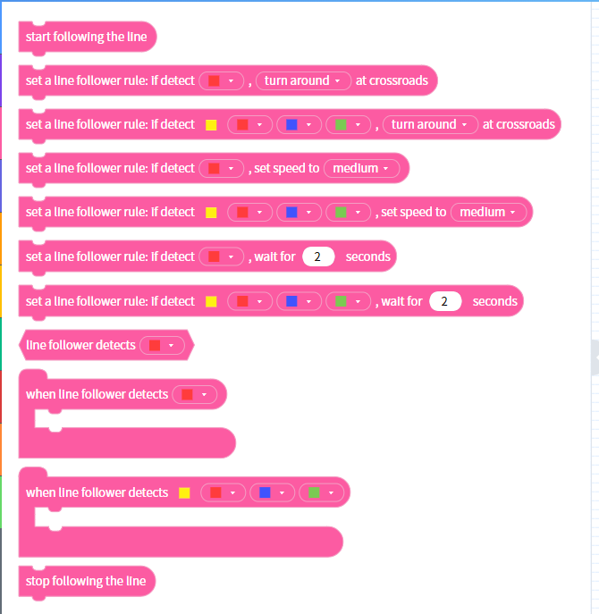
Zenbo Programming Blocks for Inputs Sensors and Line Following

Slide 5
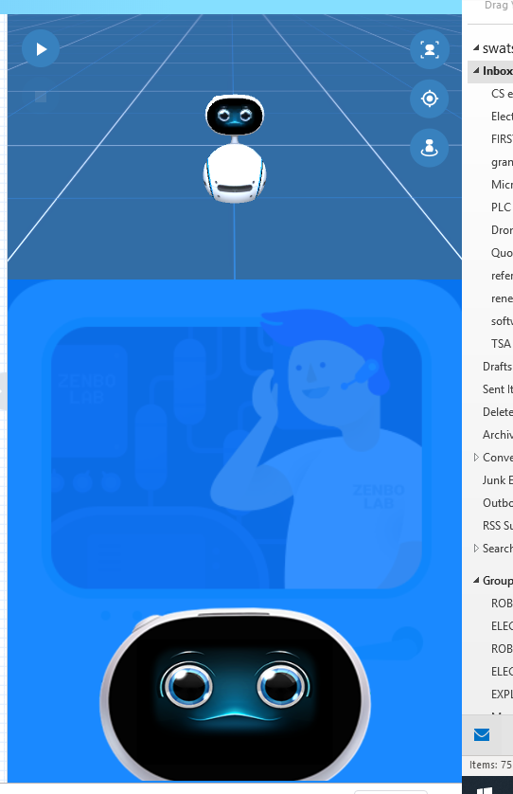
Make Zenbo robot face visible by dragging it up on right side of Zenbolab web-site

Slide 6
Today’s Task Learn – practice Zenbo robot input sensor and line following programming using Zenbo Lab web-site and simulator. Note: Main Task Command Zenbo robots sensor and line following functions.

Slide 7
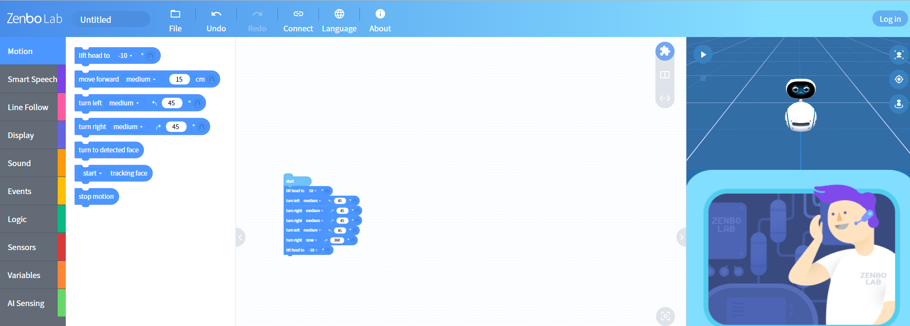
Work with a partner Zenbo Lab Web-site. https://zenbolab.asus.com/editor/?lang=en

Slide 8
Zenbo Sensor Blocks

Slide 9
Zenbo Line Following Blocks

Slide 10
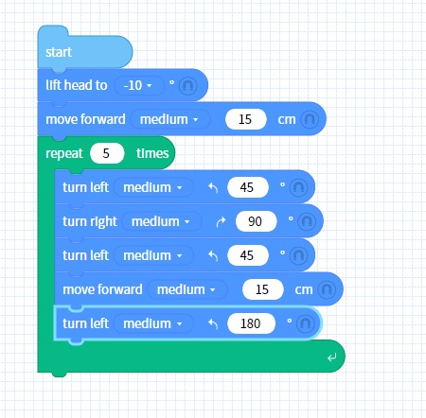
Connect blocks together. Connect blocks to “start” block to create a zenbo start-up routine .

Slide 11
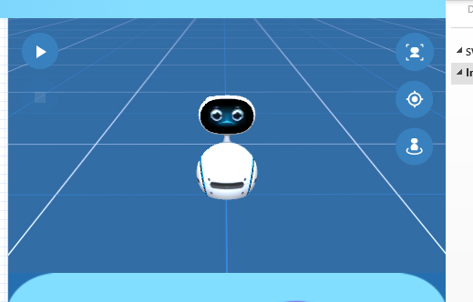
Zenbo Simulator Zenbo simulator is on right side of Zenbo Lab web-site. Click “play” arrow to start simulation

Slide 12
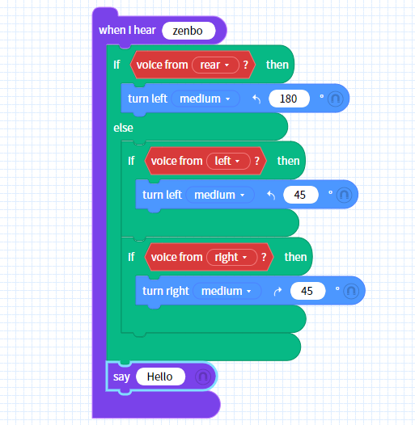
Practice Coding Zenbo Task 1: Have Zenbo use “Voice from direction” senor to orient toward person when it hears it’s name. around.

Slide 13
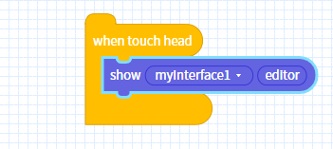
Practice Coding Zenbo Task 2: Use zenbo head touch sensor to trigger an event.

Slide 14
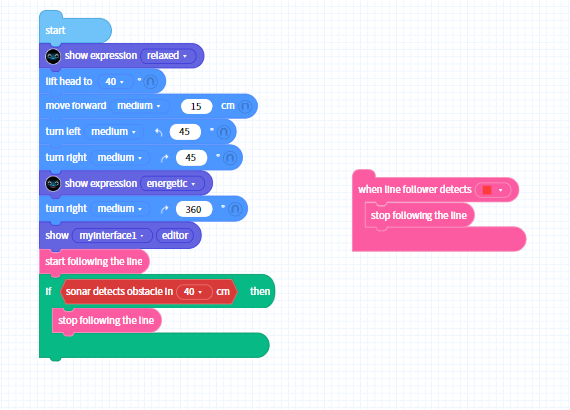
Practice Coding Zenbo Task 3: Use Zenbo line following and obstacle detect sensor in motion programming.

Slide 15
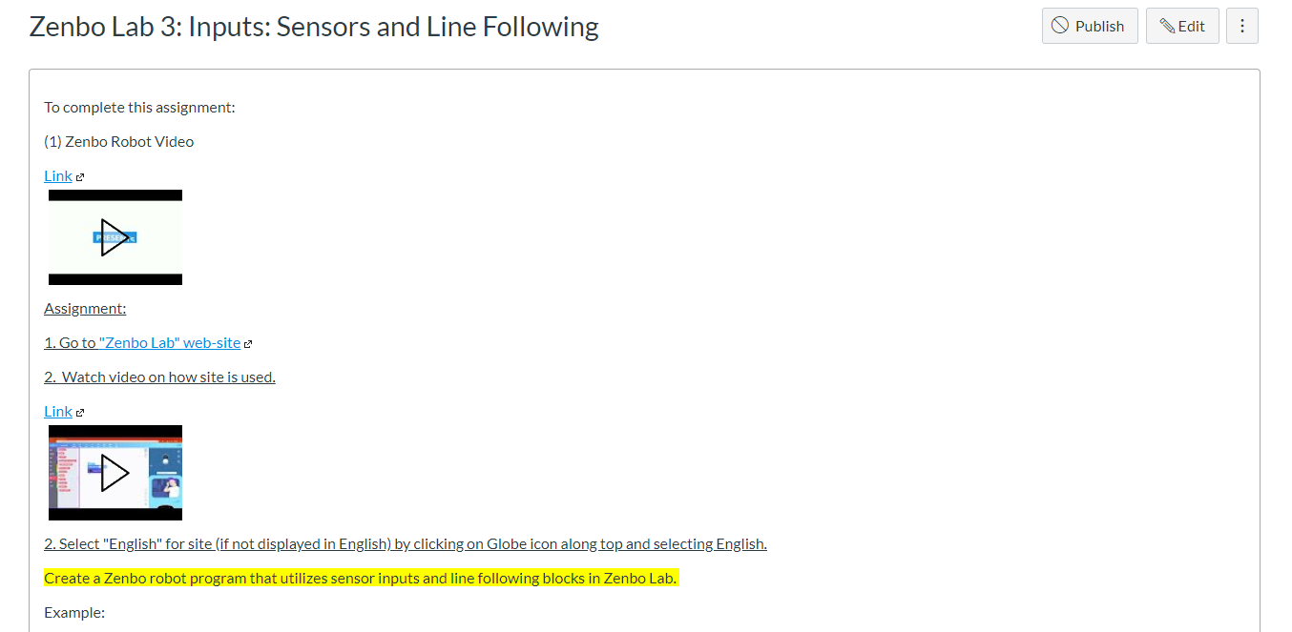
Submit Windows Snip and Sketch photos of Zenbo Input code in Canvas for credit.

