Slide 1
Robotics Project 3
Content-Objective:
Final selection notification of team project.
Language-Objective:
Complete Canvas Team Project: Selection Notification discussion with project selected for your team (example Alice Video).

Slide 2
Robotics Project 3 Project Selection Notification
Utah Robotics 1 Strand 4
Common Core High School Algebra Reasoning
Common Core High School Interpreting Functions

Slide 3
Do today’s Starter Quiz! (in Canvas)

Slide 4
Step 1: Select team project type (state course requirement shown)

Slide 5
Examples: Alice Video

Slide 6
Assignment: Send in final selection for team project in Canvas.

Slide 7
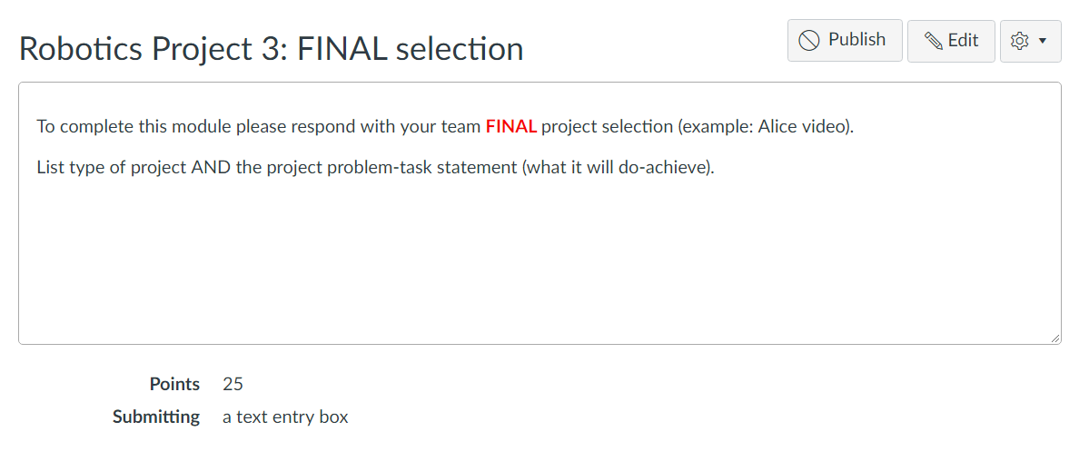
For credit:
Complete Canvas Assignment
Robot Project 3: Final Selection

