Slide 1
Alice Lab 3 JAVA Programming
Content-Objective:
Learn real time user control of action in JAVA programs.
Language-Objective:
Utilize Alice JAVA animation creation program to learn basics of real time user control.

Slide 2
Alice Lab 3 JAVA Programming
Utah Robotics 1 Standard 3
Common Core High School Algebra Reasoning
Common Core High School Interpreting Functions

Slide 3
Learn basics of Java coding in block format
Alice Lab 3
STARTER
Canvas: Starter Quiz
TODAY’S AGENDA
STARTER assignment.
Alice Demo
(event initializers).
Canvas: Alice Lab 3.
Content Objective
Language Objective
Use Alice to create Java coded animations.

Slide 4
Do today’s Starter Quiz! (in Canvas)

Slide 5
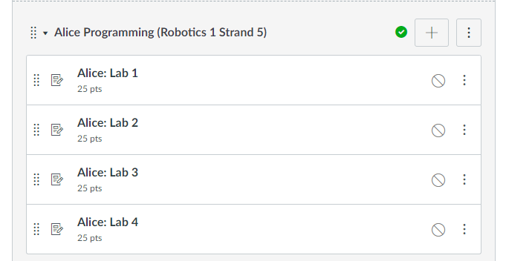
Alice Programming Module

Slide 6
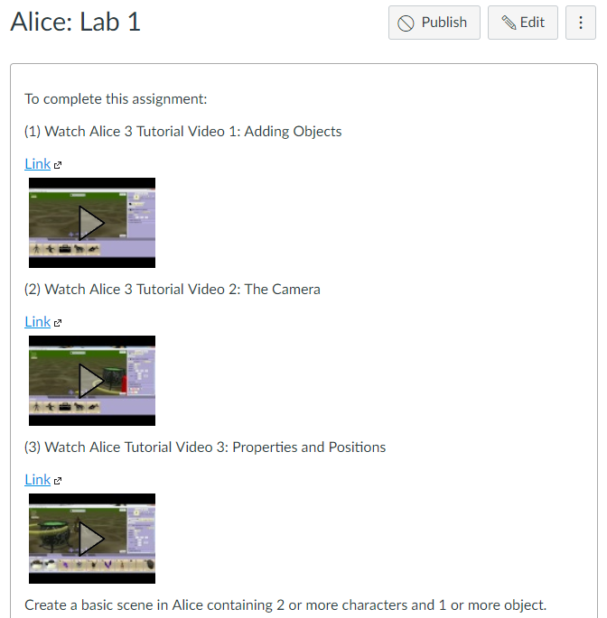
Watch Alice Tutorial Video(s)

Slide 7
Step 1: select desktop or menu “Alice”

Slide 8
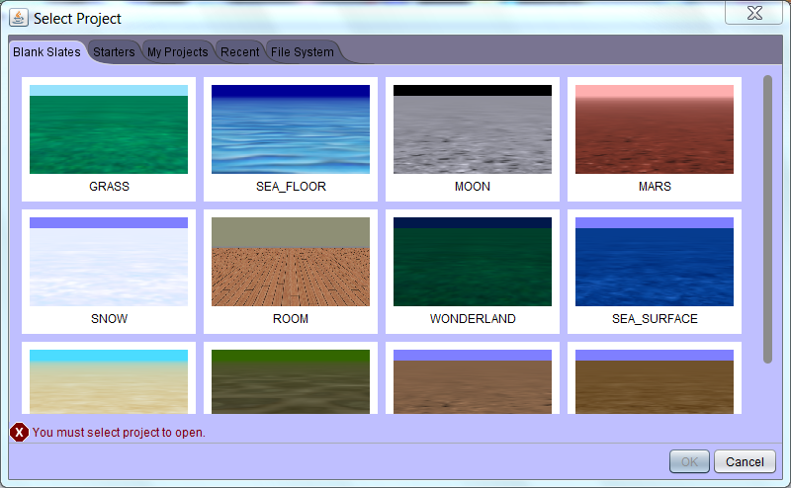
Step 2: “Select a background (use MARS initially) click on OK”

Slide 9
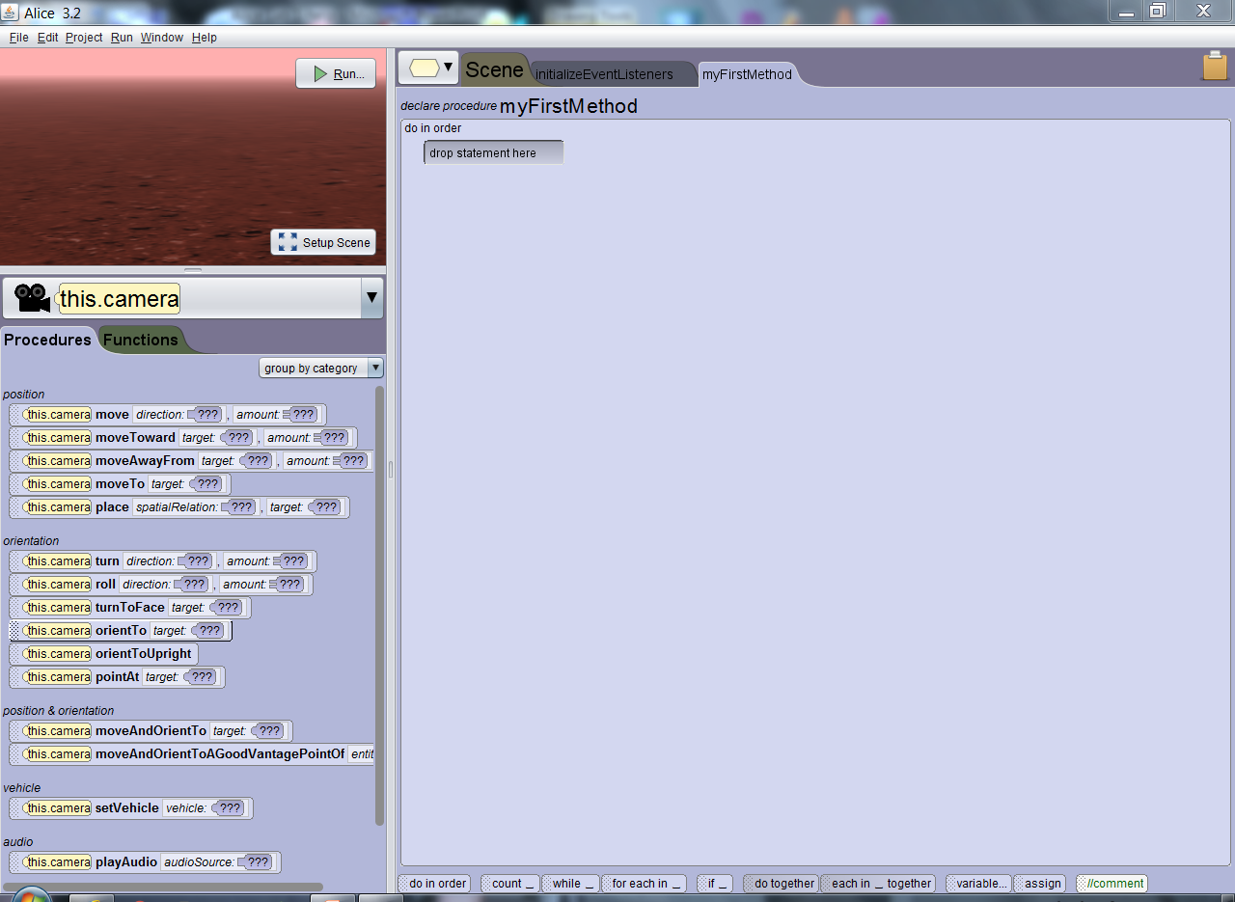
Step 3: “Alice layout screen”

Slide 10
Step 4: “click on Setup Scene”

Slide 11
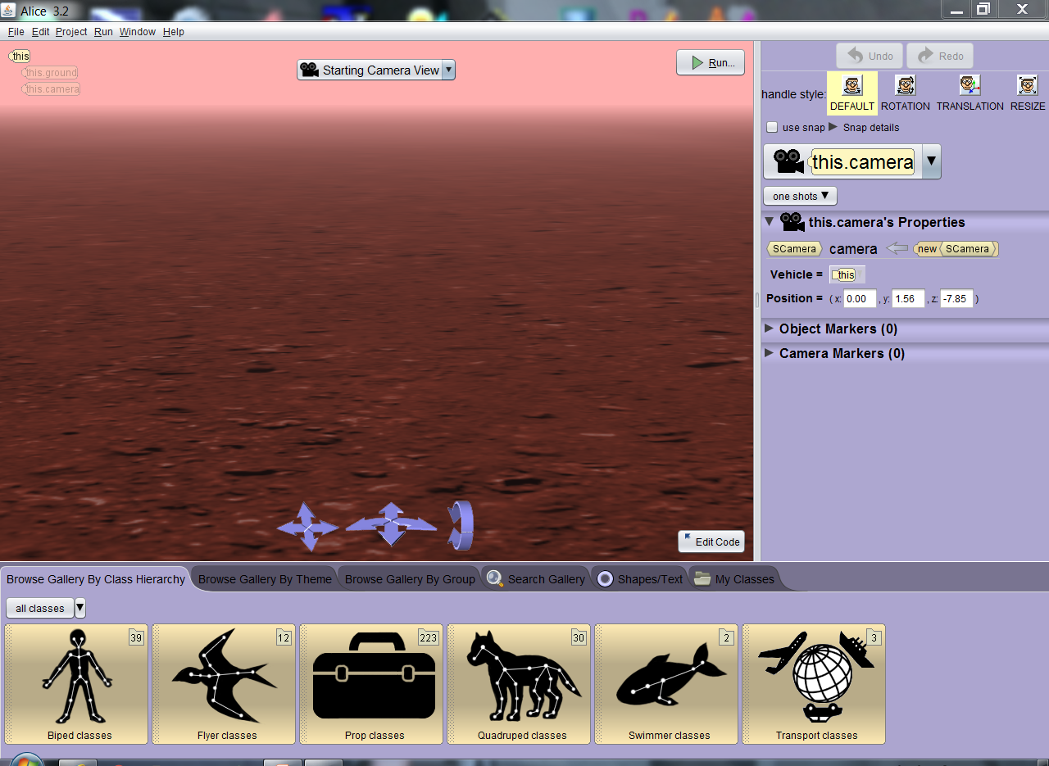
Step 5: “Scene setup window”

Slide 12
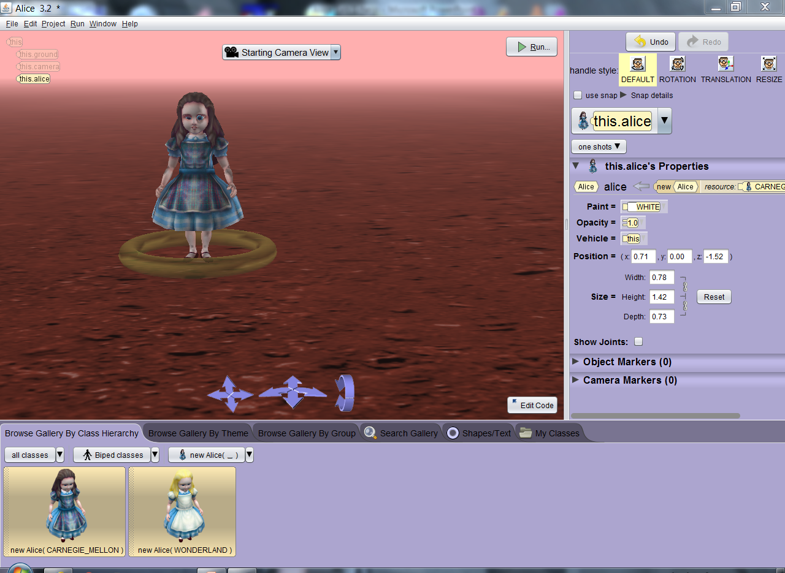
Step 6: Select a “Biped” class, then New Alice() sub-class and drag object into background then click “ok” to set in place.

Slide 13
Step 7: After objects (actors) are in place Click on “Edit Code” button

Slide 14
Step 8: Locate down arrow by “This” and select the actor you placed in the screen.

Slide 15
Step 9: Locate initializeEventListeners tab. (click on it)

Slide 16
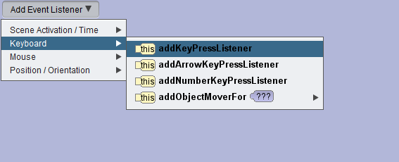
Step 10: Click on Add Event Listener drop down arrow and select “keyboard”, then addKeyPressListener.

Slide 17
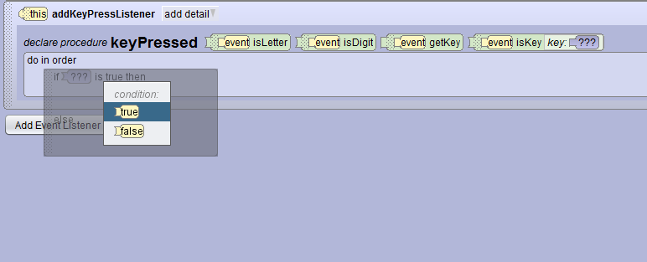
Step 11: Drag an “If_” statement (along bottom) into the block under “do in order”. Select the “true” condition.

Slide 18
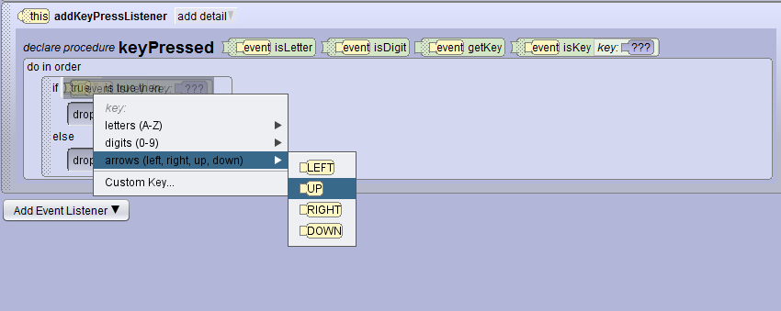
Step 12: Grab the “event is key” from right side of “keypressed” line and drag to the “true” yellow block next to “if” statement from step 11. Select arrows and then up.

Slide 19
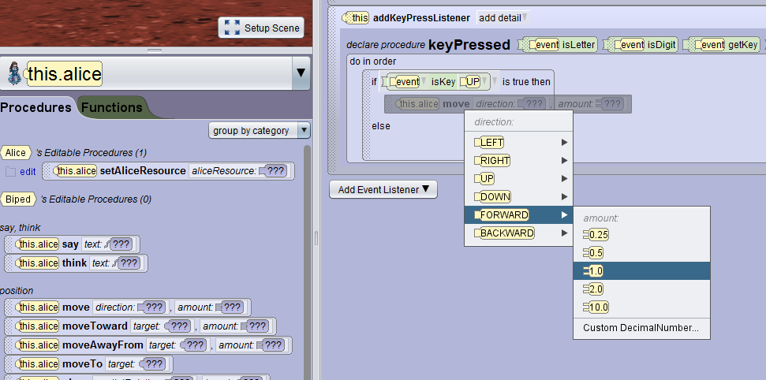
Step 13: Grab the “move” event from procedures (left side) and drag into blank block under “if”. Select “forward” and then “1.0”.

Slide 20
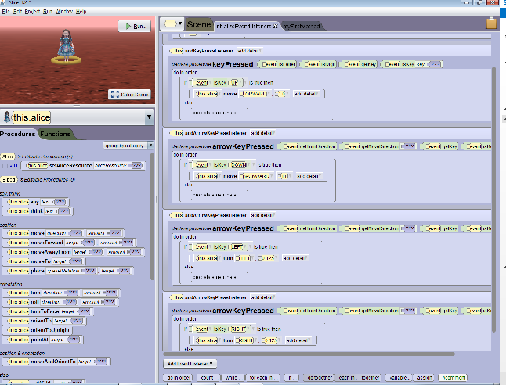
Example with all directions controllable

Slide 21
Assignment: You now have a 1 direction controllable actor. Repeat instructions above to place keyboard controls for all 4 directions into Alice program. Note: In Robotics this would be the code to control driving your robot.

Slide 22
Capturing Program Windows Snipping Tool (All Apps, Windows Accessories, Snipping Tool)

Slide 23
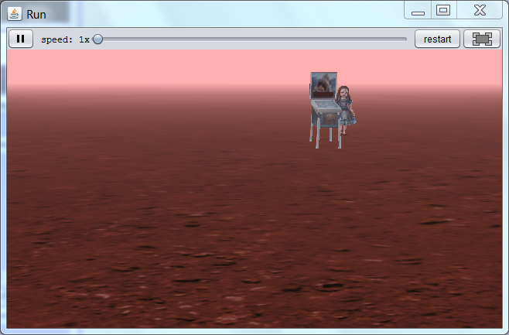
Use Windows Snipping Tool to capture image of your Alice scene and submit capture file for credit in Canvas.

Slide 24
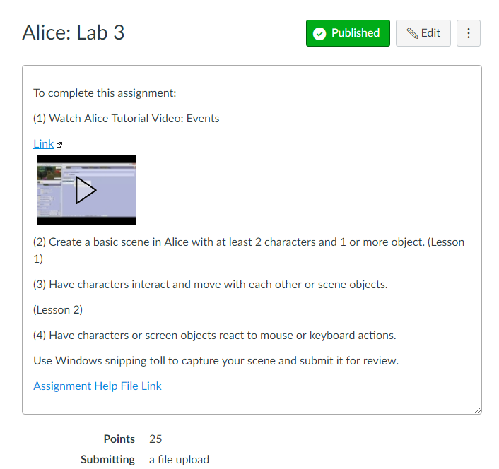
Alice: Lab 3 Submission Link

