Slide 1
Robotics Project 4
Content-Objective:
Team project workday – Rubric/Standards review.
Language-Objective:
Work on Team Project: Use project grading rubric and course standards to evaluate readiness for project presentation.

Slide 2
Robotics Project 4 Project Work day and Rubric/Standards comparison
Utah Robotics 1 Strand 4 and 6
Common Core High School Algebra Reasoning
Common Core High School Interpreting Functions

Slide 3
Do today’s Starter Quiz! (in Canvas)

Slide 4
Step 1: Course Project Standards

Slide 5
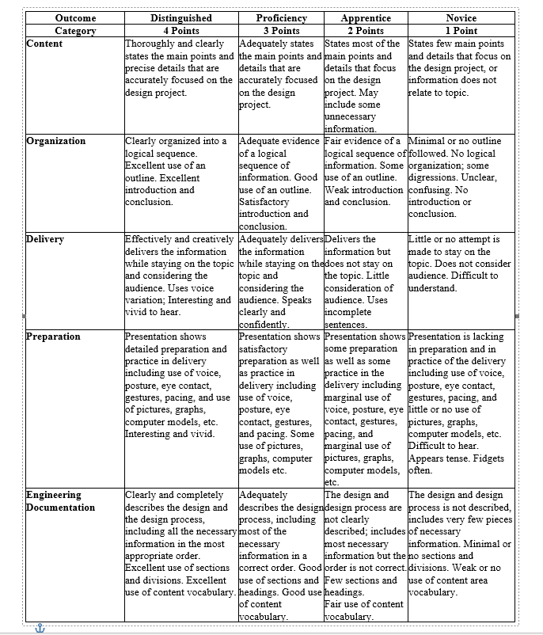
Grading Rubric

Slide 6
Assignment: Review course standards for Team project and Grading Rubric (slides prior to this one). Report on team progress in Canvas.

Slide 7
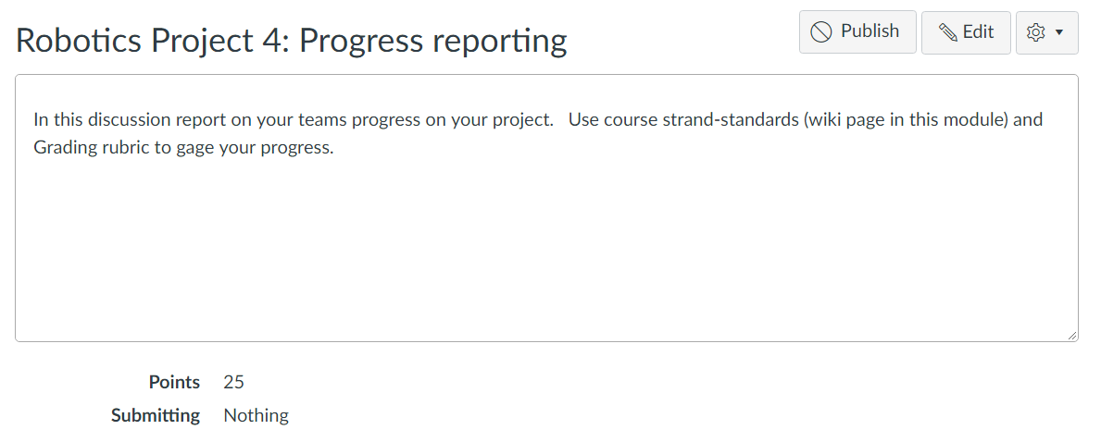
For credit:
Complete Canvas Assignment
Robot Project 4: Progress Reporting

