Slide 1
Alice Lab 1 JAVA Programming
Content-Objective:
Learn basics of object oriented JAVA programming.
Language-Objective:
Utilize Alice JAVA animation creation program to learn basics of object oriented programming.

Slide 2
Alice Lab 1 JAVA Programming
Utah Robotics 1 Standard 3
Common Core High School Algebra Reasoning
Common Core High School Interpreting Functions

Slide 3
Learn basics of Java coding in block format
Alice Lab 1
STARTER
Canvas: Starter Quiz
TODAY’S AGENDA
STARTER assignment.
Alice Demo
(scene set-up).
Canvas: Alice Lab 1.
Content Objective
Language Objective
Use Alice to create Java coded animations.

Slide 4
Do today’s Starter Quiz! (in Canvas)

Slide 5
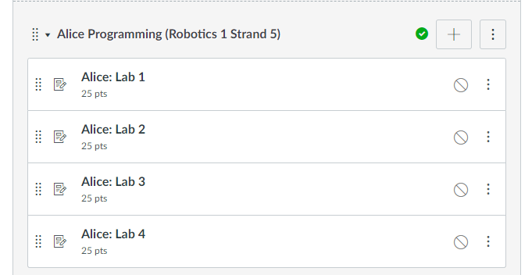
Alice Programming Module

Slide 6
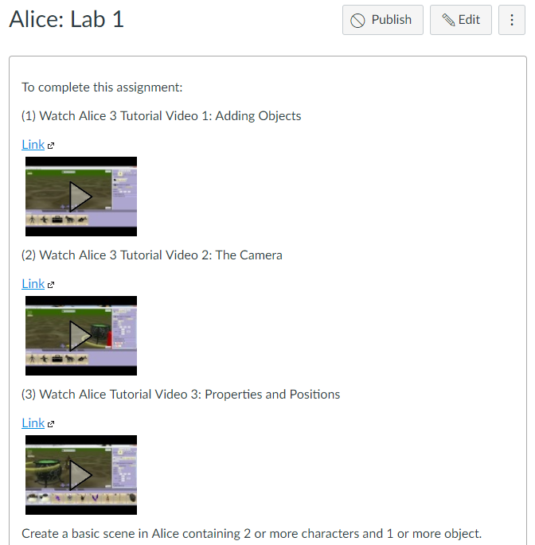
Watch Alice Tutorial Video(s)

Slide 7
Step 1: select desktop or menu “Alice”

Slide 8
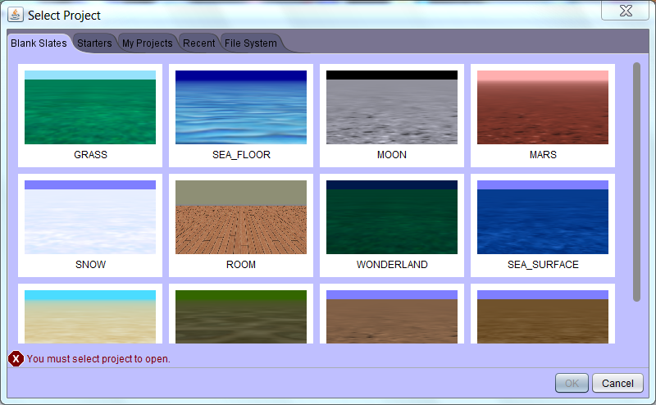
Step 2: “Select a background (use MARS initially) click on OK”

Slide 9
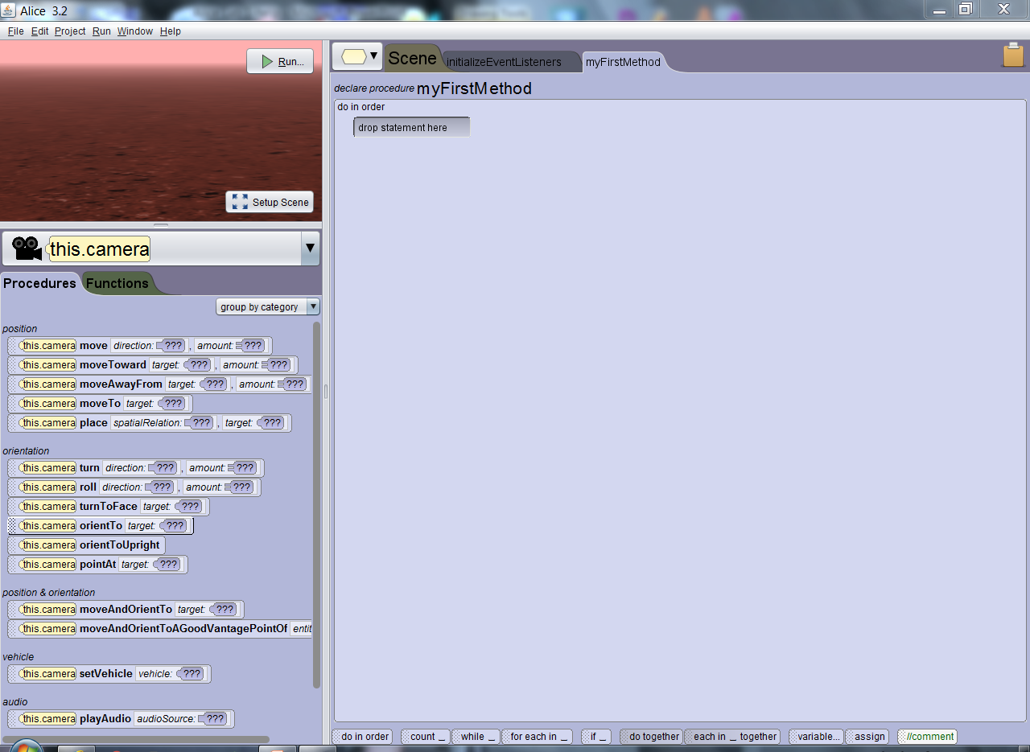
Step 3: “Alice layout screen”

Slide 10
Step 4: “click on Setup Scene”

Slide 11
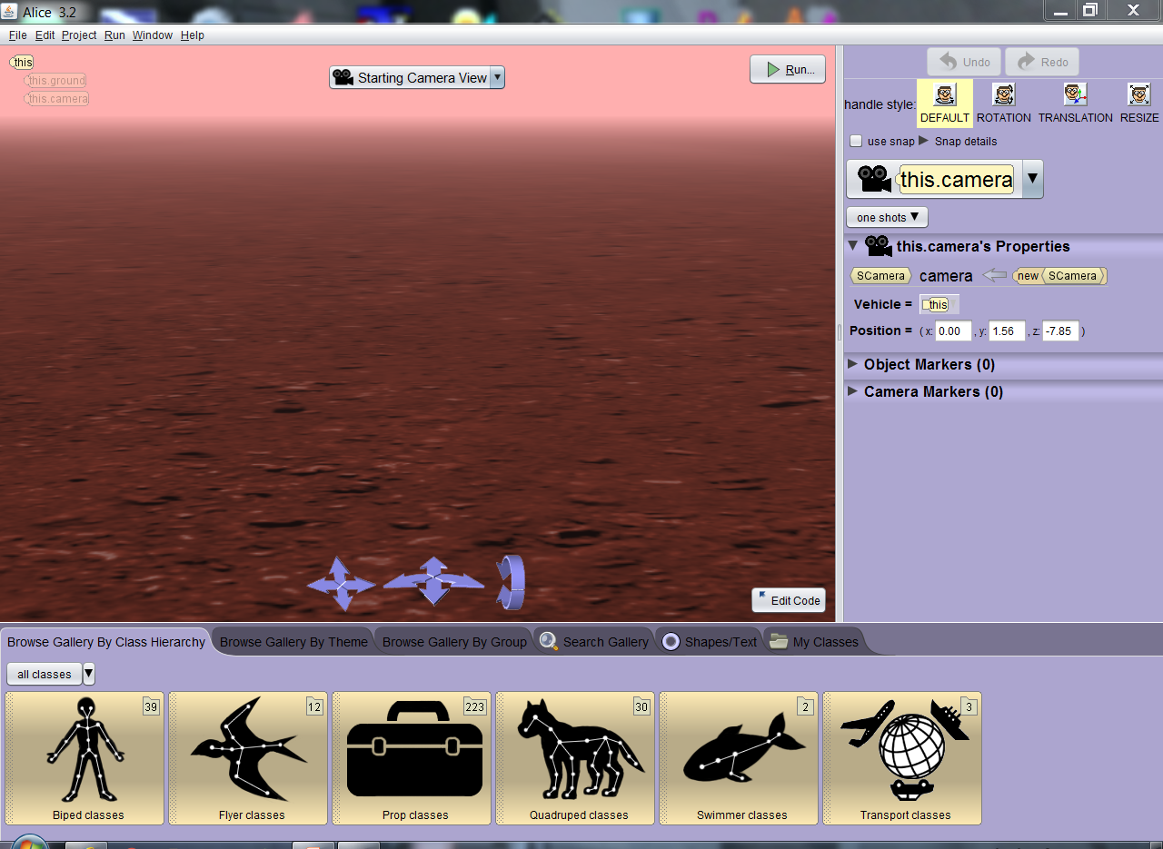
Step 5: “Scene setup window”

Slide 12
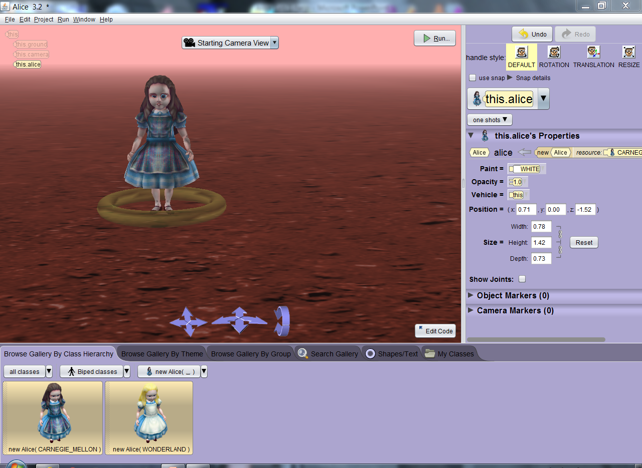
Step 6: Select a “Biped” class, then New Alice() sub-class and drag object into background then click “ok” to set in place.

Slide 13
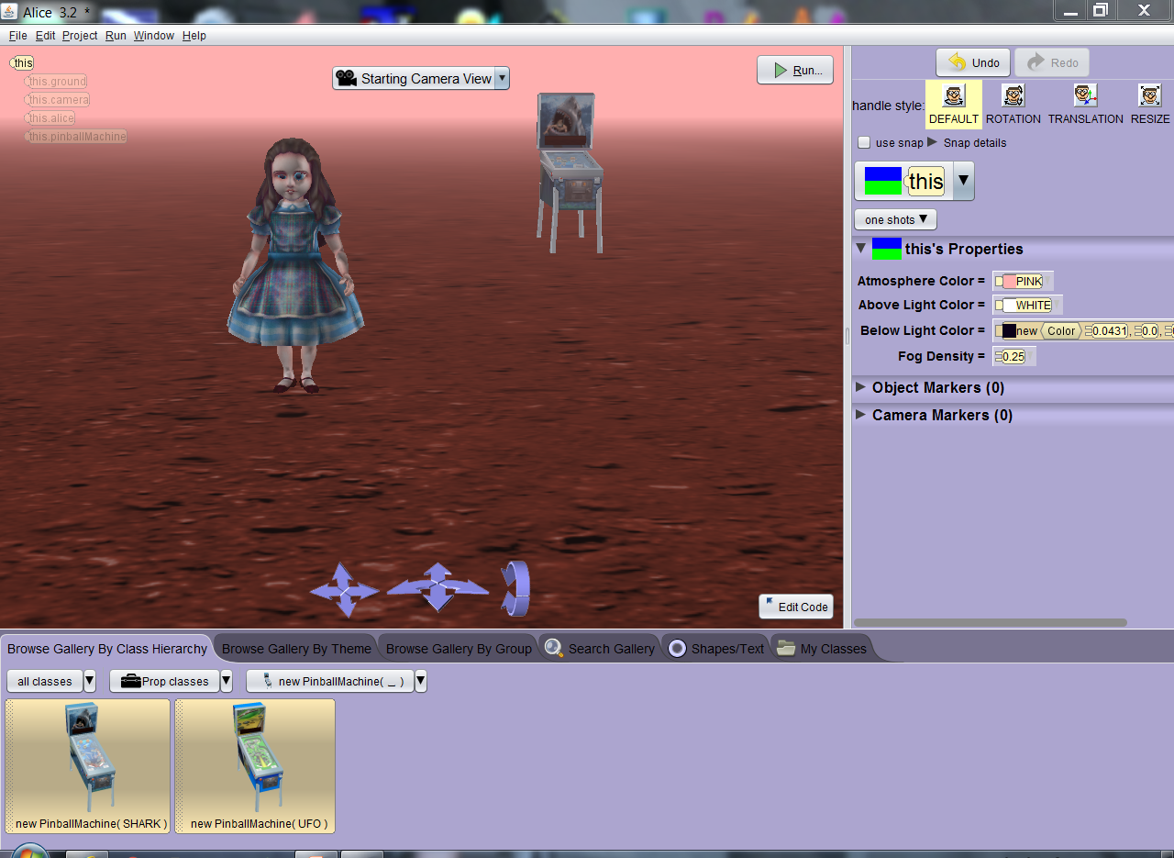
Step 7: Search through options and add at least 2 other items to background (pinball machine shown)

Slide 14
Capturing Program Windows Snipping Tool (All Apps, Windows Accessories, Snipping Tool)

Slide 15
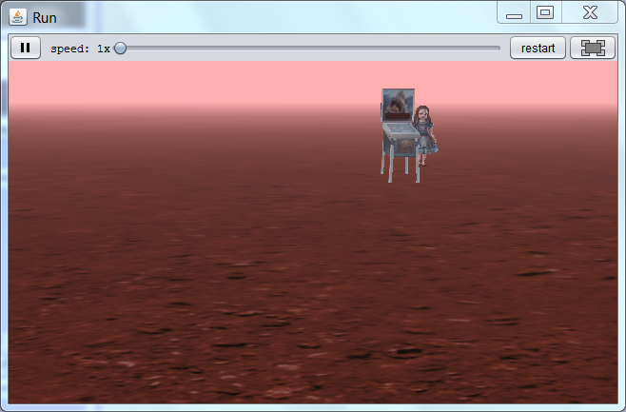
Use Windows Snipping Tool to capture image of your Alice scene and submit capture file for credit in Canvas.

Slide 16
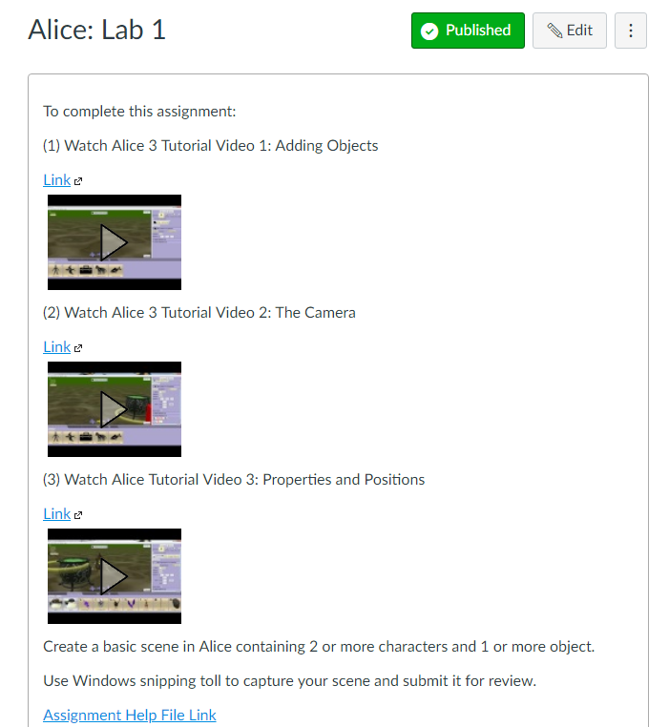
Alice: Lab 1 Submission Link

