Slide 1
Team Project Requirements
Content-Objective:
Team project requirements.
Language-Objective:
Requirements that Alice, Choreograph, ModKit, Alpha 1S, iTrilogi, EasyVeep projects must meet.

Slide 2
Team Project Requirements
Utah Robotics 1 Standard 3
Common Core High School Algebra Reasoning
Common Core High School Interpreting Functions

Slide 3
Do today’s Starter Quiz! (in Canvas)

Slide 4
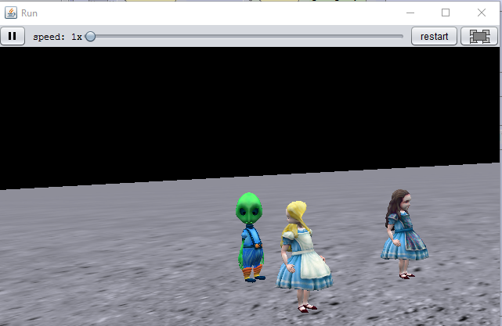
Option 1: Alice Requirements: Music Video using Alice

Slide 5
1: 2-4 minutes in length 2: Multiple characters interacting 3: Must use both do together and do in order programming. 4: Character movement matches music. 5: Different view (vehicle) options

Slide 6
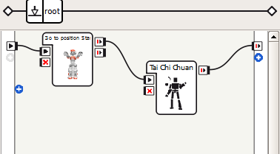
Option 2: Choregraph Requirements Social robotics program

Slide 7
1: Robot needs to interact with a human 2: Robot should respond to audio command-request. 3: Robot should visually detect human face (extra credit – identify person) 4: Robot needs to respond differently to a minimum 2 requests from 2 different pwople

Slide 8
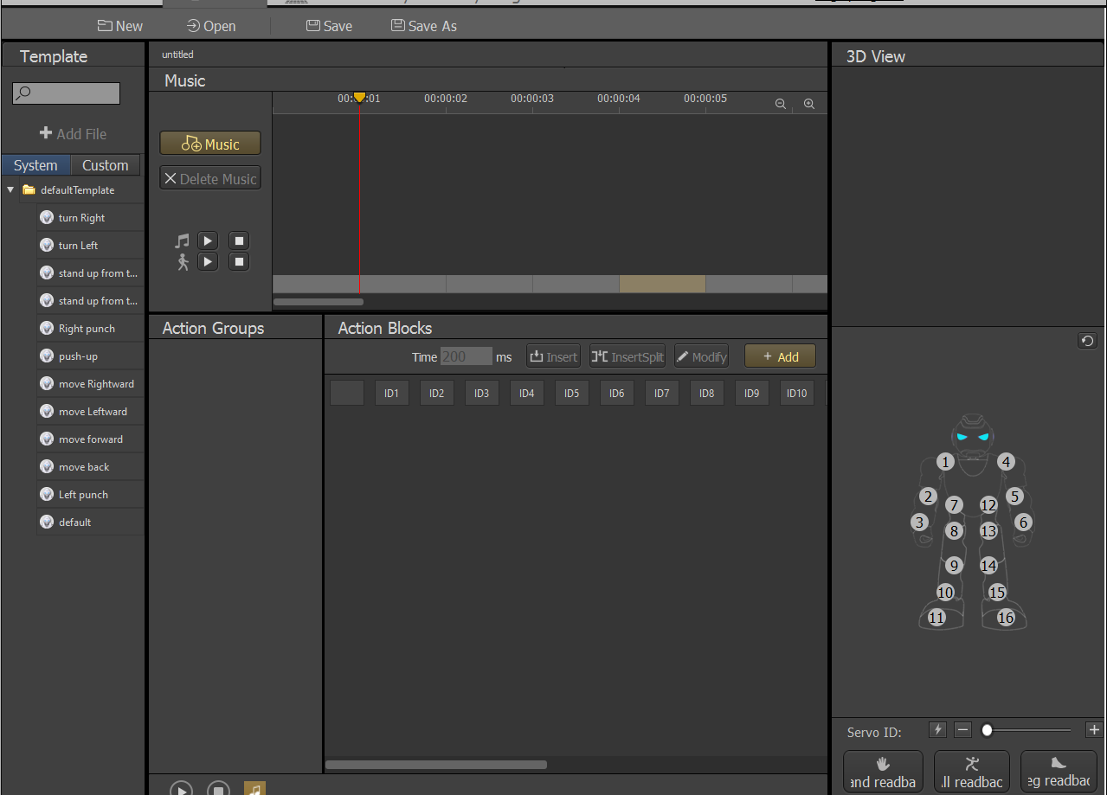
Option 3: Alpha 1S Requirements (new) Alpha 1S Robot Dance.

Slide 9
1: Dance is 2-5 minutes in length. 2: Dance is original (not searchable – downloadable from Alpha 1 S user groups or UBTECH) 3: Robot actions match music

Slide 10
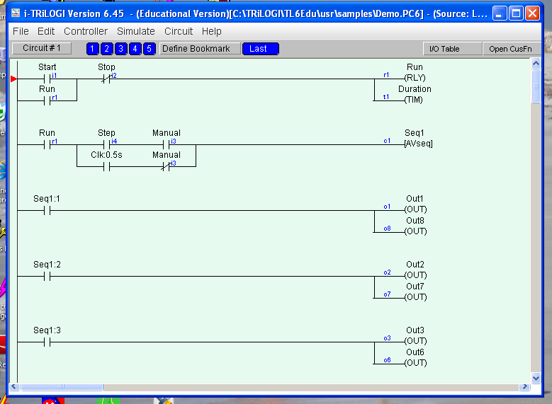
Option 4: iTrilogi-EasyVeep Requirements Industrial Robotics Program

Slide 11
1: Program is original (not located in program sample – help files) 2: Program controls a simulation involving at least 4 inputs and 4 outputs.

Slide 12
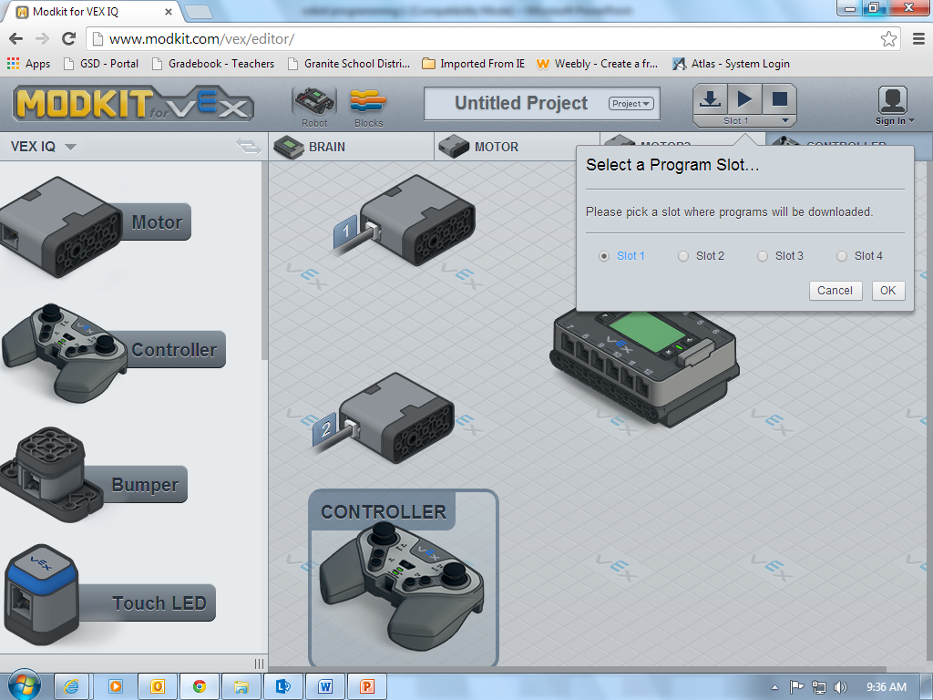
Option 5: Modkit Requirements VEX Robot Program

Slide 13
1: Use VEX clawbot robot as basis. 2: Robot can be driven manually in “tank drive”– controller front buttons control arm/claw. 3: Program autonomously drives robot forward – stopping robot when bumper switches hit an object. Robot must then back up and turn 90 degrees and start going forward again.

Slide 14
Alice Help Program built in help and Alice – help files on shared drive.

Slide 15
Alpha 1S Help Built in program help or YouTube videos

Slide 16
iTrilogi help Program built in help files or on-line tutorials (accessible through program

Slide 17
Modkit Help Site tutorials and guides

