Slide 1
Robot Arms Lab 1 Understanding a 6 axis robot arm
Content-Objective:
Learn how to identify the axis’s in a ROBOT arm.
Language-Objective:
Utilize RoKiSim software to operate a simulated 6 axis ROBOT ARM.

Slide 2
Robot Arms Lab 1 6 Axis Robot Arms
Utah State Robotics 2 Strand 6
Common Core High School Algebra Reasoning
Common Core High School Interpreting Functions

Slide 3
Do today’s Starter Quiz! (in Canvas)

Slide 4
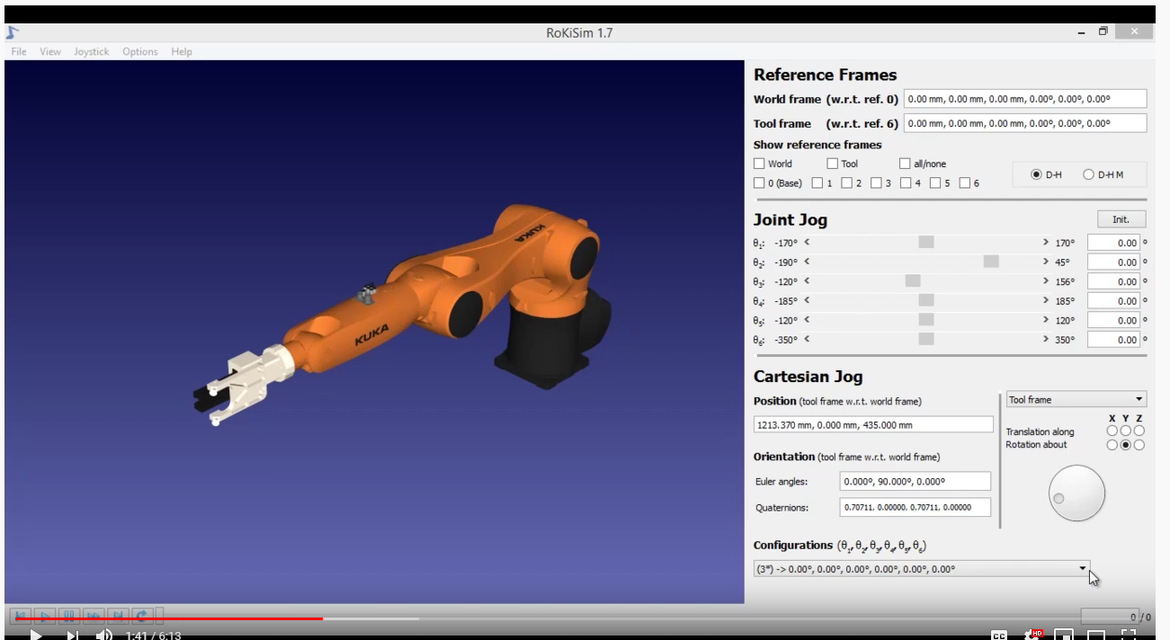
Watch RoKiSim Tutorial video

Slide 5
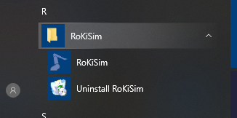
Step 1: “Windows button, Program Menu, RoKiSim”

Slide 6
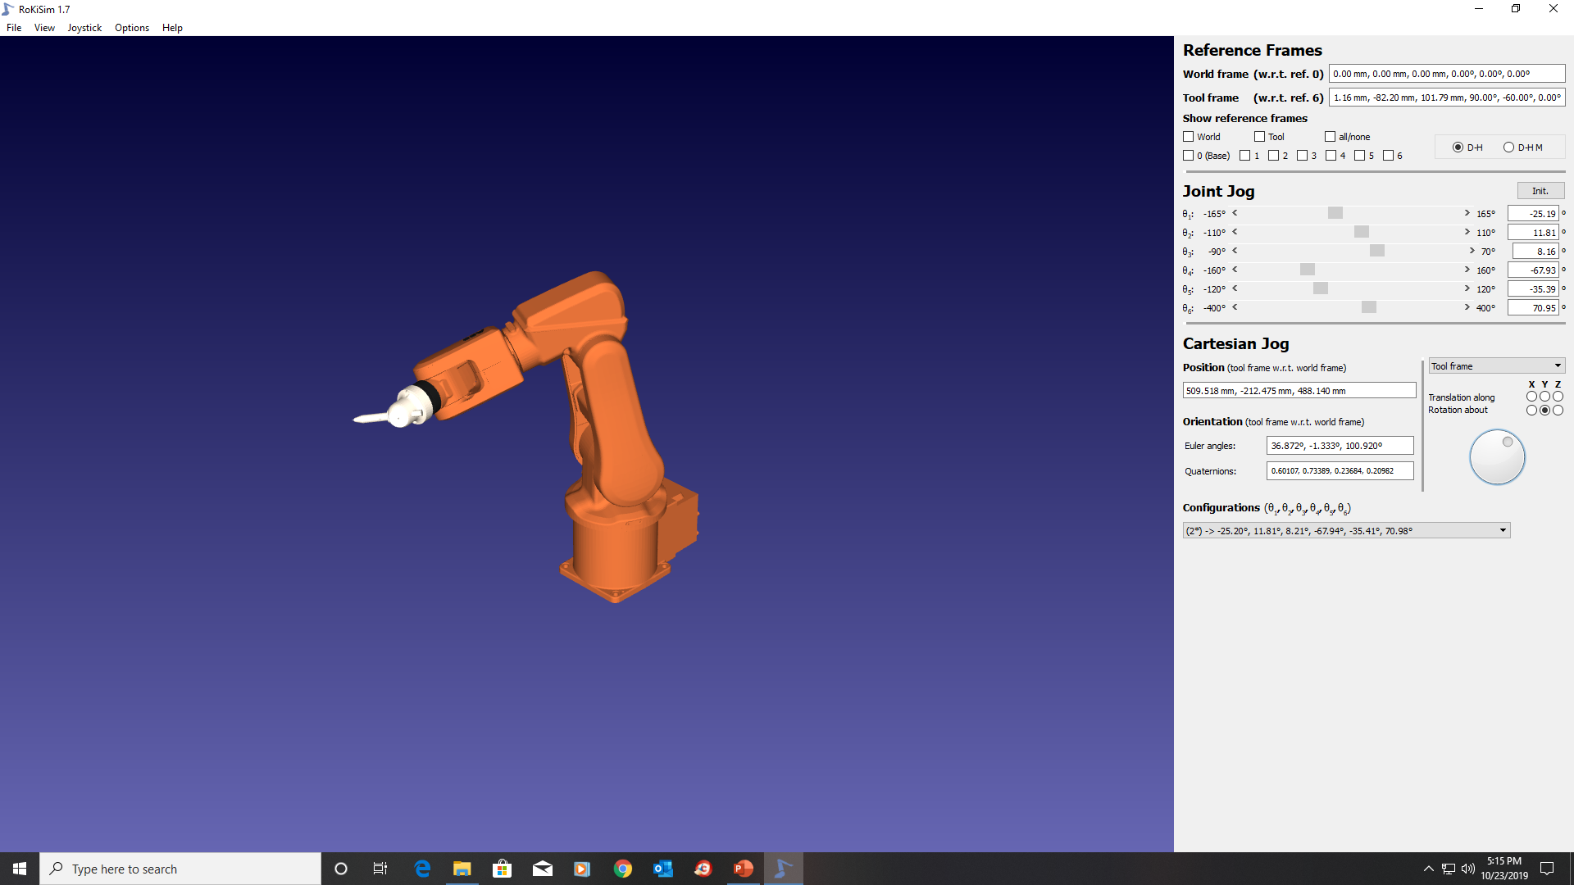
Step 2: “RoKiSim Window”

Slide 7
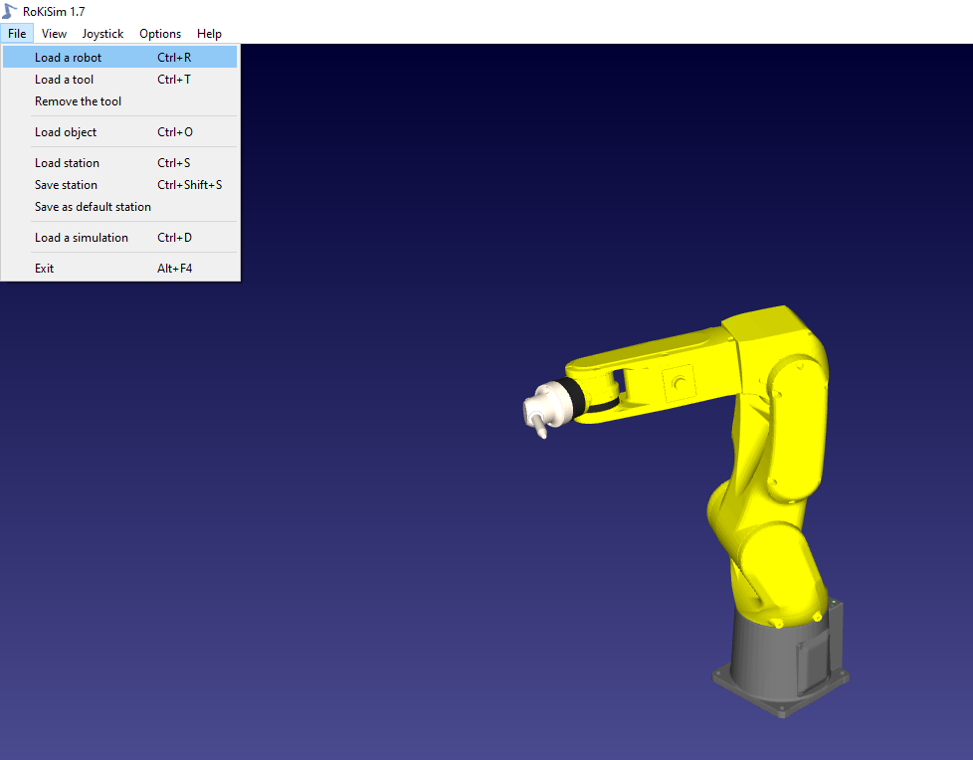
Step 3: “File”, “Load a robot”

Slide 8
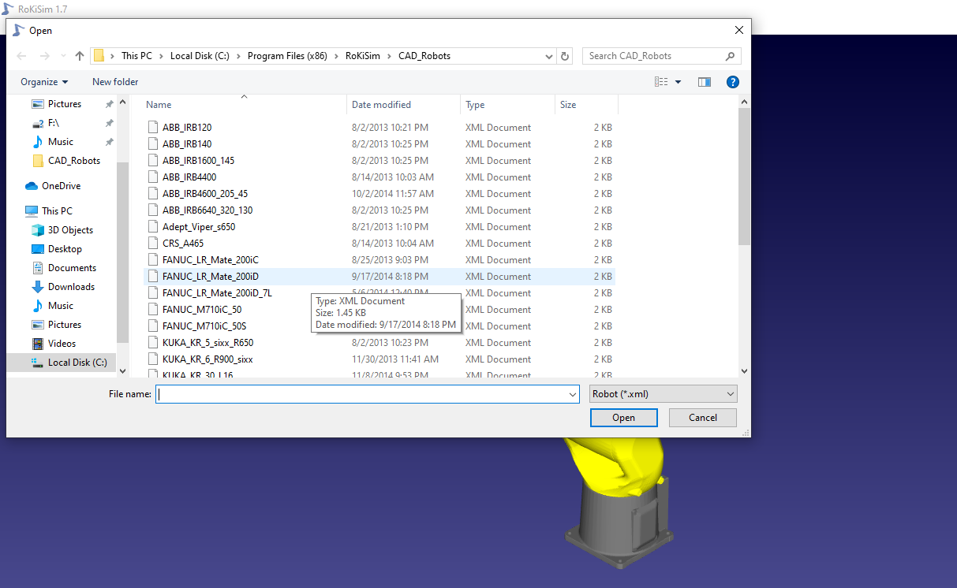
Step 4: “FANUC_LR_Mate_200iD”

Slide 9
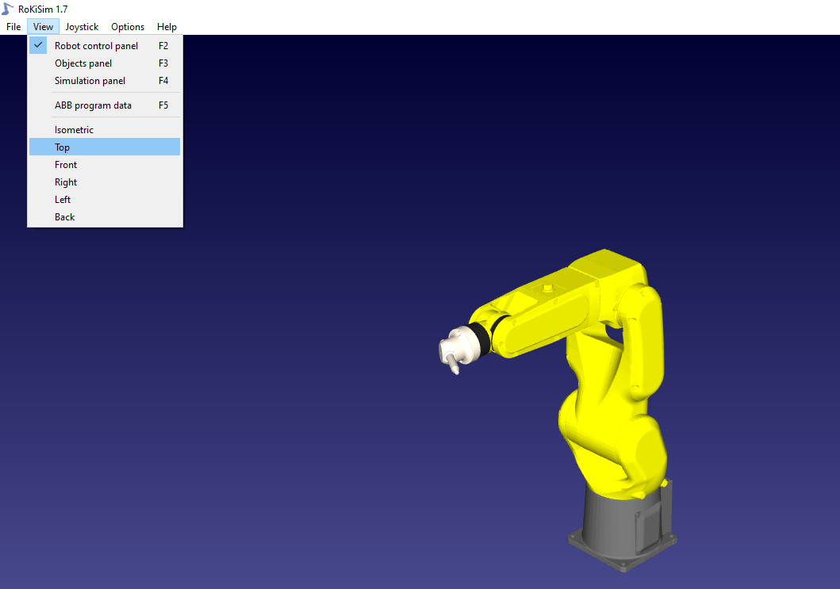
Step 5: “View” then select “Top”

Slide 10
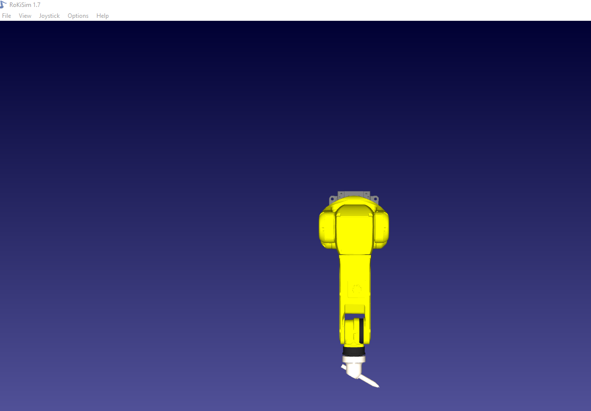
Step 6: Robot Arm Top View

Slide 11
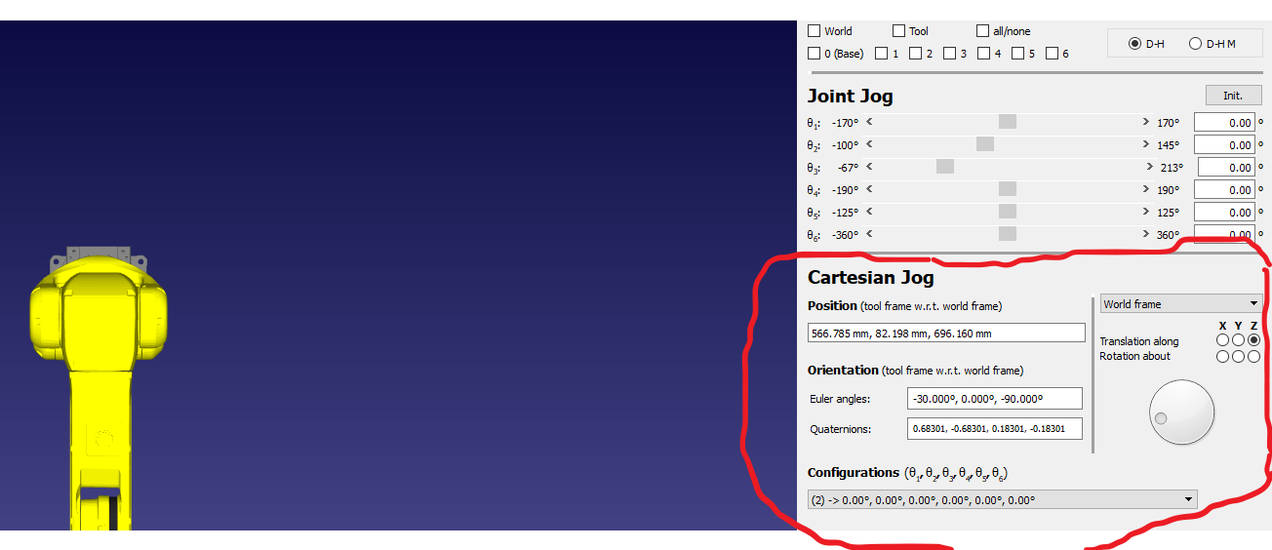
Step 7: Locate Cartesian Jog controls (Right side)

Slide 12
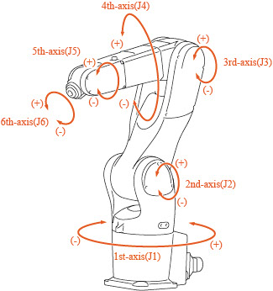
Step 8: The Robot Arm has 6 axis’s. Axis’s 1 -3 are referenced to lewtters X, Y, or Z. Axis’s 4-6 are referenced to letter sets rX, rY or rZ.

Slide 13
Task: One at a time select each of the 6 axis letters on Cartesian Jog right side controls. Move manual adjust knob and determine which axis of the robot corresponds with that letter.

Slide 14
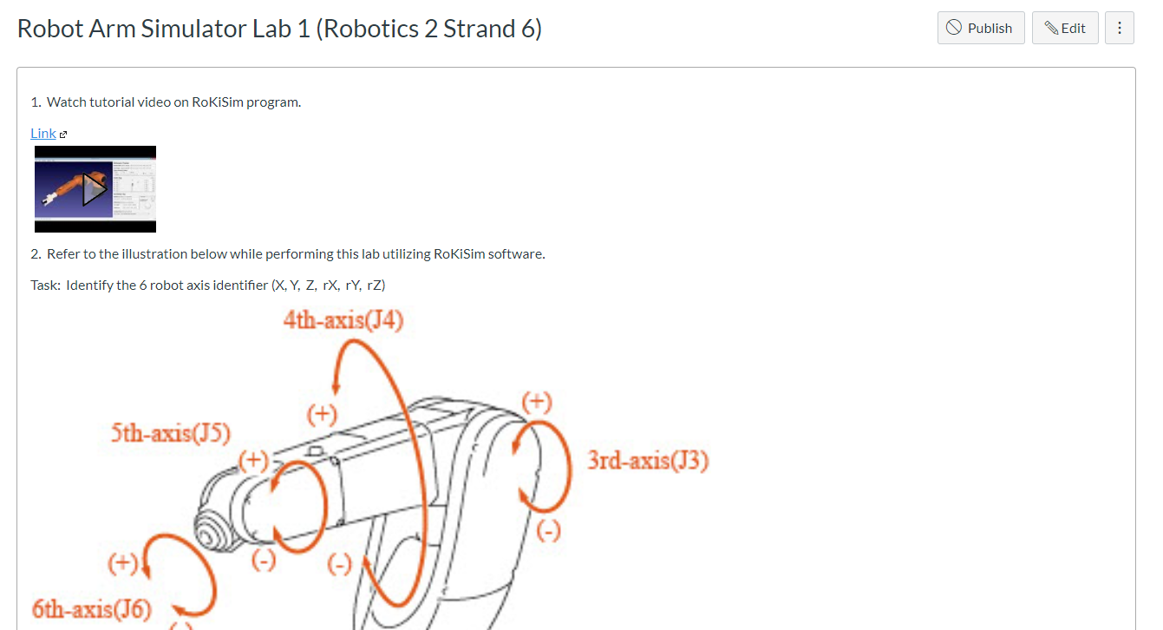
in Canvas assignment text box report which letter or letter set is associated with each robot axis..

