Slide 1
OzoBot Lab 1
Content-Objective:
Learn robot programming using color code sequences
Language-Objective:
Program OzoBot robots using color code sequences

Slide 2
Do today’s Starter Quiz! (in Canvas)

Slide 3
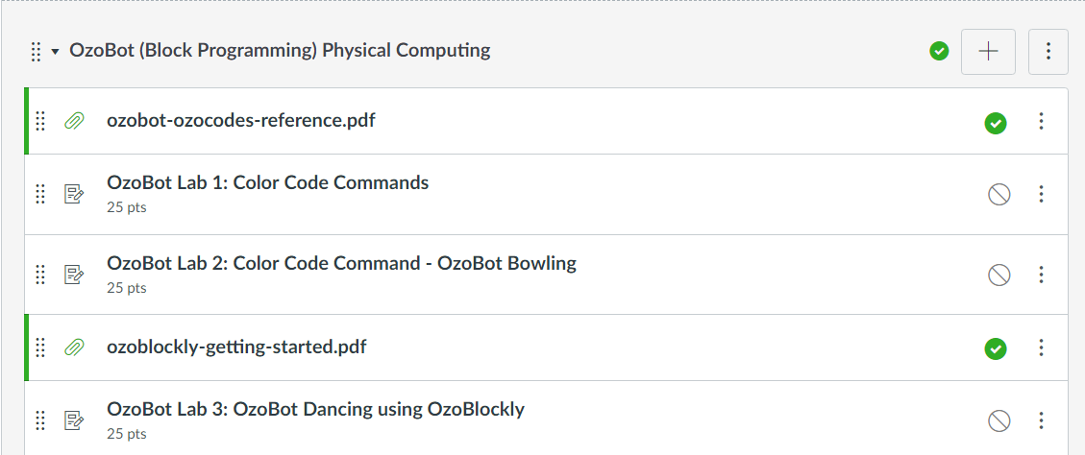
OzoBot (Block Programming) OzoBot Lab 1: Color Code Commands

Slide 4
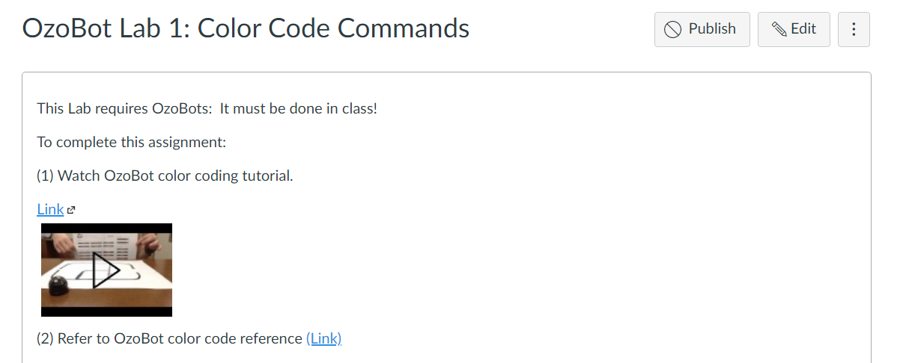
Step 1: Tutorial Video OzoBot Lab 1: Color Code Commands

Slide 5
Today’s Task Learn – practice commanding OzoBot robots using color code sequences Note: Main Task Program OzoBot’s to navigate maze

Slide 6
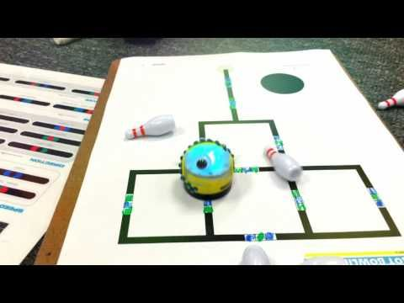
Work with a partner Obtain Supplies OzoBot, Maze sheets, Markers

Slide 7
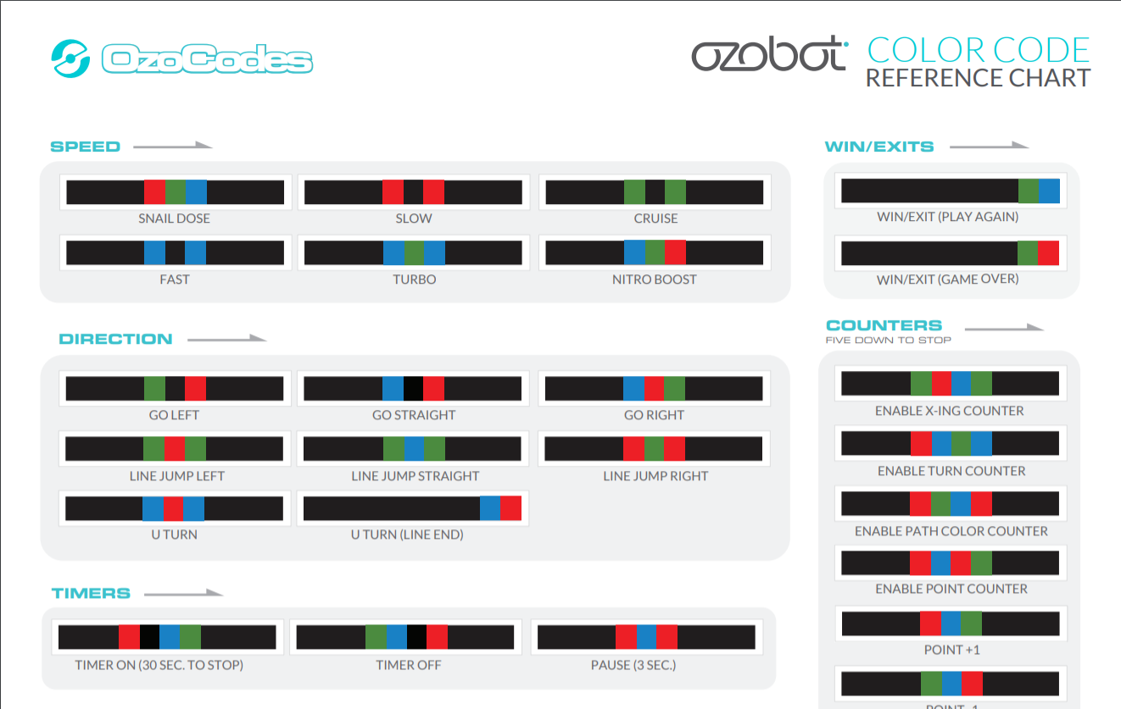
Open OzoBot Color Code reference Chart (on lab PC)

Slide 8
Color Code Sequences Go in set of 3 blank spots on Maze

Slide 9
Practice Coding Ozobot Task 1: Have OzoBot spin and then Turn Right at Junctions

Slide 10
Practice Coding Ozobot Task 2: Have OzoBot stop, spin and turn left and right to complete maze

Slide 11
Practice Coding Ozobot Task 3: Use creativity with commands and Have OzoBot Complete Maze in a dancing style.

Slide 12
Report Success Level in Canvas: If possible submit photos of OzoBot running your maze.

