Slide 1
Robotics Project 2
Content-Objective:
Determine and list team project engineering notebook artifacts.
Language-Objective:
Look at Project selection and determine engineering notebook items that need to be collected, organized, and submitted.

Slide 2
Robotics Project 2 Engineering Notebook
Utah Robotics 1 Strand 6
Common Core High School Algebra Reasoning
Common Core High School Interpreting Functions

Slide 3
Do today’s Starter Quiz! (in Canvas)

Slide 4
Step 1: State Course Engineering Data artifacts requirements.

Slide 5
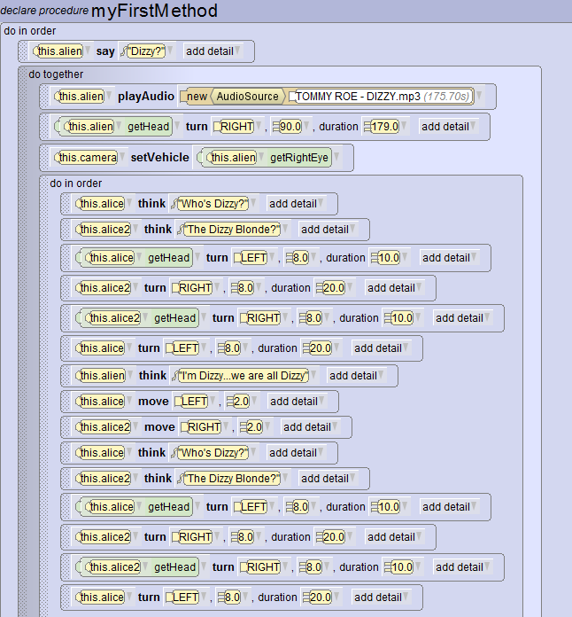
Examples: Source Code

Slide 6
Examples: Resource

Slide 7
Examples: Problem-Task statement
We want Alpha Robot to do the Macarena dance!

Slide 8
Examples: testing notes
On first try the Macarena looked more like the robot dance!
Second Try looked like Crocodile Rock (no move)
Third try was fine until Alpha fell over.

Slide 9
Assignment: Look at the initial selection you provided for team project in Team Project assignment 1 (selection). Determine what required artifacts your team can provide and how you will obtain, organize, and save them..

Slide 10
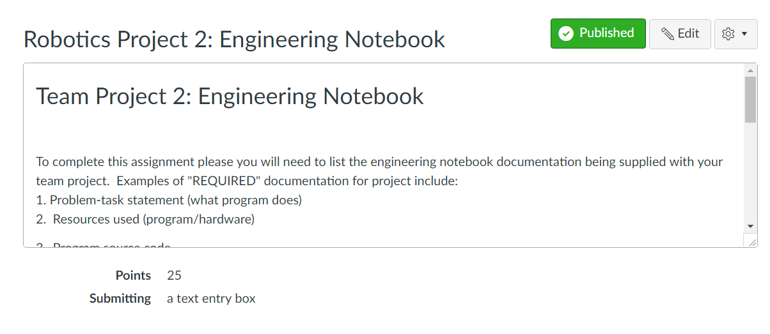
For credit:
Complete Canvas Assignment
Robotics Project 2: Engineering Notebook

