Slide 1
Alice Lab 4 Using Alice to create Music Videos
Content-Objective:
Learn simultaneous integration of items in Java to control action of objects.
Language-Objective:
Utilize Alice JAVA animation creation program “do together” code option to create simple music videos.

Slide 2
Alice Lab 4 JAVA Programming
Utah Robotics 1 Standard 3
Common Core High School Algebra Reasoning
Common Core High School Interpreting Functions

Slide 3
Learn basics of Java coding in block format
Alice Lab 4
STARTER
Canvas: Starter Quiz
TODAY’S AGENDA
STARTER assignment.
Alice Demo
(music videos).
Canvas: Alice Lab 4.
Content Objective
Language Objective
Use Alice to create Java coded animations.

Slide 4
Do today’s Starter Quiz! (in Canvas)

Slide 5
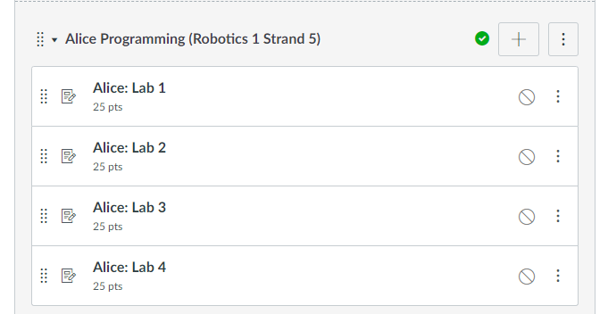
Alice Programming Module

Slide 6
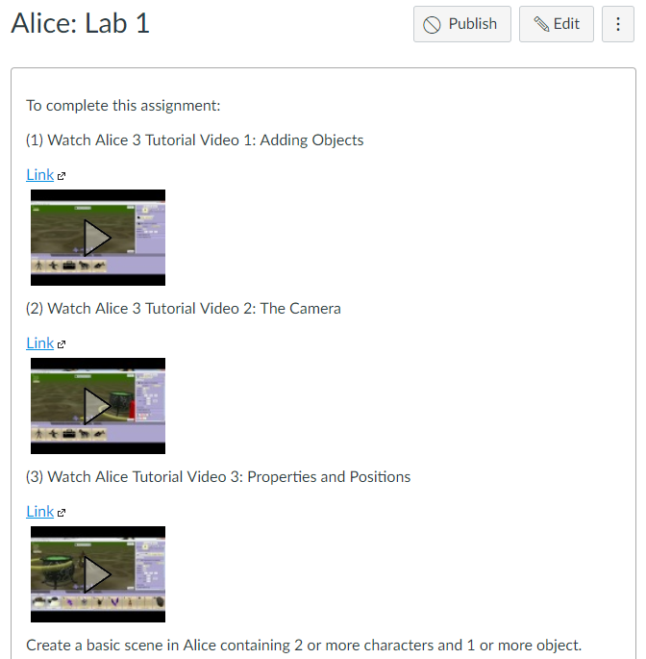
Watch Alice Tutorial Video(s)

Slide 7
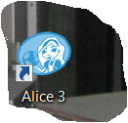
Step 1: select desktop or menu “Alice”

Slide 8
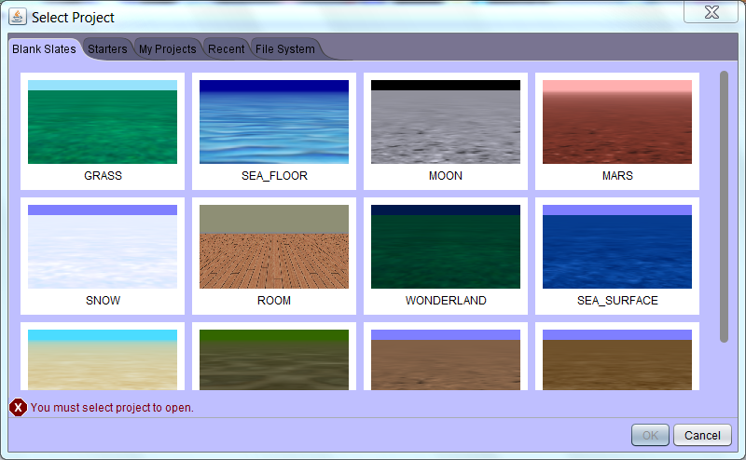
Step 2: “Select a background (use MARS initially) click on OK”

Slide 9
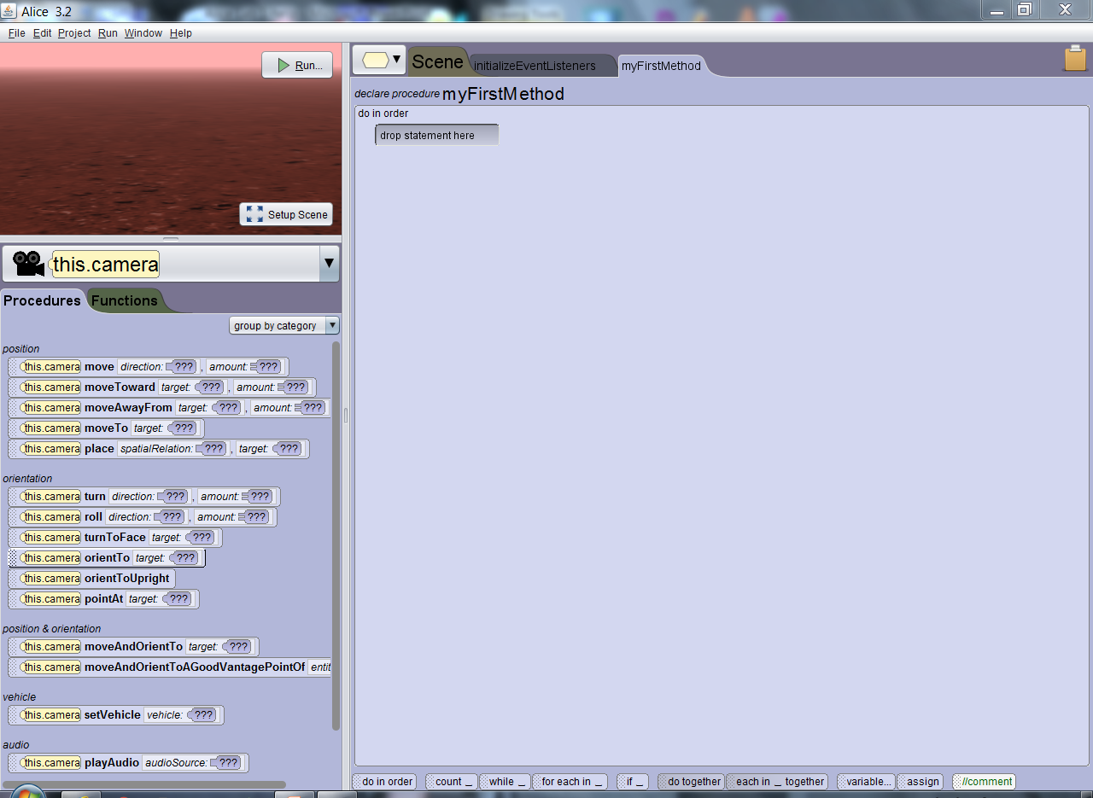
Step 3: “Alice layout screen”

Slide 10
Step 4: “click on Setup Scene”

Slide 11
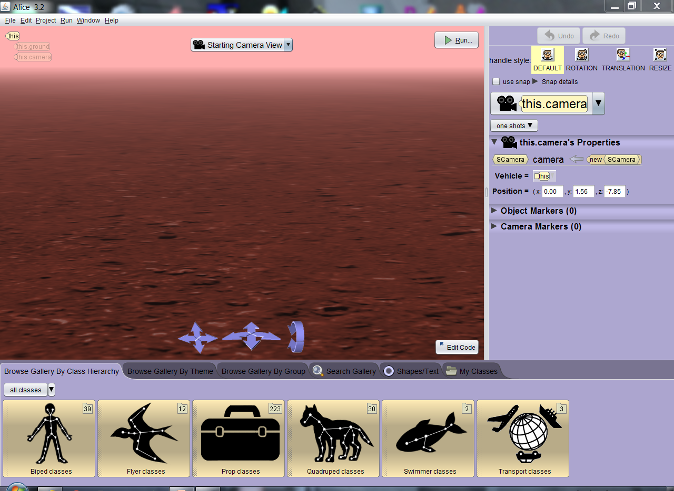
Step 5: “Scene setup window”

Slide 12
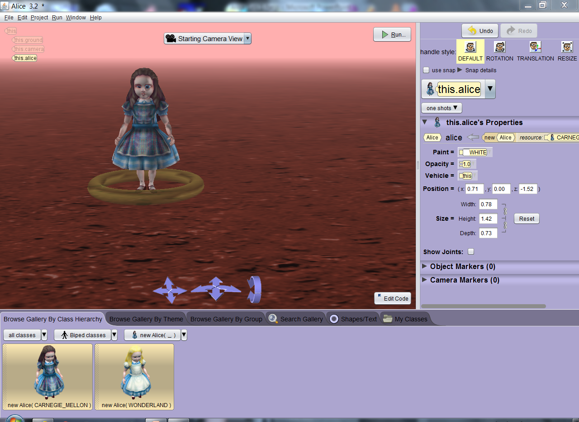
Step 6: Select multiple “Biped” class objects and then drag objects into background. Click “ok” to set in place.

Slide 13
Step 7: After objects (actors) are in place Click on “Edit Code” button

Slide 14
Step 8: Locate down arrow by “This” and select the actor you placed in the screen.

Slide 15
Step 9: Locate initializeEventListeners if a key is to be used to start action otherwise use myFirstMethod area to code action.

Slide 16
Step 10: Locate “play audio” under “audio” section of procedures tab.

Slide 17
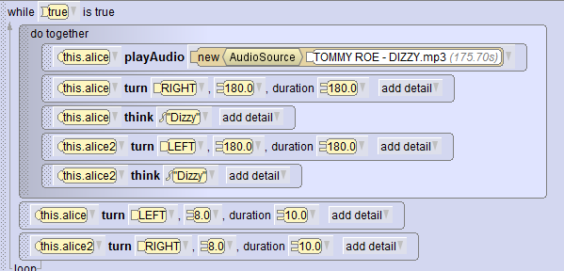
Step 11: Use “DoTogether” to create a music video where action happens while music is played.

Slide 18
Step 12: Use “duration” option to set character action to match music

Slide 19
Step 13: Use the “Timing” option to generate delays to start some character actions later in the do together loop.

Slide 20
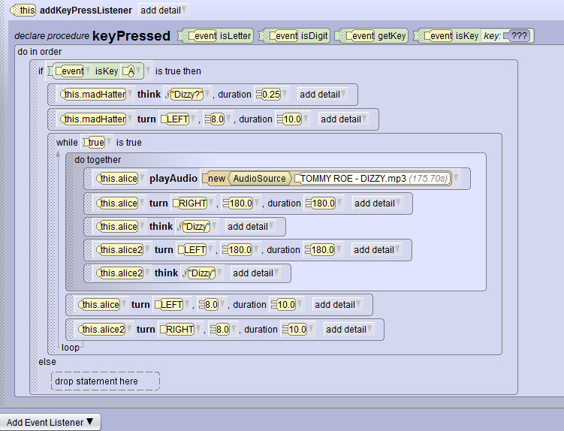
Example code. The characters spin and get “dizzy” during the song.

Slide 21
Assignment: Create a simple music video using the “do together” option involving an audio file and duration adjustment. Show completed animation to instructor. Note: In Robotics the actions in this exercise would be used to integrate autonomous and manual control.

Slide 22
Capturing Program Windows Snipping Tool (All Apps, Windows Accessories, Snipping Tool)

Slide 23
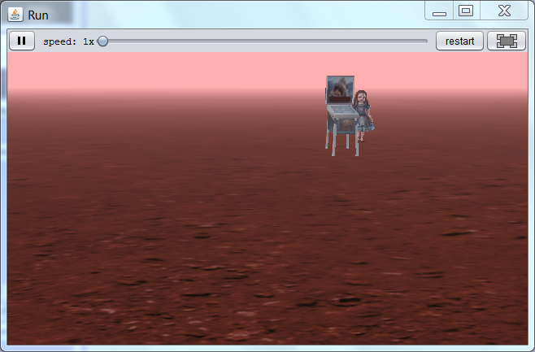
Use Windows Snipping Tool to capture image of your Alice scene and submit capture file for credit in Canvas.

Slide 24
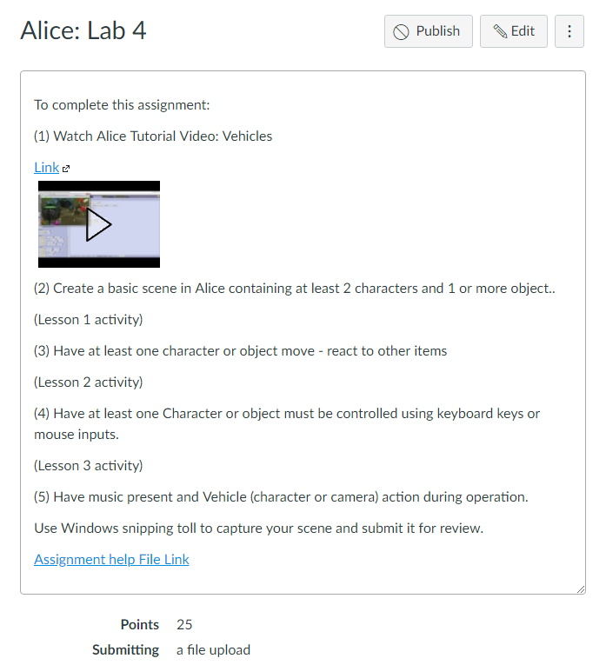
Alice: Lab 4 Submission Link

