Slide 1
Robot Components 7 “Prototype Testing”
Content-Objective:
Analyze the mechanical advantage forces created by gears, pulleys, and levers.
Language-Objective:
Report on how mechanical advantage forces were used to successfully complete Fantastic Contraption.

Slide 2
Report-Document Robot Operation
Robot Components 7
STARTER
Canvas: Starter Quiz
TODAY’S AGENDA
STARTER assignment.
Assignment Information.
Canvas: Robot Components 7
Content Objective
Language Objective
Use Fantastic Contraption web-site to make prototype “powered” robots and then report on it’s operation and problems.

Slide 3
Do today’s Starter Quiz! (in Canvas)

Slide 4
Robot System Components Lab 7 “Prototype testing”
UTAH ROBOTICS 1 STRAND 3
Robot Components
INSTRUCTIONS
Log into Lab Computers and Internet
Go to Web Site www.fantasticcontraption.com
Choose “Levels” from Menu
Pick a minimum of 10 levels to challenge-conquer.
Analyze how the mechanical advantage devices (gears, levers, pulleys) affected the outcome on these levels.
Report your findings in the Canvas Class Discussion “Robot Components Lab 6B:”

Slide 5
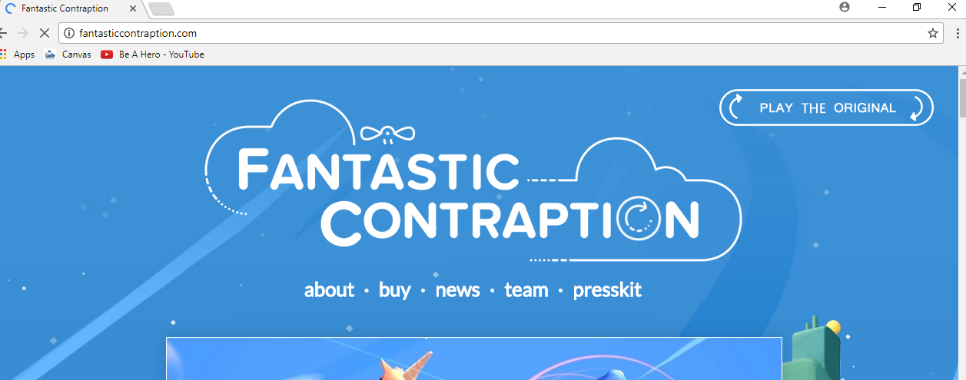
WWW.FANTASTICCONTRAPTION.COM

Slide 6
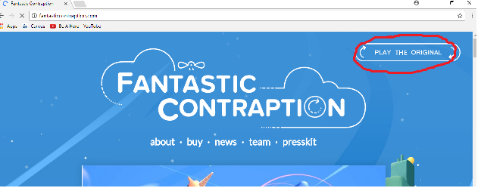
WWW.FANTASTICCONTRAPTION.COM Choose “Play The Original”

Slide 7
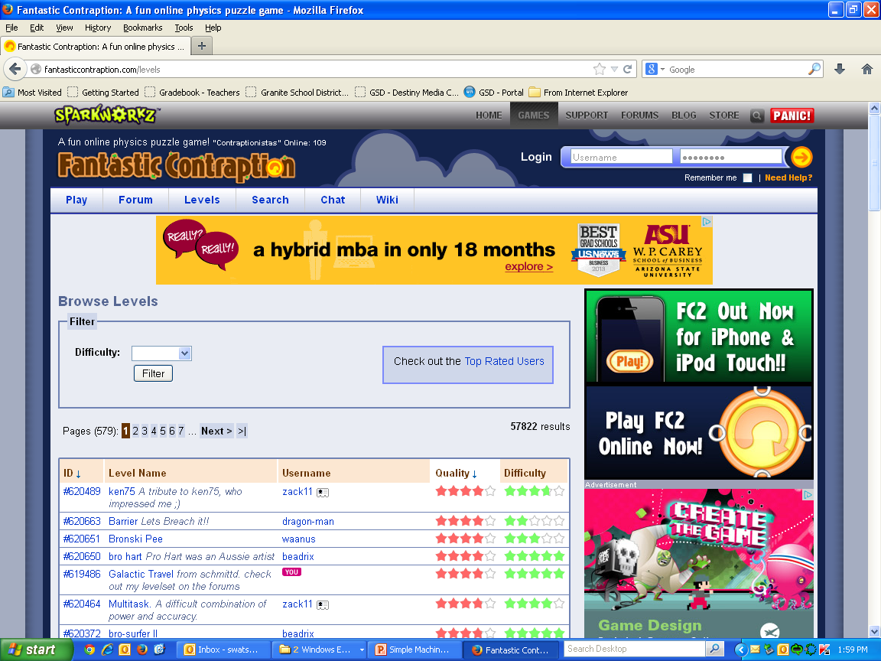
Select “Levels” and pick a minimum of 10 to complete
1. Using parts from a Power Play kit build and

Slide 8
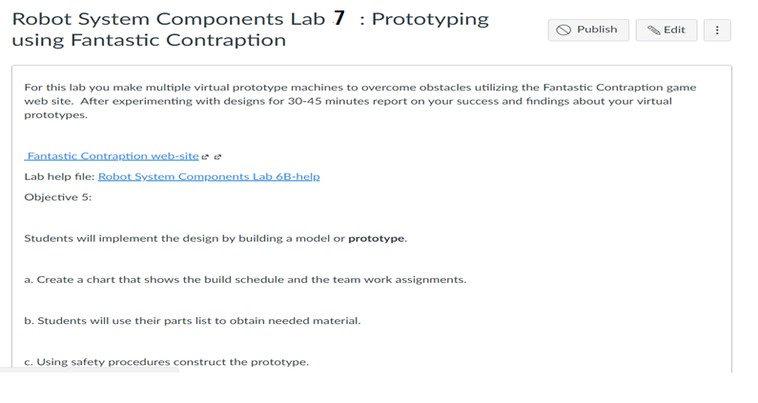
Log into Canvas and report findings in “Robot System Components 7: Prototyping using Fantastic Contraption”

