Slide 1
Zenbo Lab 1
Content-Objective:
Learn Zenbo robot programming using Zenbo Lab web-site
Language-Objective:
Program Zenbo robot movement using Zenbo Lab

Slide 2
Do today’s Starter Quiz! (in Canvas)

Slide 3
Zenbo Programming (Block Programming -Python) Zenbo Lab 1: Orientation -Motion

Slide 4
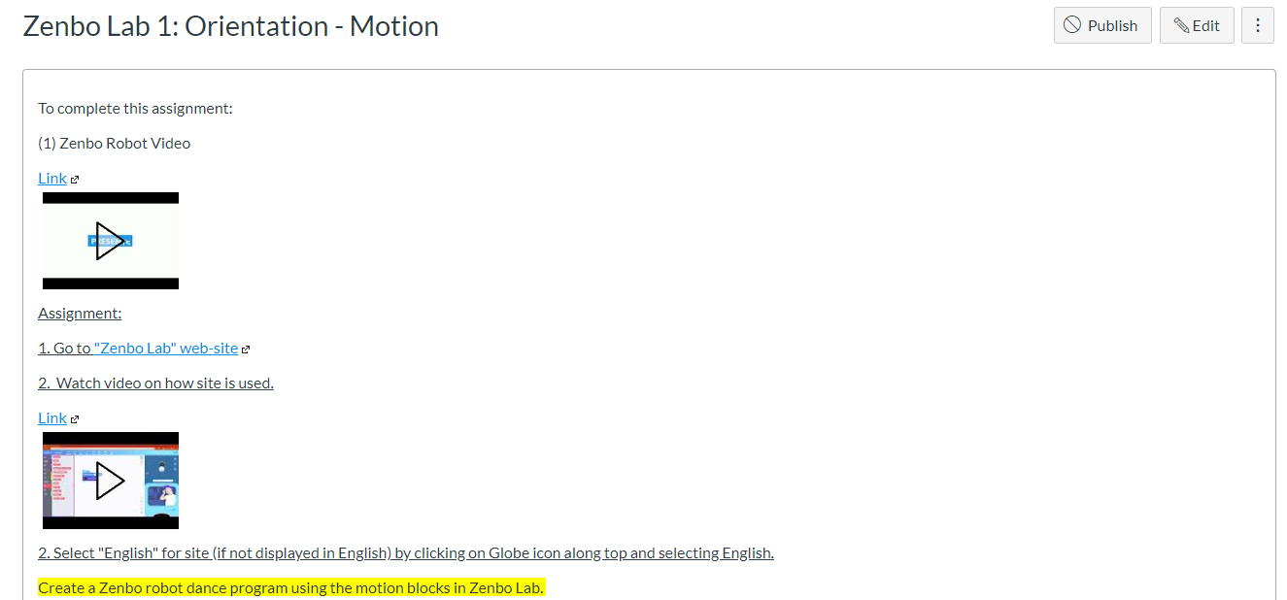
Step 1: Tutorial Video Zenbo Lab 1: Zenbo Lab web-site

Slide 5
Today’s Task Learn – practice commanding Zenbo robot movement using Zenbo Lab web-site and simulator. Note: Main Task Program Zenbo robots to dance.

Slide 6
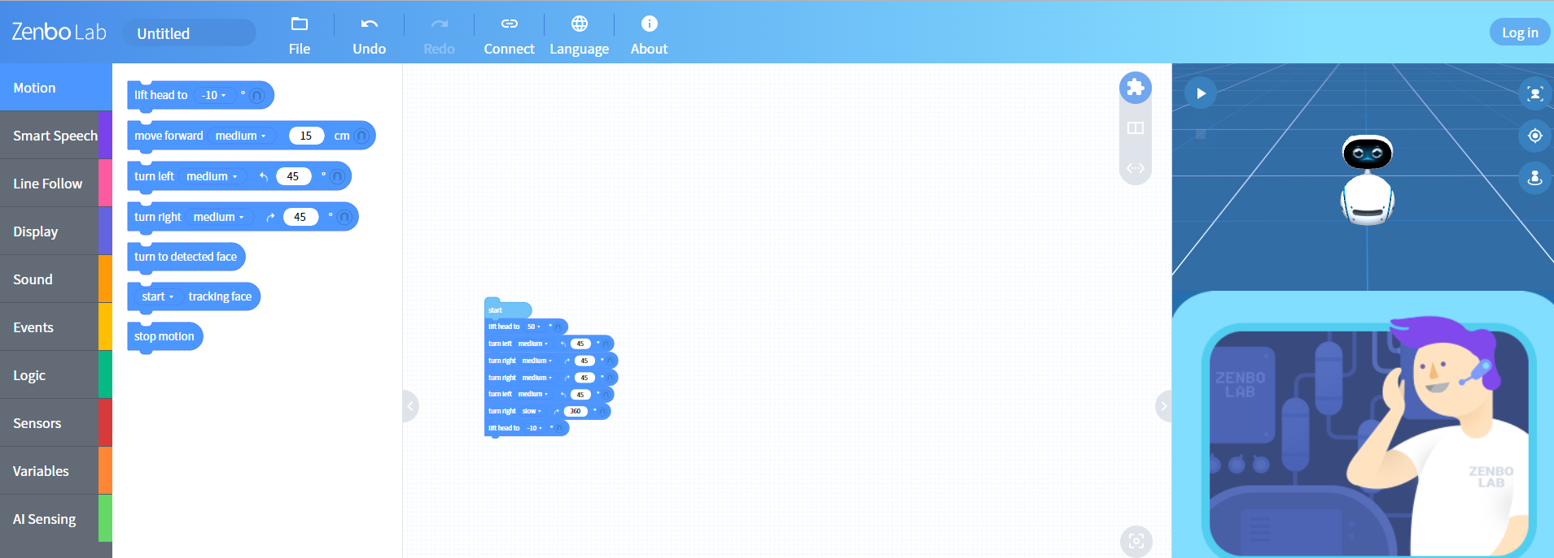
Work with a partner Zenbo Lab Web-site. https://zenbolab.asus.com/editor/?lang=en

Slide 7
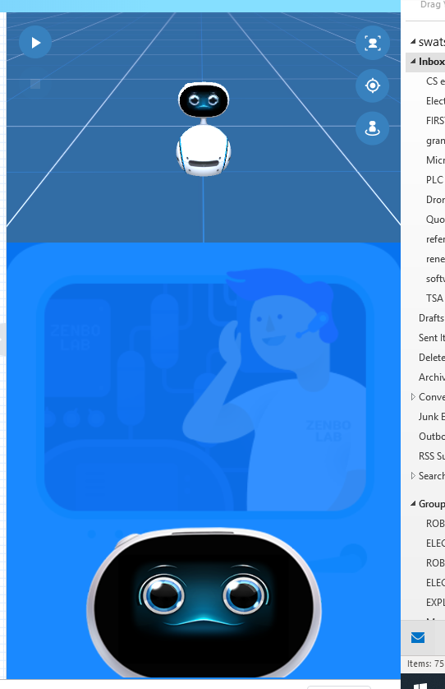
Make Zenbo robot face visible by dragging it up on right side of Zenbolab web-site

Slide 8
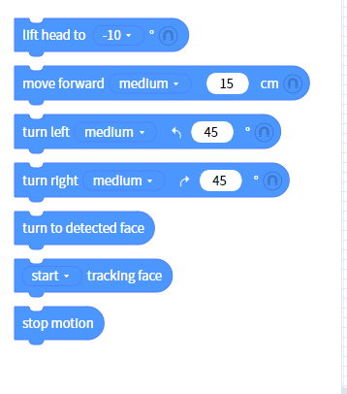
Zenbo Motion Blocks

Slide 9
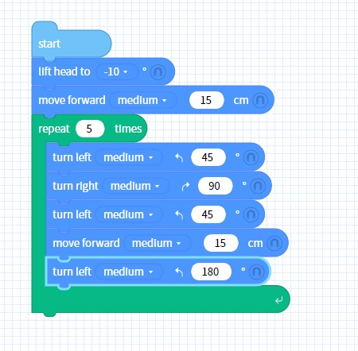
Connect motion blocks together. Connect blocks to “start” block.

Slide 10
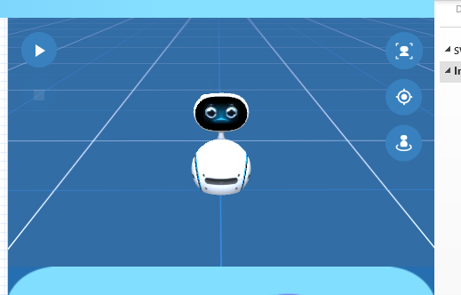
Zenbo Simulator Zenbo simulator is on right side of Zenbo Lab web-site. Click “play” arrow to start simulation

Slide 11
Practice Coding Zenbo Task 1: Have Zenbo turn left-right and spin around.

Slide 12
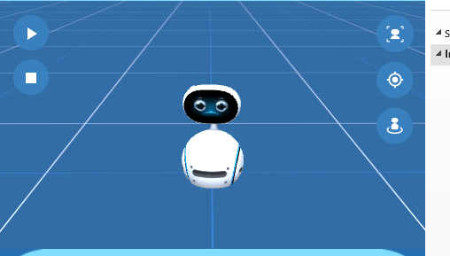
Practice Coding Zenbo Task 2: Use creativity with commands and Have Zenbo perform a complete dance in a dancing style.

Slide 13
Submit Windows Snip and Sketch photos of Zenbo dancing code in Canvas for credit.

