Slide 1
Little Bits Lab 2
Content-Objective:
Learn electronic circuit operation and connections.
Language-Objective:
Utilize Little Bits kits to learn circuit operation and control.

Slide 2
Do today’s Starter Quiz! (in Canvas)

Slide 3
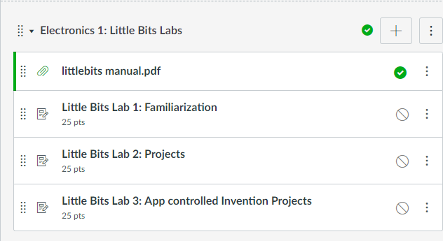
Little Bits Labs Little Bits Lab 2: Projects

Slide 4
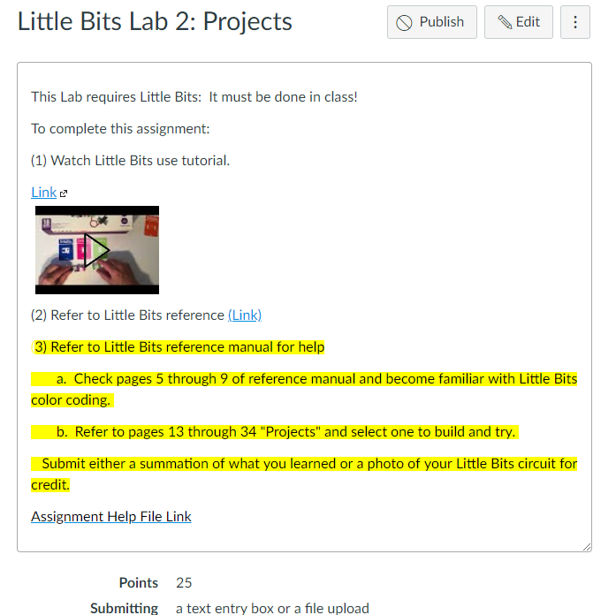
Step 1: Tutorial Video Little Bits Lab 2: Projects

Slide 5
Today’s Task Learn –connect Little Bits circuit pieces to create a project from project items located in reference manual.

Slide 6
Work with a partner Obtain Supplies Little Bit pieces from kit

Slide 7
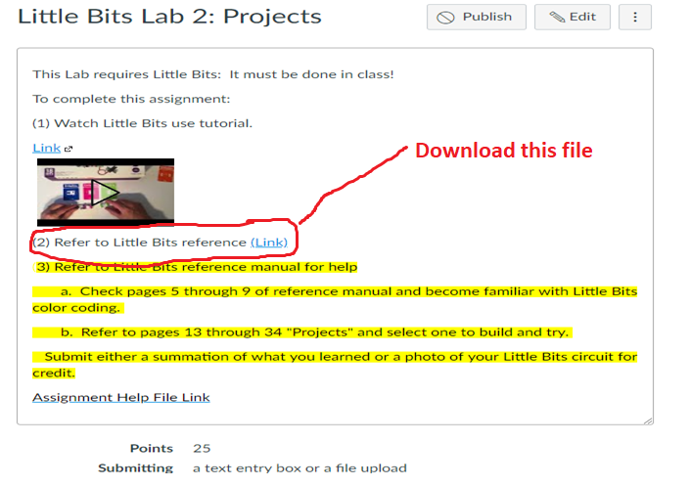
Step 1: Download reference manual in Canvas (on lab PC)

Slide 8
Step 2: Little Bits part reference (Pages 5-9)

Slide 9
Practice Building Little Bits Task: Select and build a project from manual (pages 13-34)

Slide 10
Report Success Level in Canvas: If possible submit photos of Little Bit Project.

