Slide 1
Little Bits Lab 3
Content-Objective:
Learn electronic circuit operation and connections.
Language-Objective:
Utilize Little Bits kits to learn circuit operation and control.

Slide 2
Do today’s Starter Quiz! (in Canvas)

Slide 3
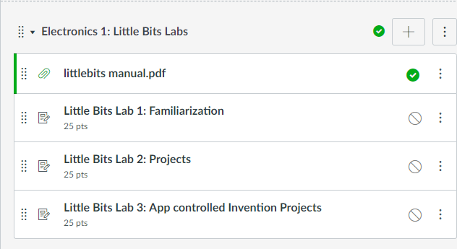
Little Bits Labs Little Bits Lab 3: App Controlled Invention Projects

Slide 4
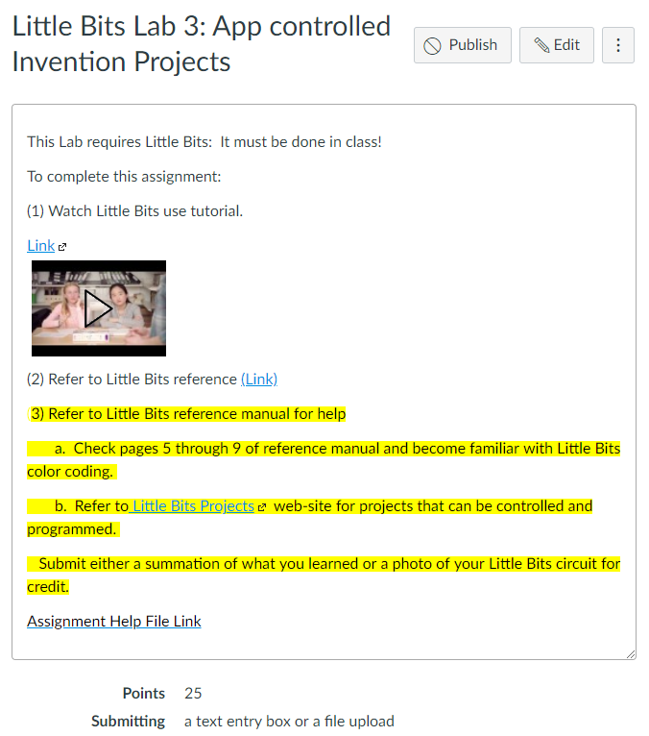
Step 1: Tutorial Video Little Bits Lab 3: App controlled Invention Projects

Slide 5
Today’s Task Learn – Build a Little Bits circuit project from web-site collection.

Slide 6
Work with a partner Obtain Supplies Little Bit pieces from kit

Slide 7
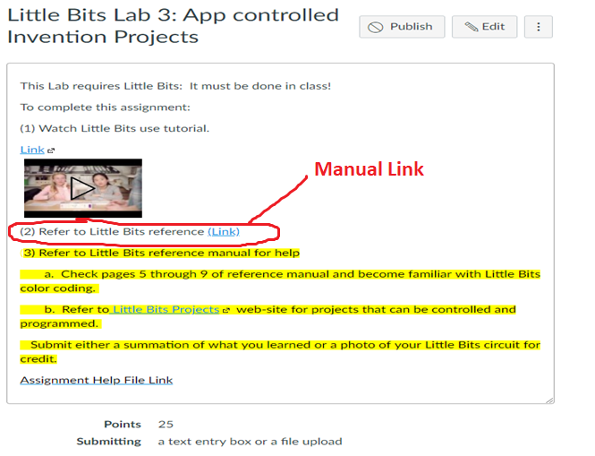
Step 1: Download reference manual in Canvas (on lab PC)

Slide 8
Step 2: Little Bits part reference (Pages 5-9)

Slide 9
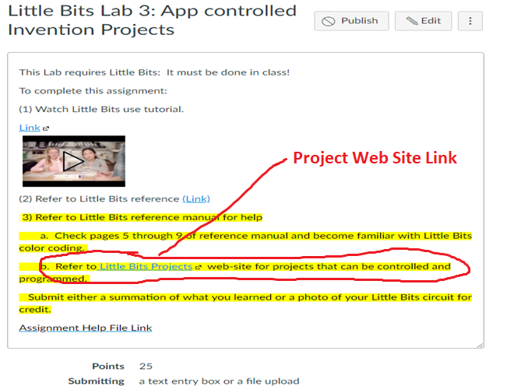
Step 3: Go to Little Bits Project collection web-site.

Slide 10
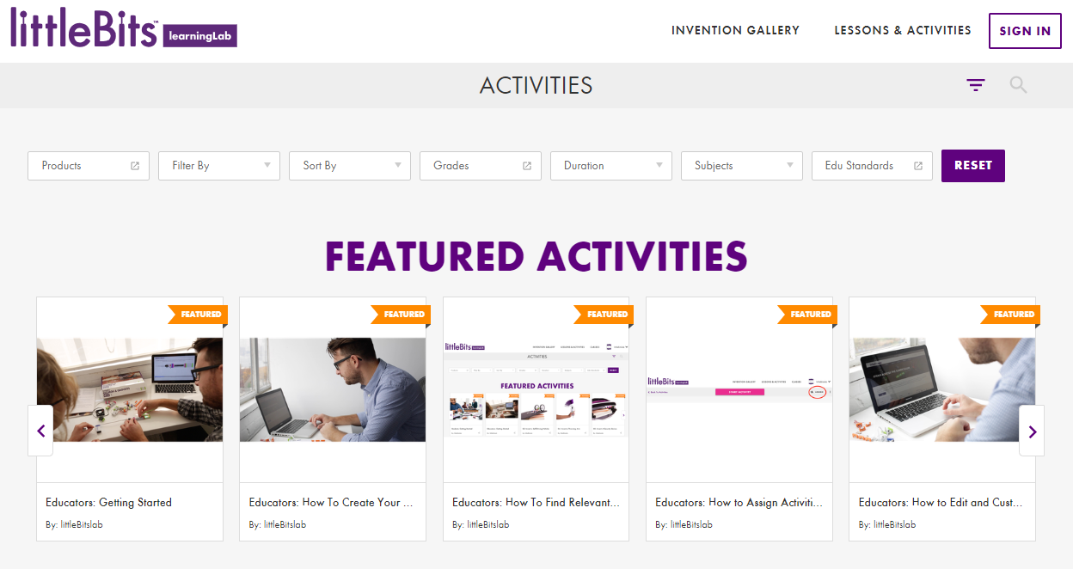
Step 4: Browse through the thousands of projects listed and choose one to build.

Slide 11
Report Success Level in Canvas: If possible submit photos of Little Bit project.

