Slide 1
Choregraphe Lab 3 Full Interaction Social Robot programs
Content-Objective:
Learn creation of social interaction coding to.
Language-Objective:
Utilize Choregraphe Software to create social interaction program.

Slide 2
Choregraphe Lab 3 Creating Social Robot Programs
Utah Robotics 1 Standard 3
Common Core High School Algebra Reasoning
Common Core High School Interpreting Functions

Slide 3
What is a Social Interaction program?
A program for a social robot platform that will recognize a person, greet them and then interact with them. To do this the program involves;
Facial recognition
Speech recognition and response
Robot movement and gestures.
Robot sensing: touch sensing, sound position, people or face tracking

Slide 4
Do today’s Starter Quiz! (in Canvas)

Slide 5
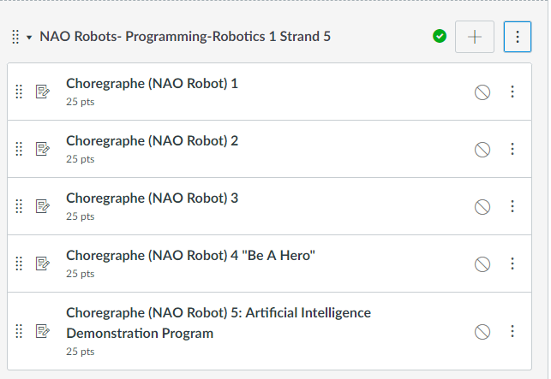
NAO Robots-Programming Module

Slide 6
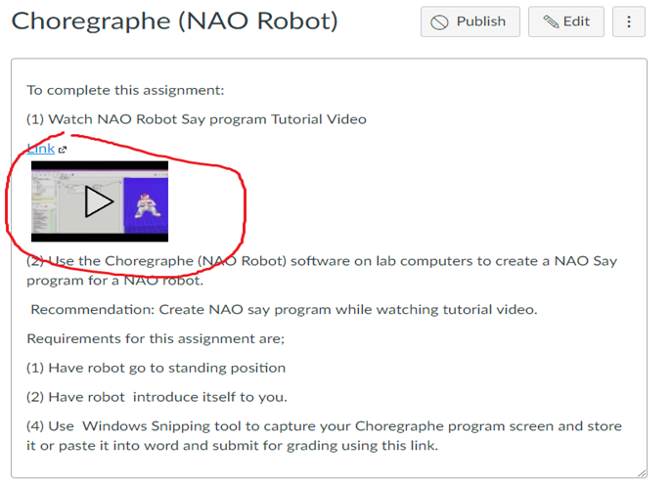
Watch Tutorial Video

Slide 7
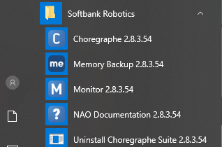
Select desktop or menu “Choregraphe”

Slide 8
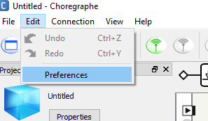
“Click on Edit and Then Preferences”

Slide 9
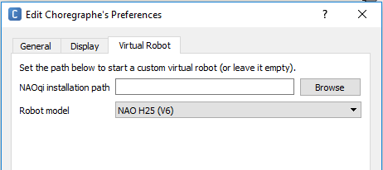
Click on Virtual Robot Tab and select “NAO H25 (V6)” from Robot Model drop down menu

Slide 10
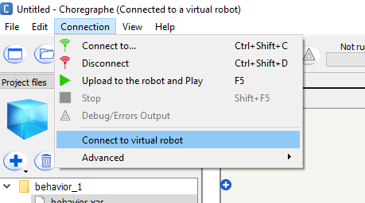
Click “Connection and then Connect to virtual robot”. It may take several moments for this step to complete.

Slide 11
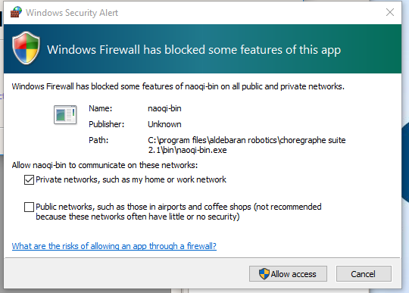
Click “Cancel” if Windows Security Alert appears. (Normally around 7 of these appear)

Slide 12
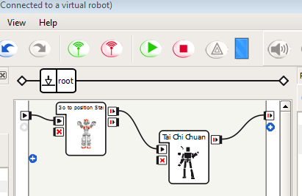
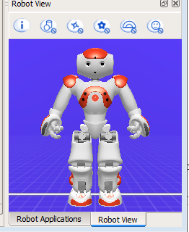
The first step for any Choregraphe program is to have a robot stand starting position (from right side position library)

Slide 13
Basics of a Social Interaction Program
A social interaction program has 4 elements
Facial recognition
Robot movement and gestures
Speech recognition and response
Tactile (touch) response

Slide 14
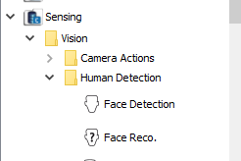
Part 1: Facial Recognition Locate “Vision”, “Human Detection” in the “Sensing” section of standard actions library in lower left corner of Choregraphe.

Slide 15
Now locate “Face Detection” and “Face Reco.” in the “Human Detection” options

Slide 16
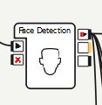
Drag in a Face detection icon (Robots have to know to detect faces before they can recognize one)

Slide 17
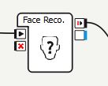
Now drag in a face recognition icon.

Slide 18
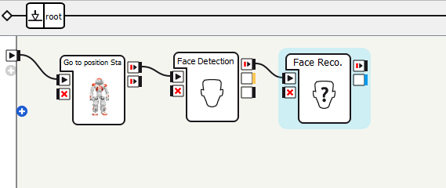
Connect the Face Detection input to the Starting position (Stand) box output and the Facial Reco. Input to the Facial Detection output. recognition. The NAO robot must know to look for faces before it can recognize them.

Slide 19
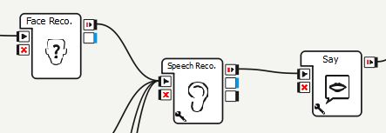
Items are connected together in left-to-right order they are performed . example: face recognition controls speech recognition listening for “Hello” command which results in “Greetings Wonderful one” from Say command in example below.

Slide 20
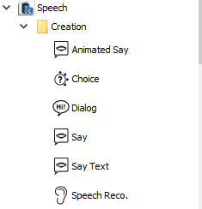
Part 2: Speech recognition and audio response locate the “Speech”, “Creation” options in standard actions library

Slide 21
Select “Speech Reco.” from standard actions library located in lower left corner.

Slide 22
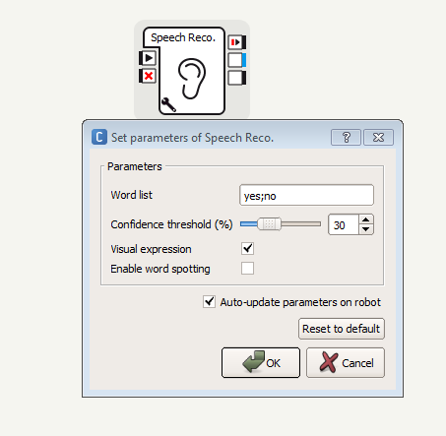
Now Click on wrench symbol to open Speech parameter options. The words in word list are the ones the robot is programmed to recognize.

Slide 23
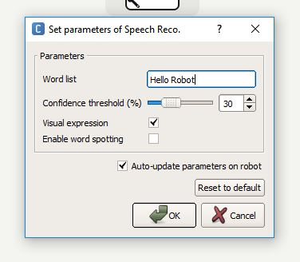
Enter words or short phrase you want robot to recognize and respond to in word list.

Slide 24
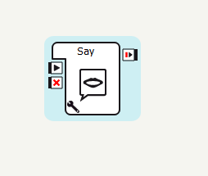
Now select “Say” from “Speech” options and drag into workspace.

Slide 25
Double-click on wrench symbol in lower left corner of say icon to change robot speech output.

Slide 26
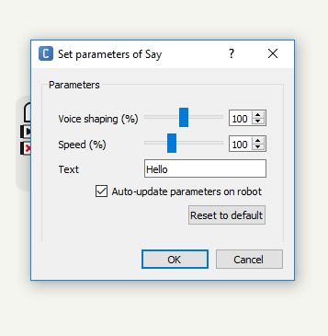
Set parameters of Say box will appear. Enter what you want robot to say in text block.

Slide 27
Click on “ok” to return to main screen.

Slide 28
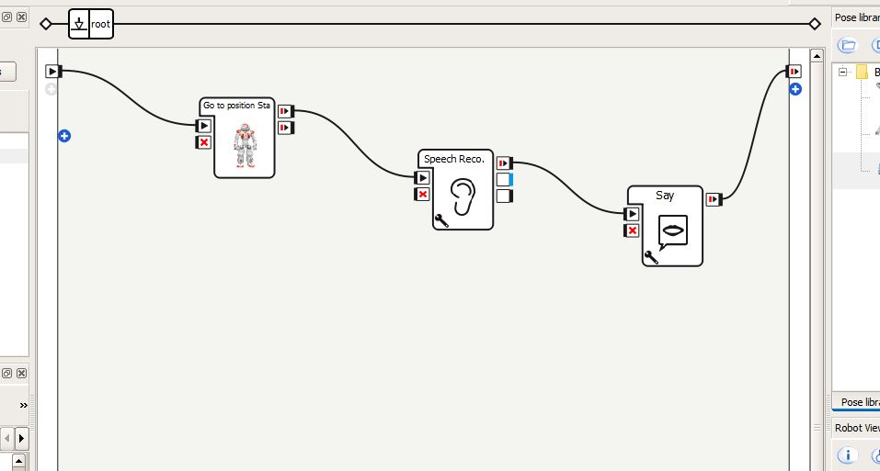
Connect icons together as shown to make complete speech recognition and response.

Slide 29
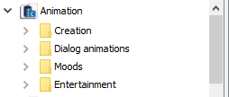
Part 3: Robot movement and gestures. In standard action library locate “Animation”

Slide 30
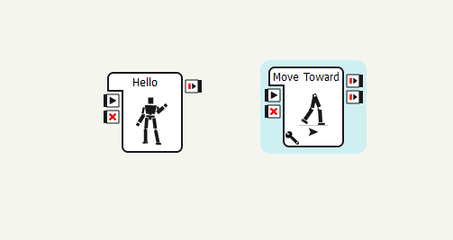
Robot movements are located in the Entertainment section. Robot gestures like waving are in the “Moods” section of Animation.

Slide 31
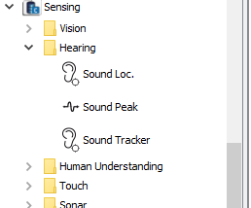
Part 4: Hearing and Touch Sensors options are in the Sensing Hearing and Touch folders in standard actions library.

Slide 32
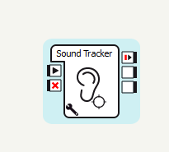
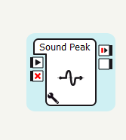
Use a “sound tracking” icon to have robot turn it’s head toward sound and sound peak monitoring (in audio, sound) to determine when a person has stopped responding.

Slide 33
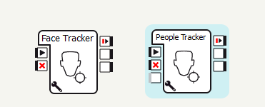
Use a “facial tracking” or “People tracking” (Vision, Human Detection) to have robot head or entire robot follow a face or group of people.

Slide 34
Use tactile options in Touch folder to have the robot detect when (and where) it has been touched. Use these options to create interactions based on touch.

Slide 35
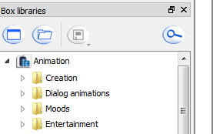
To add entertaining robot actions check the “Animation – Entertainment” Box Library for options.

Slide 36
Capturing Program Windows Snipping Tool (All Apps, Windows Accessories, Snipping Tool) or Snip and Sketch

Slide 37
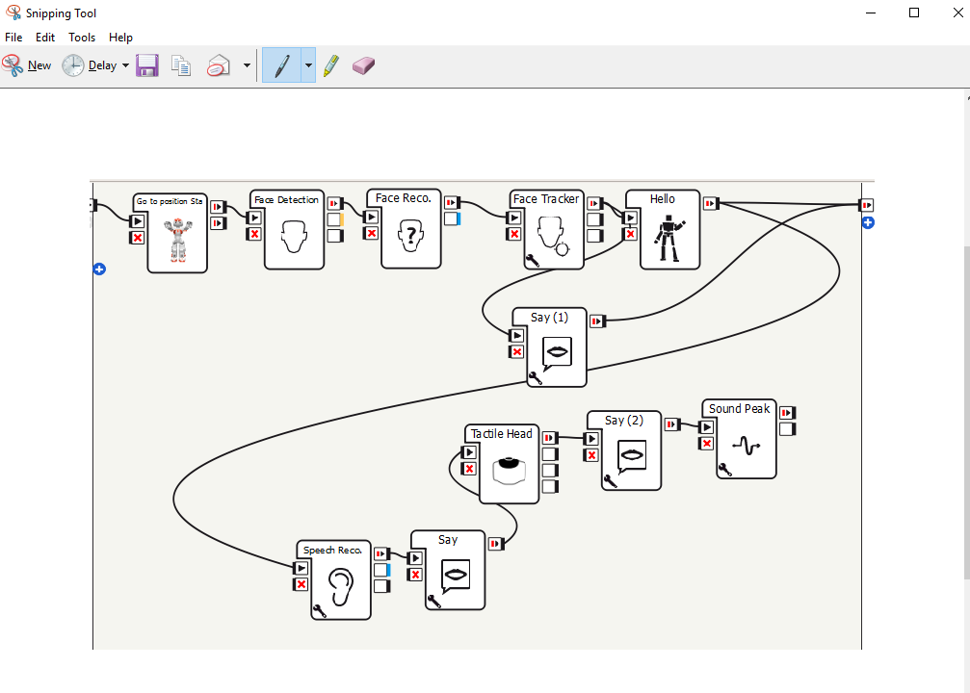
Select File, Save As, and use Choregraphe 3 as title

Slide 38
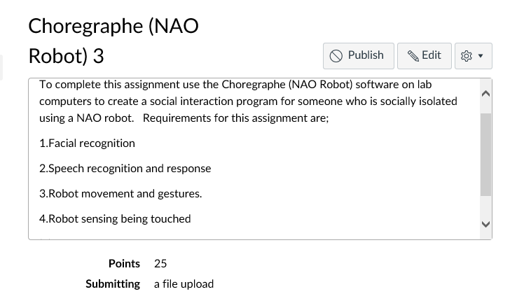
Submit Screen capture in Canvas

