Slide 1
Choregraphe Lab “Emotion Detection Apps” NAO Robot Programming
Content-Objective:
Learn how to create a NAO Robot program where the robot analyzes a person's emotions.
Language-Objective:
Utilize Choregraphe to create a NAO Robot program that determines a emotion-mood and what happens based on the emotion detected.

Slide 2
Choregraphe Lab “Emotion Detections” Nao Robot Programming
Utah Robotics 1 Standard 3
Common Core High School Algebra Reasoning
Common Core High School Interpreting Functions

Slide 3
Do today’s Starter Quiz! (in Canvas)

Slide 4
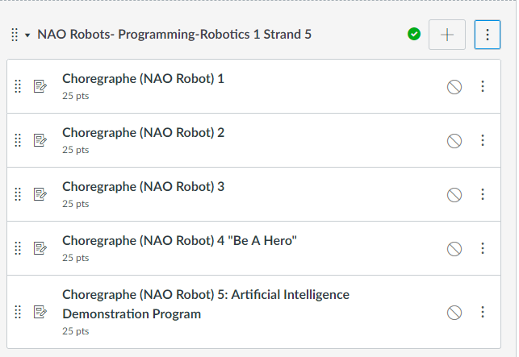
NAO Robots-Programming Module

Slide 5
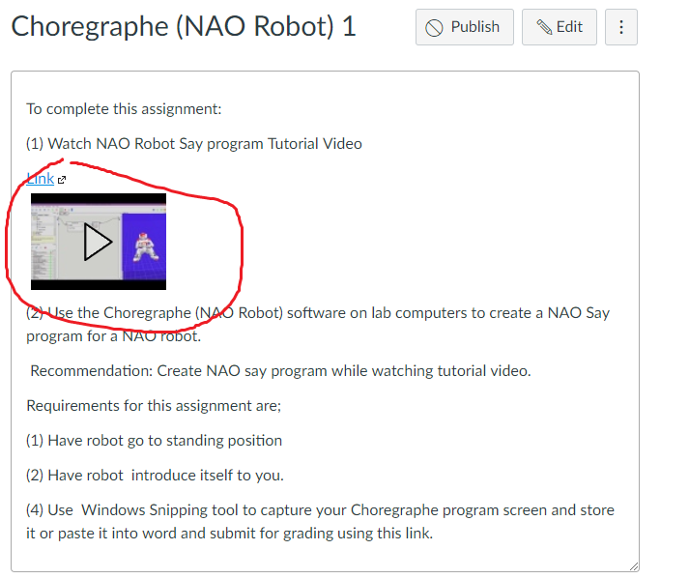
Watch Tutorial Video

Slide 6
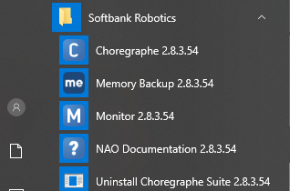
select desktop or menu “Choregraphe”

Slide 7
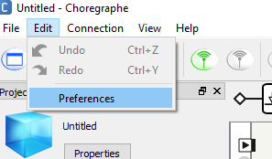
“Click on Edit and Then Preferences”

Slide 8
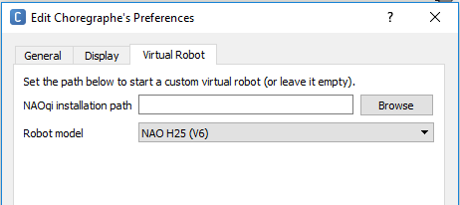
Click on Virtual Robot Tab and select “NAO H25 (V6)” from Robot Model drop down menu

Slide 9
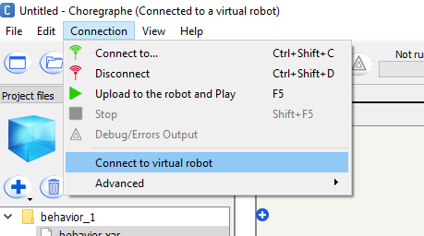
click “Connection and then Connect to virtual robot” . It may take several moments for this step to complete.

Slide 10
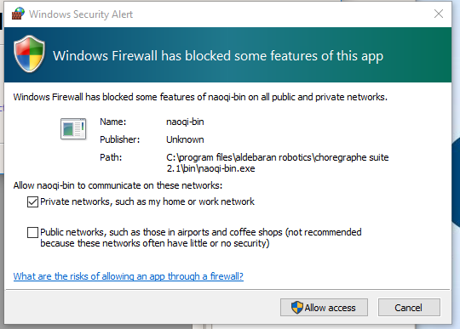
click “Cancel” if Windows Security Alert appears. (Normally around 7 of these appear)

Slide 11
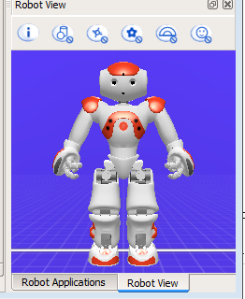
Select “New Project” and title project “Emotion Detection”.

Slide 12
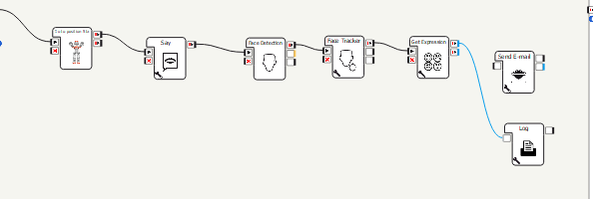
Choregraphe Blocks required to complete this assignment are shown below.

Slide 13
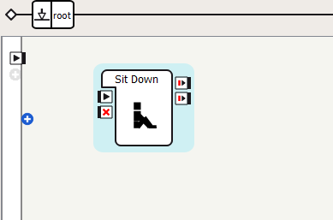
Drag “Sit down” into main screen bottom left side “Box Libraries”, “Movement”, “Postures”, “Sit down”.

Slide 14
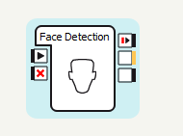
Now drag “Face Detection” and “Face Tracker” in from “Box Libraries”, “Vision”, Human Detection located in lower left corner.

Slide 15
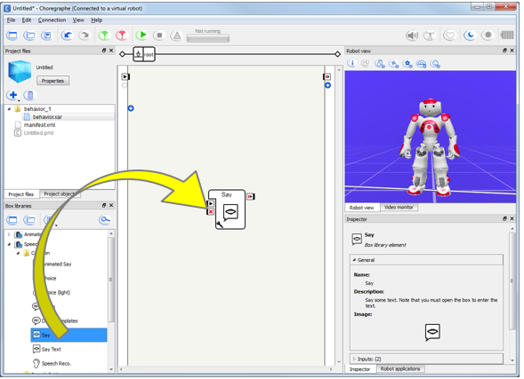
Now drag “Say” in from “Box Libraries”, “Speech”, Creation located in lower left corner.

Slide 16
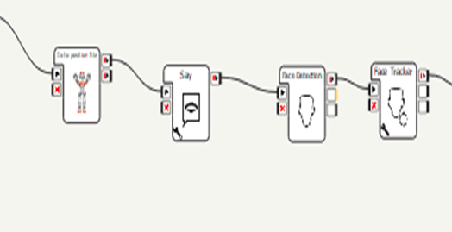
Now click at direction arrows and connect first 4 blocks as shown below.

Slide 17
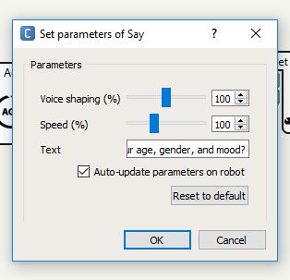
Click on the wrench symbol on Say block and change text to robot introducing itself.

Slide 18
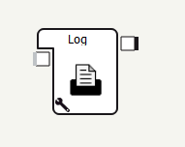
Now drag “Log” in from “Box Libraries”, “Programming”, “Tools” located in lower left corner. Connect Log to output of “say”

Slide 19
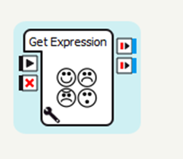
Now drag in a “Get expression” block from “Box Libraries, Sensing, Human Understanding”.

Slide 20
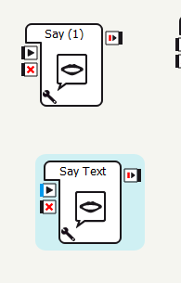
Now drag in a “Say” block and Say text” block from “Box Libraries, Speech, Creation”.

Slide 21
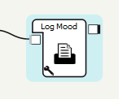
Now drag in a “Log” block “Box Libraries, Programming, Tools”.

Slide 22
Now connect each of the blocks to together to form the starting position, introduction, facial detection, facial tracking, get expression sequence with a log attached to get expression.

Slide 23
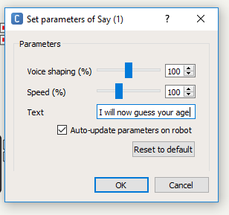
One at a time click on the wrench symbol of the blocks and change the blocks displayed text to what the block is actually doing. Example for get expression – looking for smile, anger, etc.

Slide 24
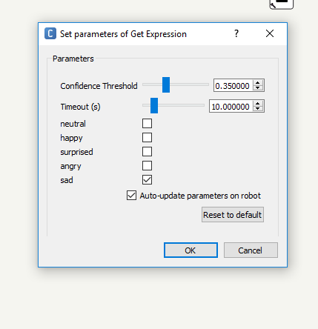
Click on Get Expression block wrench symbol and select emotion (or emotions) you want the robot to monitor for.

Slide 25
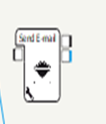
Now you have to determine what you want the robot to do when it detects the emotion(s) specified. (Example send e-mail)

Slide 26
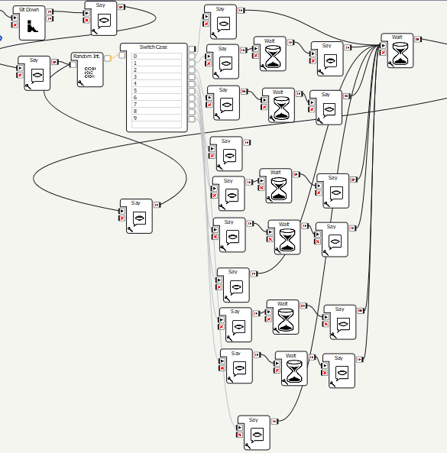
Connect the blocks you want to do when the robot detects emotion and attach them in sequence desired to Get Expression right (output) connection point. Example Joke Telling to get a smile.

Slide 27
Screen Captures Windows Snipping Tool (All Apps, Windows Accessories, Snipping Tool)

Slide 28
Select File, Save As, and use Emotion Detect as title

Slide 29
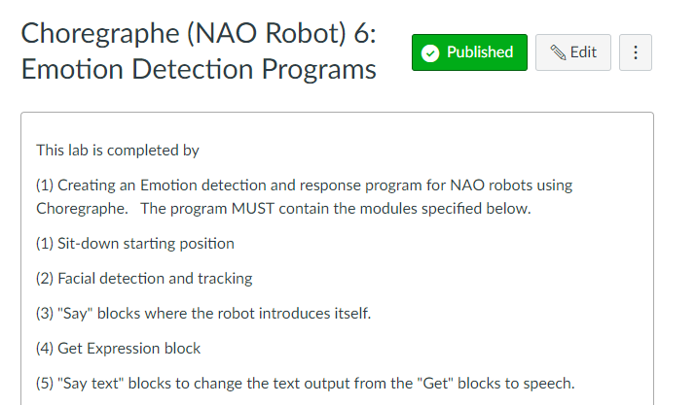
Submit screen capture file in Canvas “

