Slide 1
Alice Lab 5 Giving Music Videos a professional appearance
Content-Objective:
Learn integration of video “camera” and screen objects to give a professionally made appearance.
Language-Objective:
Utilize Alice JAVA animation creation program Set-Vehicle and “do in order” code options to create sophisticated music videos.

Slide 2
Alice Lab 5 JAVA Programming
Utah Robotics 1 Standard 3
Common Core High School Algebra Reasoning
Common Core High School Interpreting Functions

Slide 3
Learn basics of Java coding in block format
Alice Lab 5
STARTER
Canvas: Starter Quiz
TODAY’S AGENDA
STARTER assignment.
Alice Demo
(professional
appearance)
Canvas: Alice Lab 5.
Content Objective
Language Objective
Use Alice to create Java coded animations.

Slide 4
Do today’s Starter Quiz! (in Canvas)

Slide 5
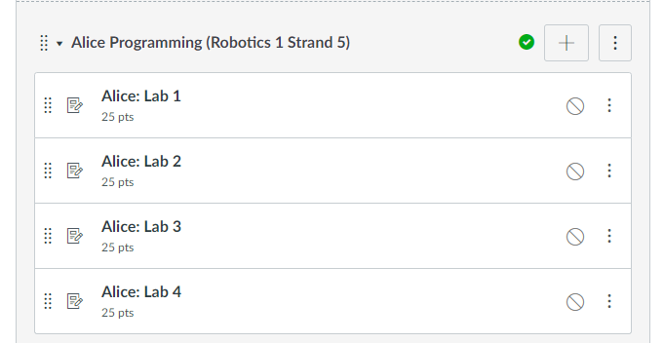
Alice Programming Module

Slide 6
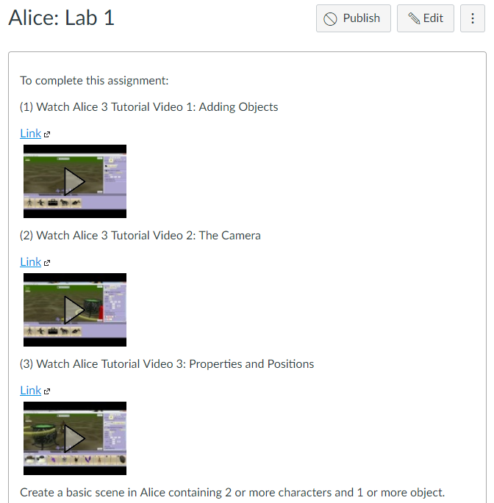
Watch Alice Tutorial Video(s)

Slide 7
Step 1: select desktop or menu “Alice”

Slide 8
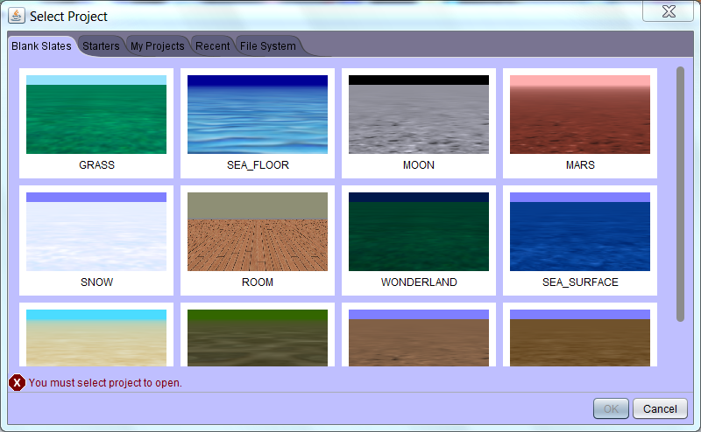
Step 2: “Select a background (use MARS initially) click on OK”

Slide 9
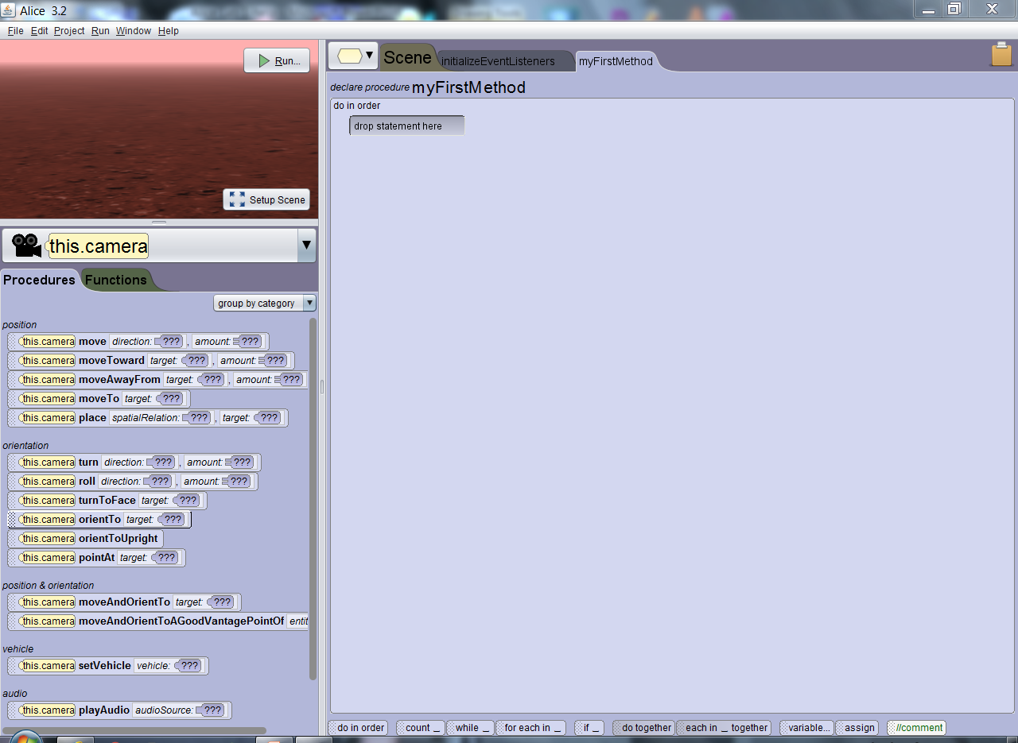
Step 3: “Alice layout screen”

Slide 10
Step 4: “click on Setup Scene”

Slide 11
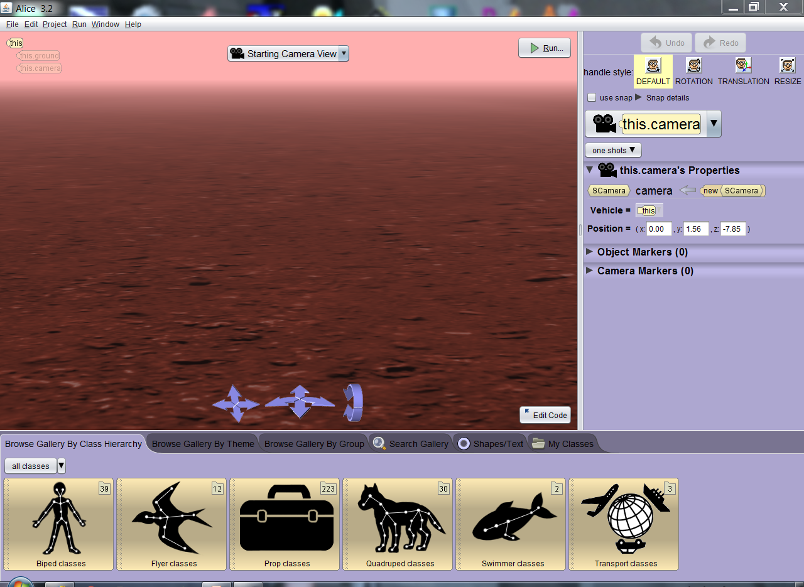
Step 5: “Scene setup window”

Slide 12
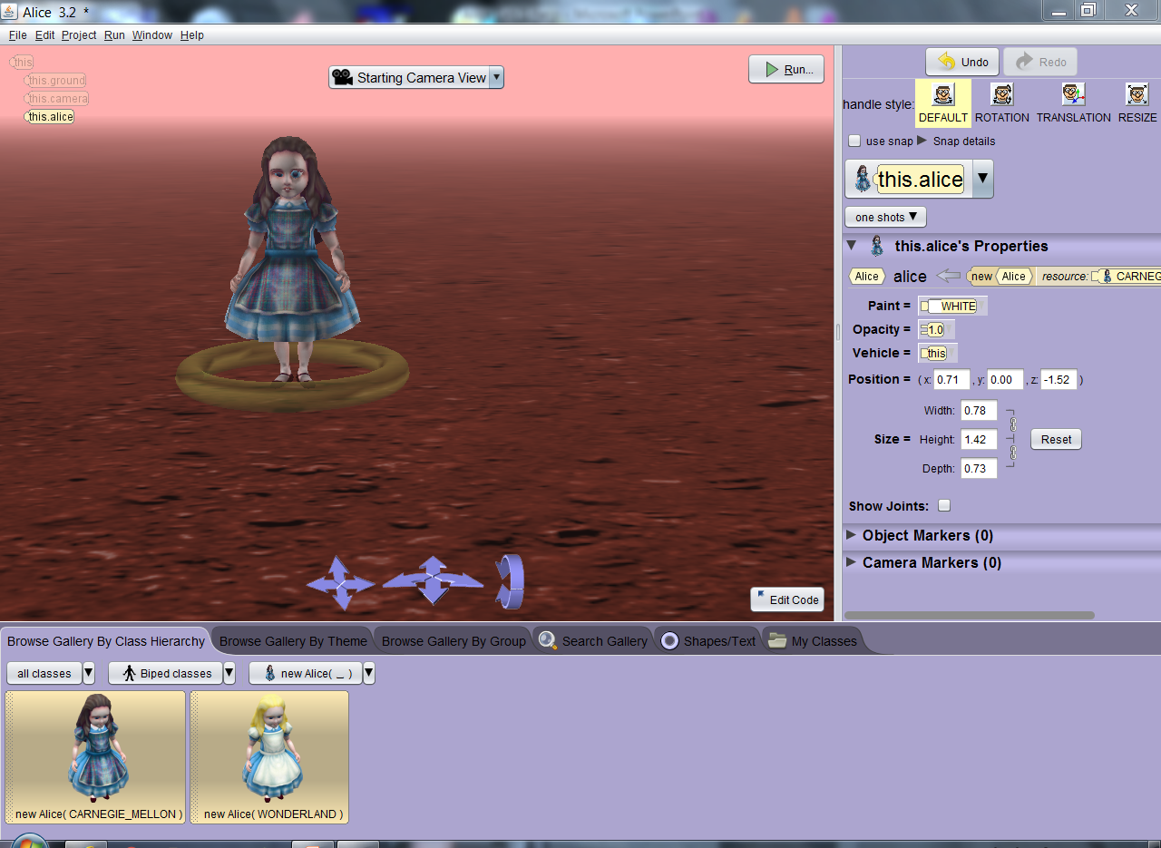
Step 6: Select multiple “Biped” class objects and then drag objects into background. Click “ok” to set in place.

Slide 13
Step 7: After objects (actors) are in place Click on “Edit Code” button

Slide 14
Step 8: Locate down arrow by “This” and select the actor you placed in the screen.

Slide 15
Step 9: Locate My First Method area to code action.

Slide 16
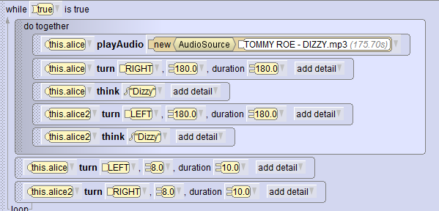
Step 10: Use “DoTogether” to create a music video where action happens while music is played.

Slide 17
Step 11: Add setVehicle command to have camera follow a screen object like a professionally made video would do.

Slide 18
Step 12: If you want to have the camera fly around the characters use an object near center of action and have that object turn for entire video.

Slide 19
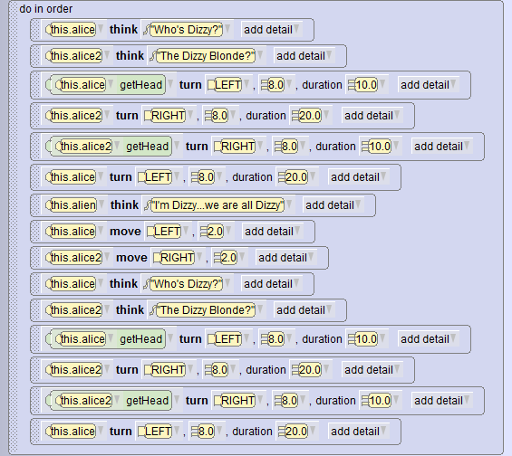
Step 12: Use “do in order” option within Do together music loop to have items perform actions sequentially.

Slide 20
Example code. The characters and audience both get “dizzy”

Slide 21
Assignment: Create a more professional music video using the “do in order” within the “Do together” option Use a character as a camera “set vehicle” reference to make video appear more professional. Show completed animation to instructor. Note: In Robotics the actions in this exercise would be used to integrate autonomous and manual control.

Slide 22
Capturing Program Windows Snipping Tool (All Apps, Windows Accessories, Snipping Tool)

Slide 23
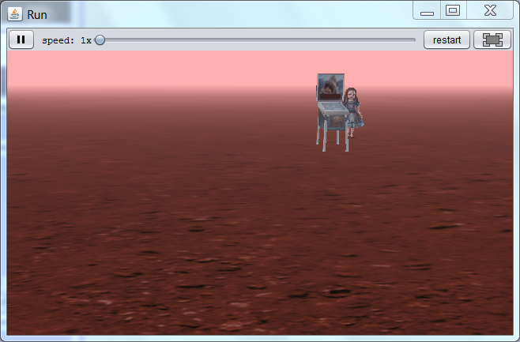
Use Windows Snipping Tool to capture image of your Alice scene and submit capture file for credit in Canvas.

Slide 24
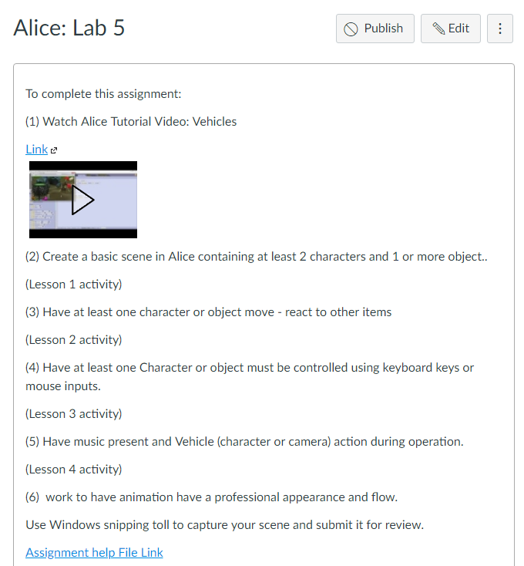
Alice: Lab 5 Submission Link

