Slide 1
Robotics Project Preliminary Submission
Content-Objective:
Team project workday – Submit team project “main file” for evaluation.
Language-Objective:
Work on Team Project: Submit the Team project “Main Project file” for evaluation.

Slide 2
Robotics Project Preliminary Submission
Utah Robotics 1 Standard 3
Common Core High School Algebra Reasoning
Common Core High School Interpreting Functions

Slide 3
Do today’s Starter Quiz! (in Canvas)

Slide 4
Course Project Standards

Slide 5
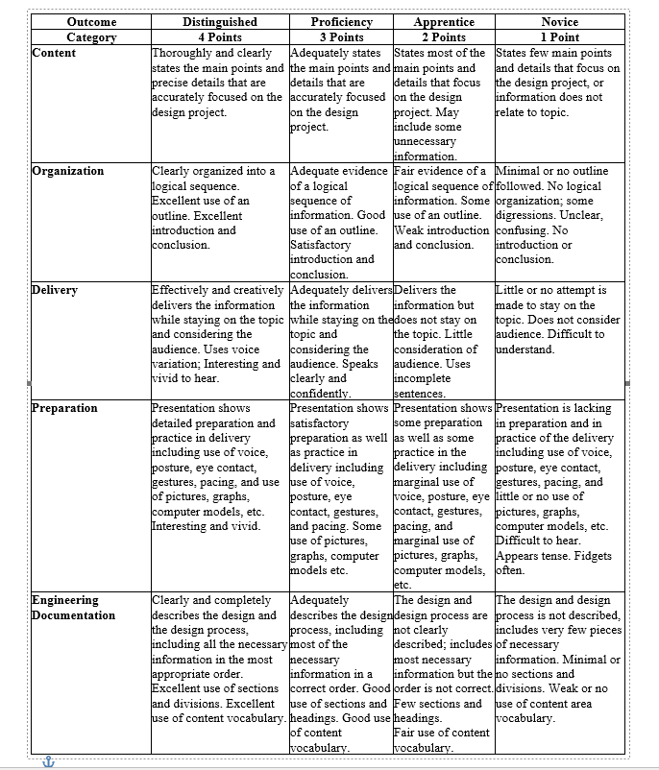
Grading Rubric

Slide 6
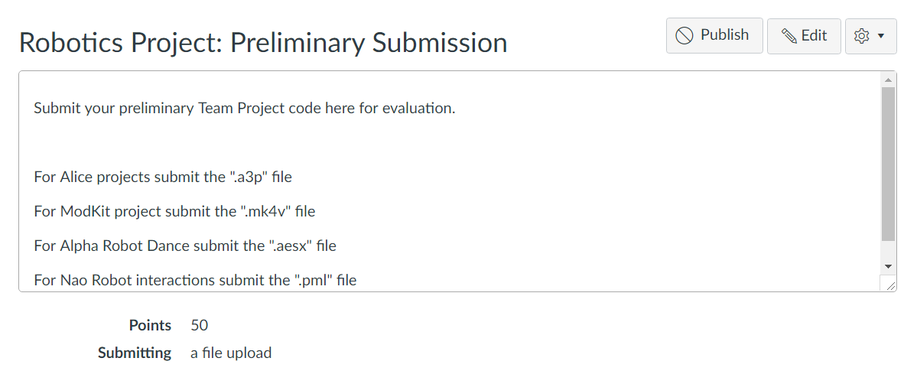
Submitting File

