Slide 1
Alice Lab 2 JAVA Programming
Content-Objective:
Learn basics of object oriented JAVA programming.
Language-Objective:
Utilize Alice JAVA animation creation program to learn basics of object oriented programming.

Slide 2
Alice Lab 2 JAVA Programming
Utah Robotics 1 Standard 3
Common Core High School Algebra Reasoning
Common Core High School Interpreting Functions

Slide 3
Learn basics of Java coding in block format
Alice Lab 2
STARTER
Canvas: Starter Quiz
TODAY’S AGENDA
STARTER assignment.
Alice Demo
(character action).
Canvas: Alice Lab 2.
Content Objective
Language Objective
Use Alice to create Java coded animations.

Slide 4
Do today’s Starter Quiz! (in Canvas)

Slide 5
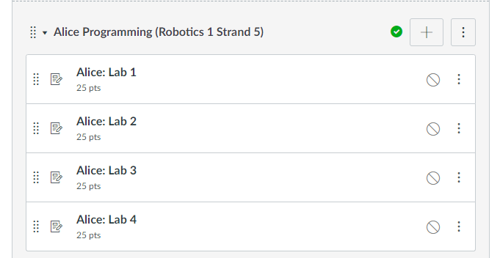
Alice Programming Module

Slide 6
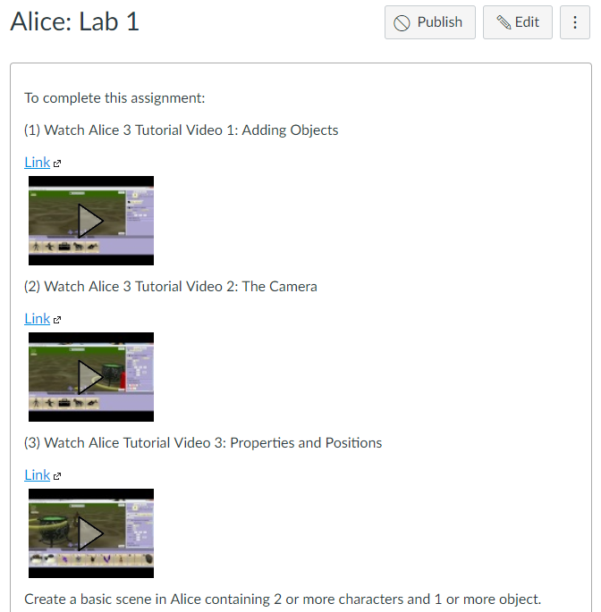
Watch Alice Tutorial Video(s)

Slide 7
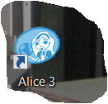
Step 1: select desktop or menu “Alice”

Slide 8
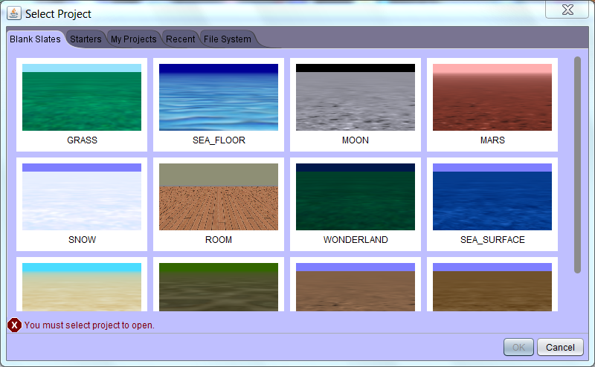
Step 2: “Select a background (use MARS initially) click on OK”

Slide 9
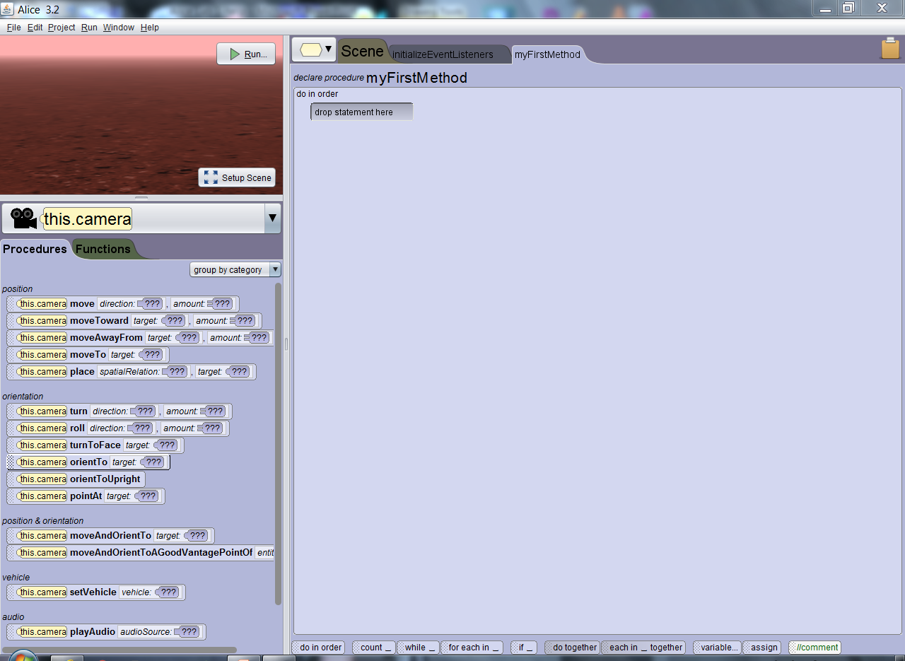
Step 3: “Alice layout screen”

Slide 10
Step 4: “click on Setup Scene”

Slide 11
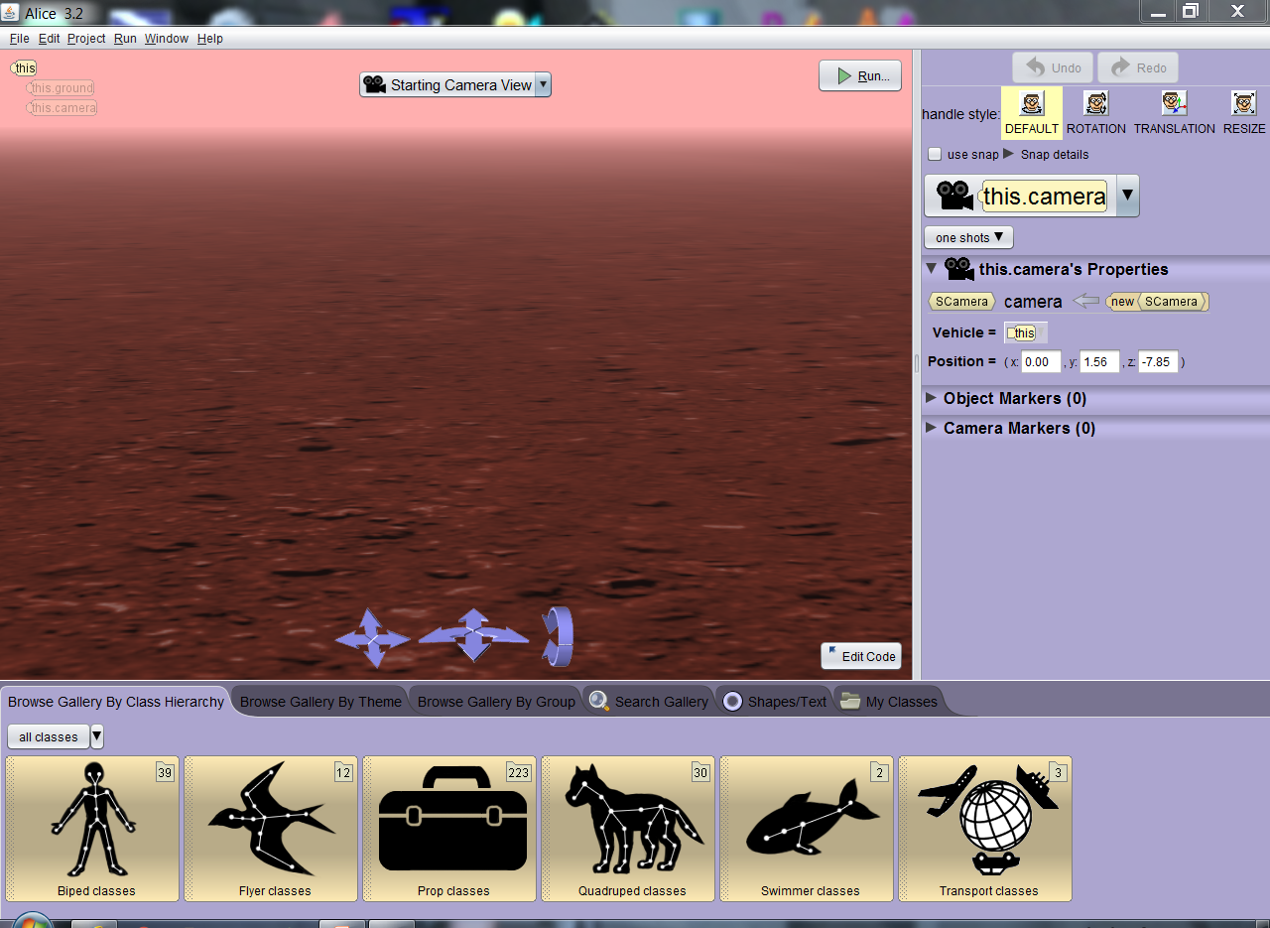
Step 5: “Scene setup window”

Slide 12
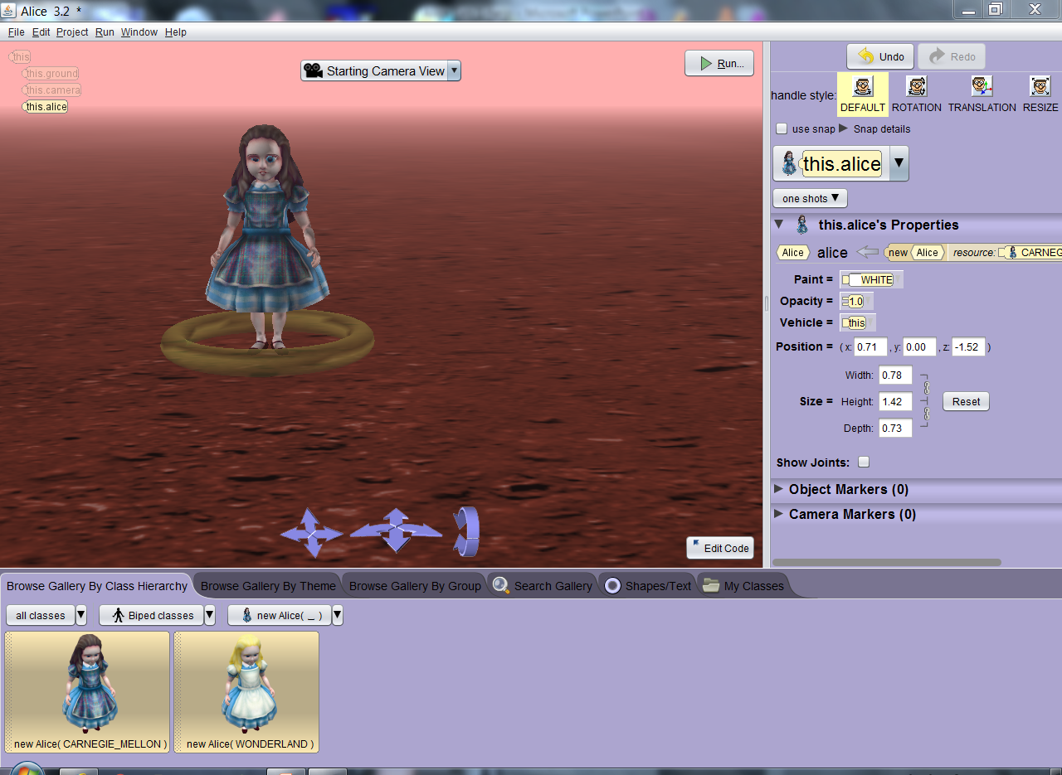
Step 6: Select a “Biped” class, then New Alice() sub-class and drag object into background then click “ok” to set in place.

Slide 13
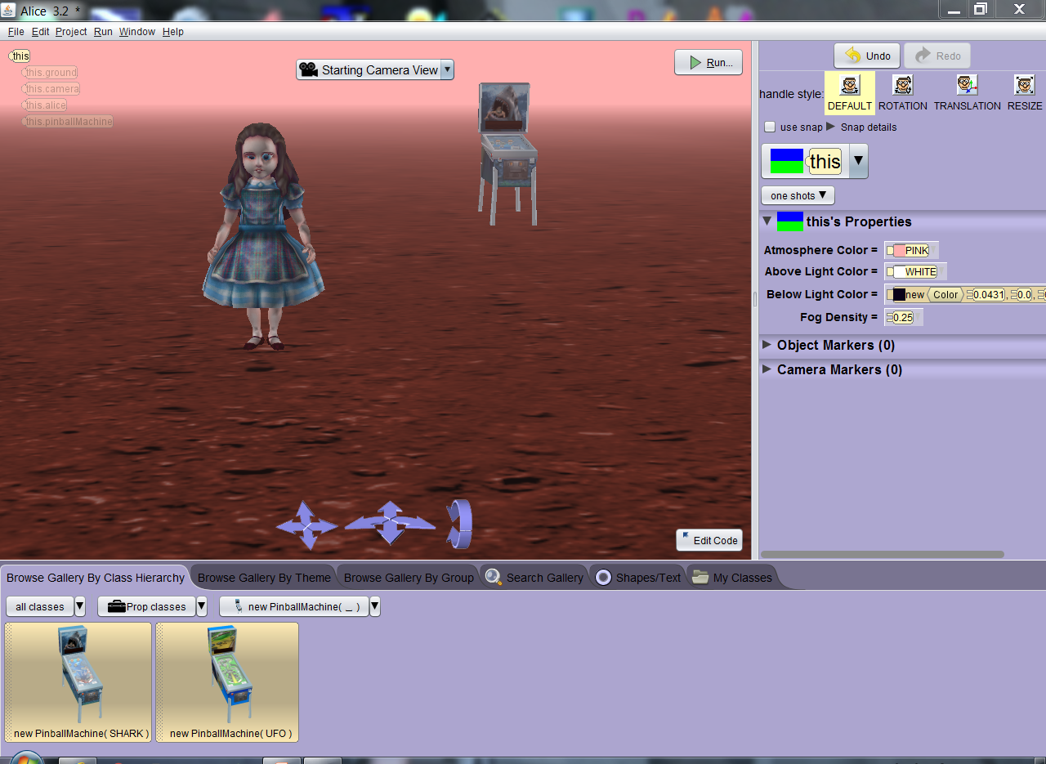
Step 7: Search through options and add at least 2 other items to background (pinball machine shown)

Slide 14
Step 8: After objects (actors) are in place Click on “Edit Code” button

Slide 15
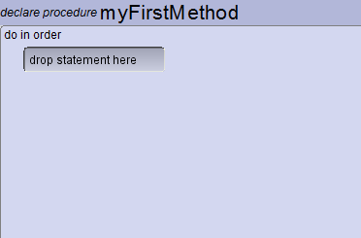
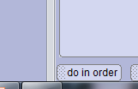
Step 9: Locate “do in order” button on bottom of screen so it displays along top near “drop statement here”

Slide 16
Step 10: Locate down arrow by “This” and select one of the objects (actors) you brought into screen.

Slide 17
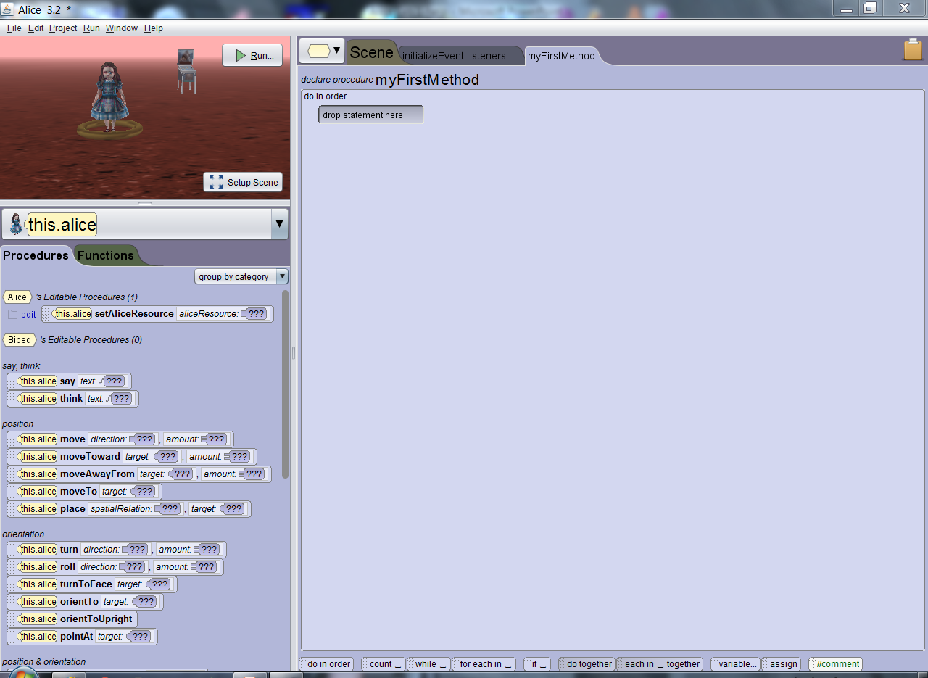
Step 11: Actions the actor can perform are displayed in “procedures” column.

Slide 18
Step 12: Drag procedures to “myFirst Method” use down arrows on procedure to customize action

Slide 19
Step 13: Two statements in example has Alice move to ward pinball machine and ask if anyone wants to play?

Slide 20
Step 13: Two statements in example has Alice move to ward pinball machine and ask if anyone wants to play?

Slide 21
Assignment: By dragging procedures into myFirstMethod create an action scene involving your characters.

Slide 22
Capturing Program Windows Snipping Tool (All Apps, Windows Accessories, Snipping Tool)

Slide 23
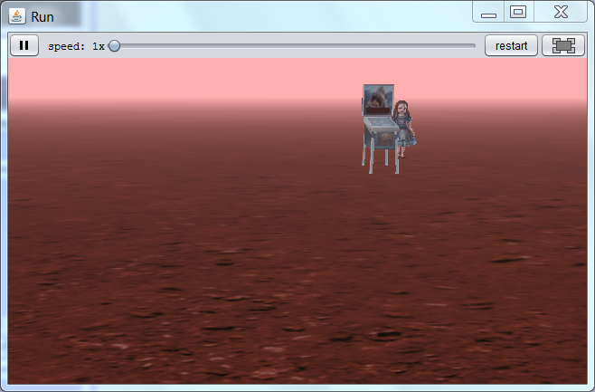
Use Windows Snipping Tool to capture image of your Alice scene and submit capture file for credit in Canvas.

Slide 24
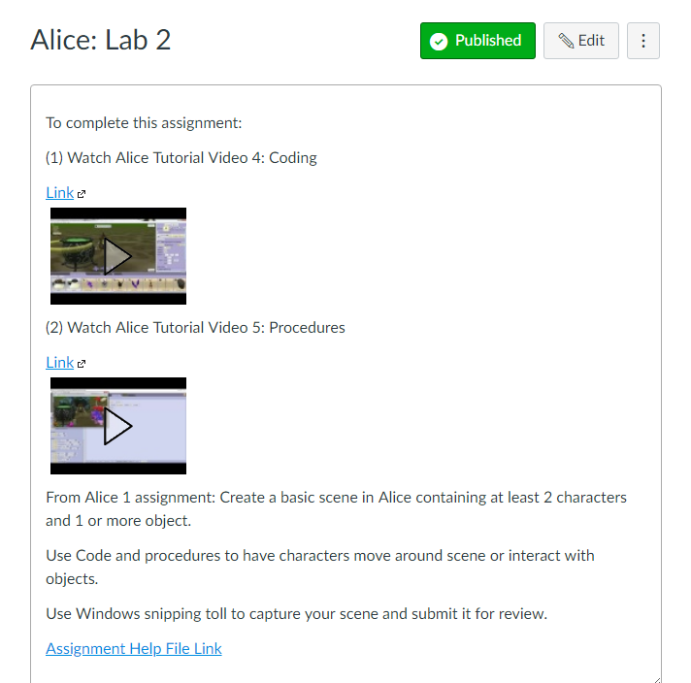
Alice: Lab 2 Submission Link

