Slide 1
Choregraphe Lab “Artificial Intelligence” NAO Robot Programming
Content-Objective:
Learn how to create a NAO Robot program where the robot analyzes a person's age, gender, and emotions.
Language-Objective:
Utilize Choregraphe to create a NAO Robot program that determines a persons age, gender and emotion-mood.

Slide 2
Choregraphe Lab “Artificial Intelligence” Nao Robot Programming
Utah Robotics 1 Standard 3
Common Core High School Algebra Reasoning
Common Core High School Interpreting Functions

Slide 3
Do today’s Starter Quiz! (in Canvas)

Slide 4
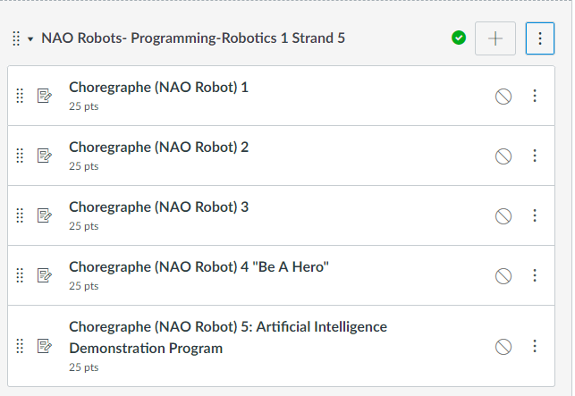
NAO Robots-Programming Module

Slide 5
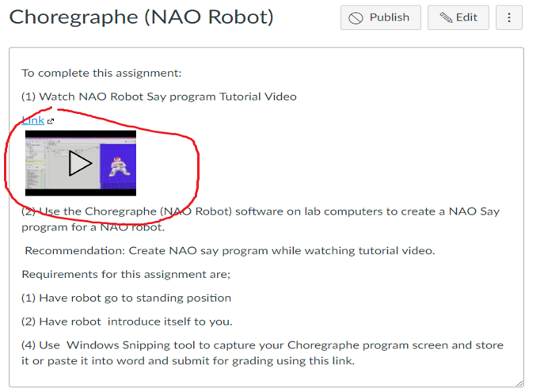
Watch Tutorial Video

Slide 6
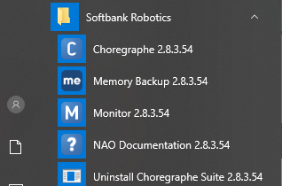
select desktop or menu “Choregraphe”

Slide 7
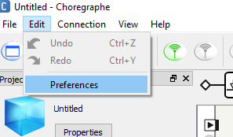
“Click on Edit and Then Preferences”

Slide 8
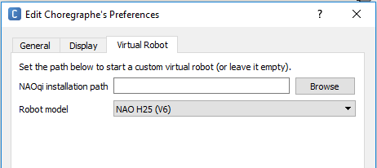
Click on Virtual Robot Tab and select “NAO H25 (V6)” from Robot Model drop down menu

Slide 9
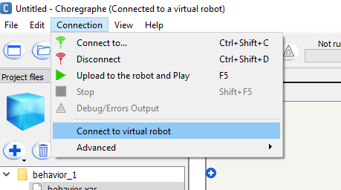
“Connection and then Connect to virtual robot” . It may take several moments for this step to complete.

Slide 10
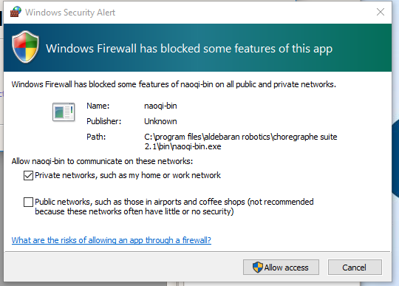
click “Cancel” if Windows Security Alert appears. (Normally around 7 of these appear)

Slide 11
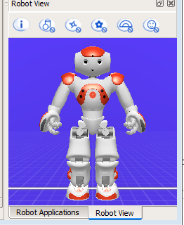
Select “New Project” and title project “Artificial Intelligence”.

Slide 12
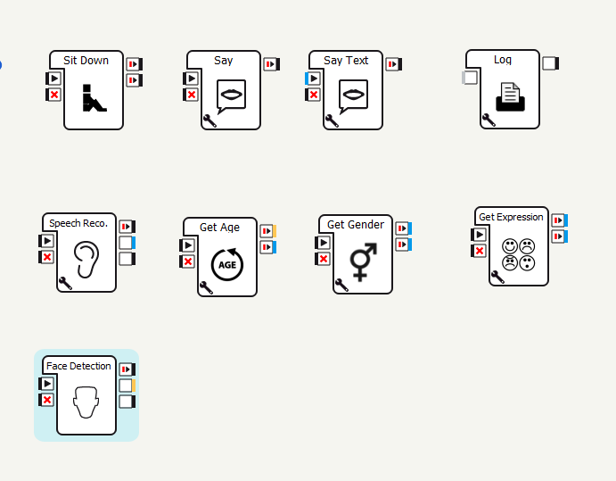
Choregraphe Blocks required to complete this assignment are shown below.

Slide 13
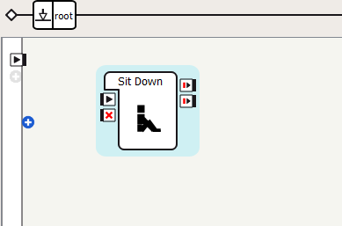
Drag “Sitdown” into main screen bottom left side “Box Libraries”, “Movement”, “Postures”, “Sitdown”.

Slide 14
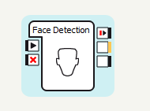
Now drag “Face Detection” in from “Box Libraries”, “Vision”, Human Detection located in lower left corner.

Slide 15
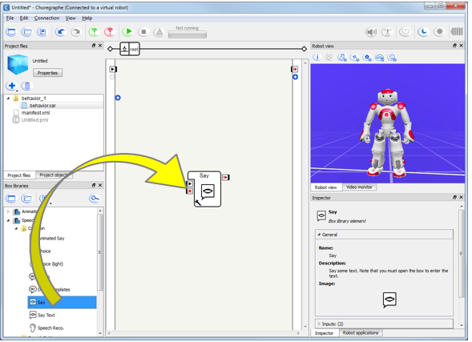
Now drag “Say” in from “Box Libraries”, “Speech”, Creation located in lower left corner.

Slide 16
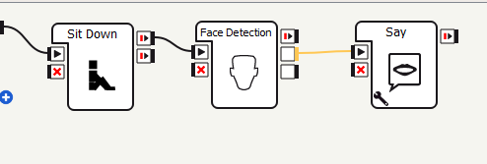
Now click at direction arrows and connect first 3 blocks as shown below.

Slide 17
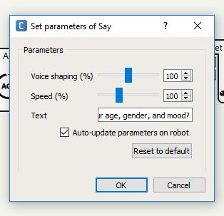
Step 10: Click on the wrench symbol on Say block and change text to robot introducing itself and then asking if person detected would like for the robot to guess their age, gender, and mood.

Slide 18
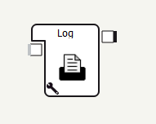
Now drag “Log” in from “Box Libraries”, “Programming”, “Tools” located in lower left corner. Connect Log to output of “say”

Slide 19
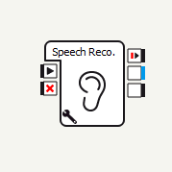
Now drag “Speech Reco.” in from “Box Libraries”, “Speech”, “Creation” located in lower left corner. Connect “Speech Reco” input to output of “Log”

Slide 20
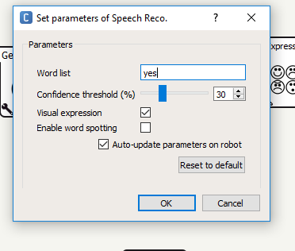
Now click on wrench symbol of “Speech Reco.” block and change the recognized word list to “Yes” (delete no)

Slide 21
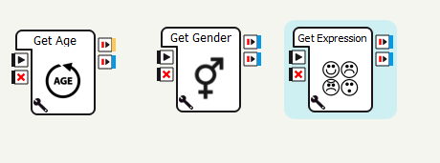
Now drag in a “Get age”, “Get gender”, and “Get expression” blocks from “Box Libraries, Sensing, Human Understanding”.

Slide 22
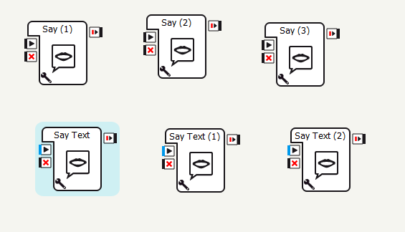
Now drag in 3 “Say” blocks and 3 “Say text” blocks from “Box Libraries, Speech, Creation”.

Slide 23
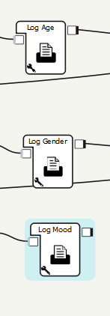
Now drag in 3 “Log” blocks “Box Libraries, Programming, Tools”.

Slide 24
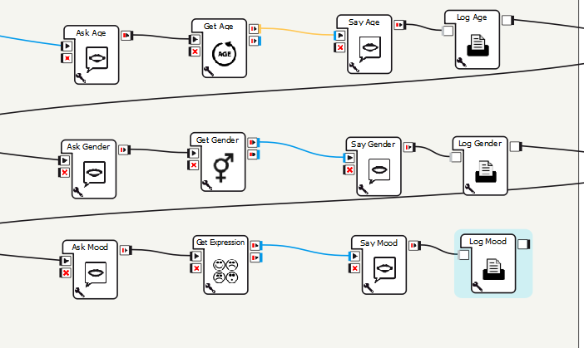
Now connect each of the “Get” blocks to be between a “Say” and “Say text” block with a log block on the end.

Slide 25
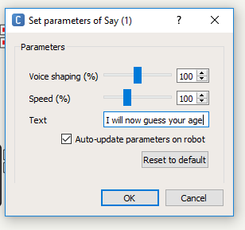
One at a time click on the wrench symbol of the “Say” blocks and change the text to “I will now guess your ____” with the underscored being the type of Get block attached to the Say.

Slide 26
Arrange the 3 “Say”, “Get”, and “Say text, log” block strings into the order you would like them asked.

Slide 27
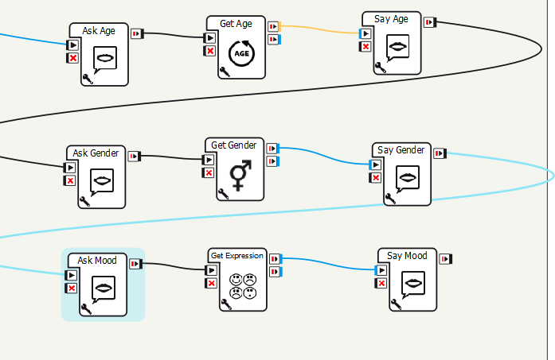
Right click on each of the “Say” blocks and choose ‘Edit block”. Change box description to what Say is asking.

Slide 28
Step 21: Right click on each of the “Say text” blocks and choose ‘Edit block”. Change box description to what Say text is responding with.

Slide 29
Step 22: Right click on each of the “Log” blocks and choose ‘Edit block”. Change box description to what Log is recording.

Slide 30
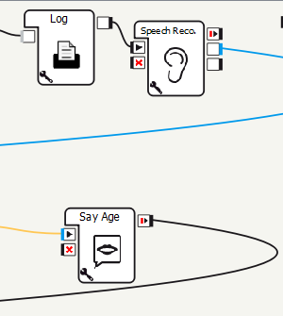
Step 23: Connect the blocks together with the input connection of the first Ask block connected to the middle (blue) output of the “Speech Reco” block.

Slide 31
Screen Captures Windows Snipping Tool (All Apps, Windows Accessories, Snipping Tool) or Snip and Sketch

Slide 32
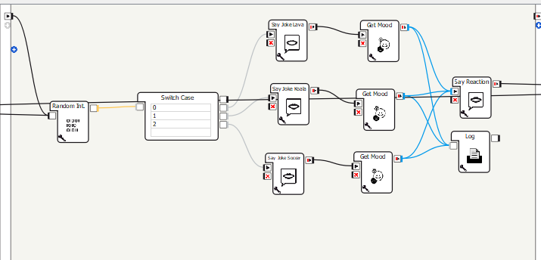
Select File, Save As, and use Artifical Intelligence as title

Slide 33
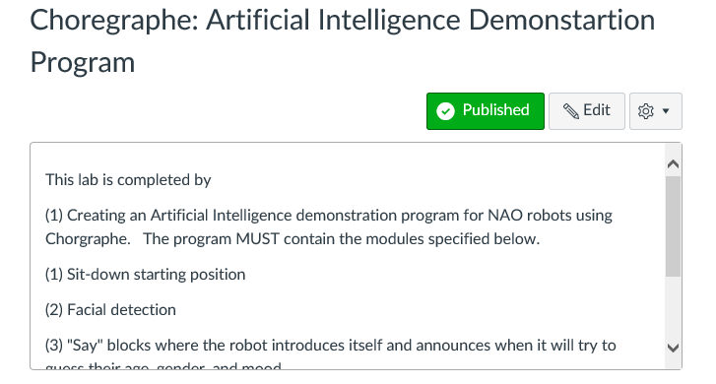
Submit screen capture file in Canvas

