Slide 1
Choregraphe Lab 4
Content-Objective:
Learn creation of social interaction coding to better mankind.
Language-Objective:
Utilize Choregraphe Software to create social interaction programs for the socially isolated.

Slide 2
Be A Hero Program
Utah Robotics 1 Standard 3
Common Core High School Algebra Reasoning
Common Core High School Interpreting Functions

Slide 3
What is an Interaction program for socially isolated?
A program for a social robot platform that will recognize a person, greet them and then interact with them. To do this the program involves;
Facial recognition
Speech recognition and response
Robot movement and gestures.
Robot sensing: touch sensing, sound position, people or face tracking

Slide 4
Why create Interaction programs for socially isolated?
To make the world better…….
Or…would you rather be a hero, or a zero….

Slide 5
Who are the socially isolated these robot programs are intended for?
Children with autism. Social robots work well with autism because the robot has predictable responses that are not threatening.
Hospitalized children or adults.
Senior citizens.

Slide 6
Why should YOU want to do this?
If you think your life sucks……honestly it does…because your trying to live for yourself through entertainment or thrills. The “SECRET” of fulfilling life is to live for others. (Churches have known this for centuries).
This form of fulfillment is also in demand in the business world…meaning you make great money for that entertainment stuff.
A chance to be a leader…or as I say
Be a Hero instead of a zero

Slide 7
Do today’s Starter Quiz! (in Canvas)

Slide 8
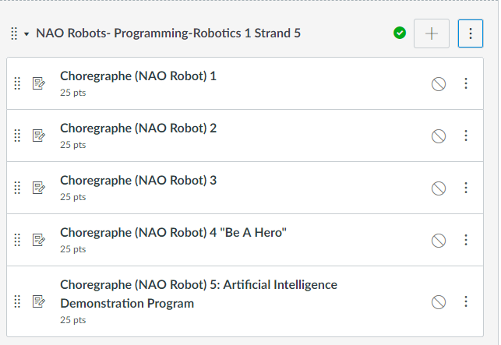
NAO Robots-Programming Module

Slide 9
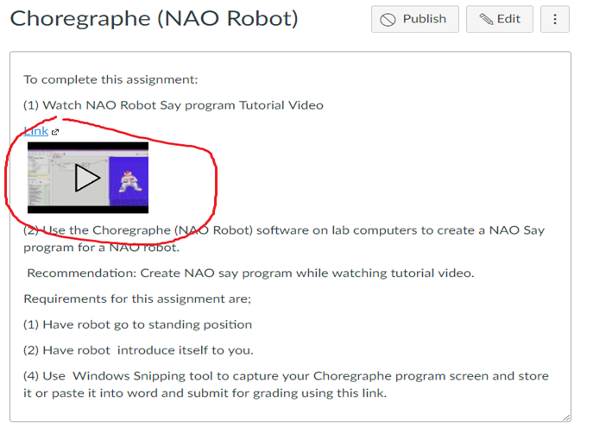
Watch Tutorial Video

Slide 10
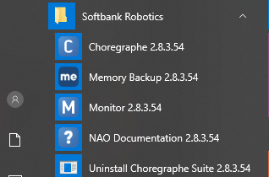
select desktop or menu “Choregraphe”

Slide 11
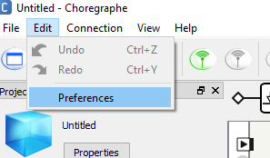
“Click on Edit and Then Preferences”

Slide 12
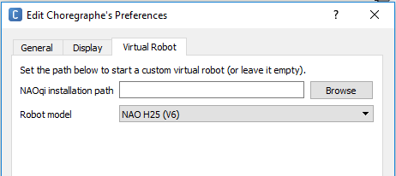
Click on Virtual Robot Tab and select “NAO H25 (V6)” from Robot Model drop down menu

Slide 13
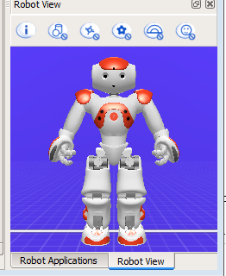
Select “New Project”, In lower right Corner locate the “Robot View” tab. Click on tab to have robot simulation shown.

Slide 14
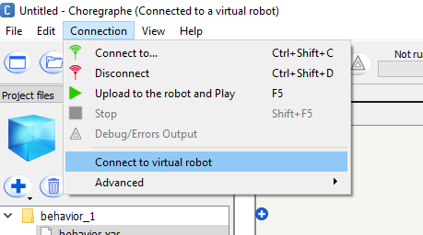
Click “Connection and then Connect to virtual robot” It may take several moments for this to complete.

Slide 15
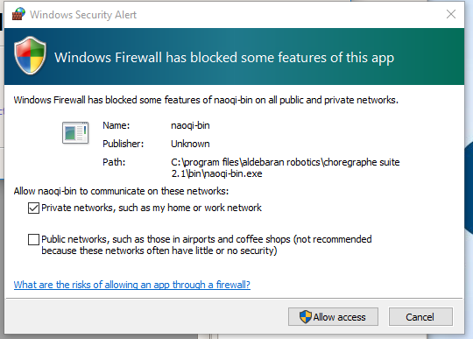
click “Cancel” if Windows Security Alert appears.

Slide 16
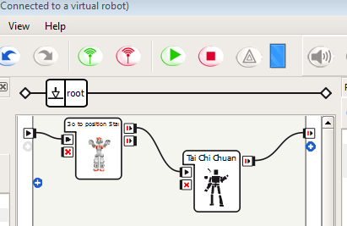
The first step for any Choregraphe program is to have a robot stand starting position (from right side position library)

Slide 17
Basics of a Social Interaction Program
A social interaction program has 4 elements
Facial recognition
Robot movement and gestures
Speech recognition and response
Tactile (touch) response

Slide 18
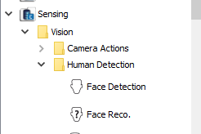
Part 1: Facial Recognition Locate “Vision”, “Human Detection” in the “Sensing” section of standard actions library in lower left corner of Choregraphe.

Slide 19
Now locate “Face Detection” and “Face Reco.” in the “Human Detection” options

Slide 20
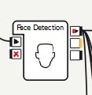
Drag in a Face detection icon (Robots have to know to detect faces before they can recognize one)

Slide 21
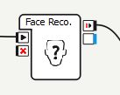
Now drag in a face recognition icon.

Slide 22
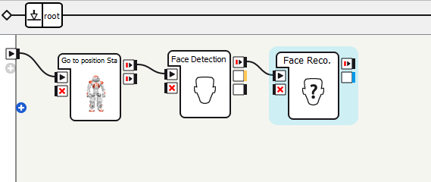
Connect the Face Detection input to the Starting position (Stand) box output and the Facial Reco. Input to the Facial Detection output. recognition. The NAO robot must know to look for faces before it can recognize them.

Slide 23
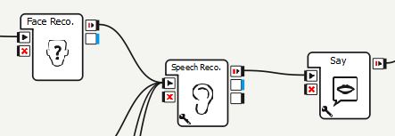
Items are connected together in left-to-right order they are performed . example: face recognition controls speech recognition listening for “Hello” command which results in “Greetings Wonderful one” from Say command in example below.

Slide 24
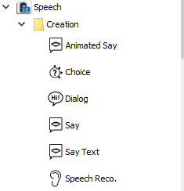
Part 2: Speech recognition and audio response locate the “Speech”, “Creation” options in standard actions library

Slide 25
Select “Speech Reco.” from standard actions library located in lower left corner.

Slide 26
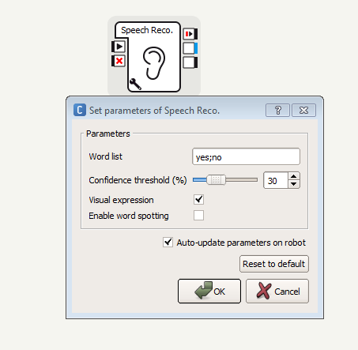
Now Click on wrench symbol to open Speech parameter options. The words in word list are the ones the robot is programmed to recognize.

Slide 27
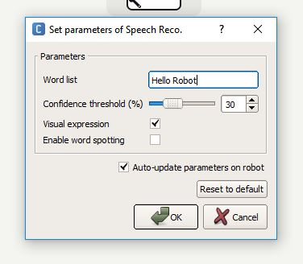
Enter words or short phrase you want robot to recognize and respond to in word list.

Slide 28
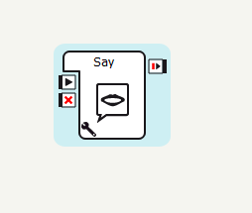
Now select “Say” from “Speech” options and drag into workspace.

Slide 29
Double-click on wrench symbol in lower left corner of say icon to change robot speech output.

Slide 30
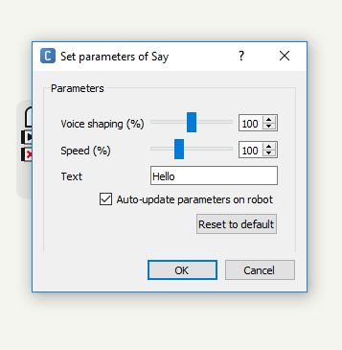
Set parameters of Say box will appear. Enter what you want robot to say in text block.

Slide 31
Click on “ok” to return to main screen.

Slide 32
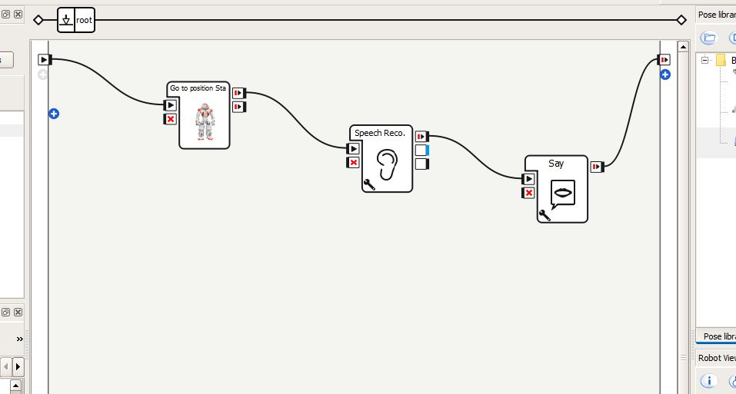
Connect icons together as shown to make complete speech recognition and response.

Slide 33
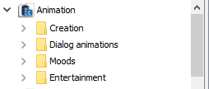
Part 3: Robot movement and gestures. In standard action library locate “Animation”

Slide 34
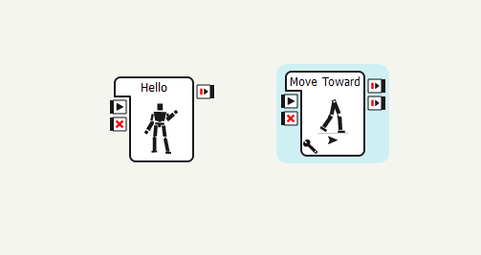
Robot movements are located in the Entertainment section. Robot gestures like waving are in the “Moods” section of Animation.

Slide 35
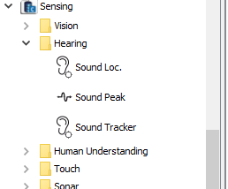
Part 4: Hearing and Touch Sensors options are in the Sensing Hearing and Touch folders in standard actions library.

Slide 36
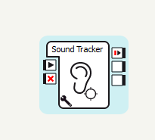
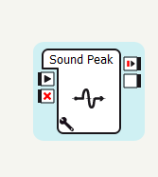
Use a “sound tracking” icon to have robot turn it’s head toward sound and sound peak monitoring (in audio, sound) to determine when a person has stopped responding.

Slide 37
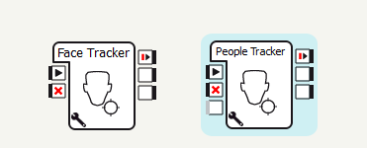
Use a “facial tracking” or “People tracking” (Vision, Human Detection) to have robot head or entire robot follow a face or group of people.

Slide 38
Use tactile options in Touch folder to have the robot detect when (and where) it has been touched. Use these options to create interactions based on touch.

Slide 39
Now create a “Hero” Program. The robot will look for one particular face, then greet the person by waving and speaking to them. This should be followed up by the robot asking them about their interests. The robot should then interact with them using touch and voice. Finally the robot should maintain eye contact with them at all times.

Slide 40
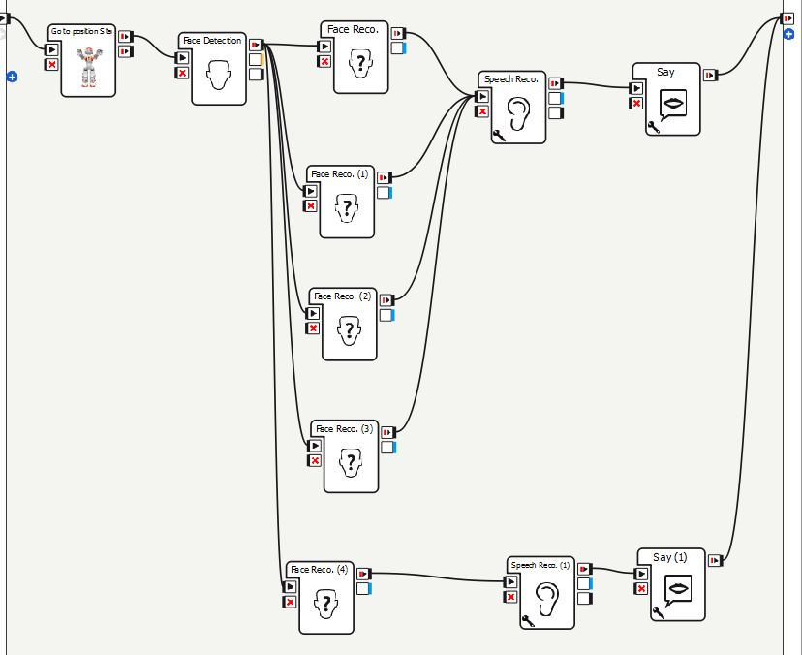
Robot do items in left-right order. When multiple things are done at same time or feed to same result parallel connections as shown below for facial recognition (robot recognizes and responds to more than one person in example)

Slide 41
Today’s Lab: Create a NAO robot social interaction program that includes the items below.
Facial recognition
Speech recognition and response
Robot movement and gestures.
Robot sensors (touch) and facial/group vision and/or sound tracking.

Slide 42
Screen Capturing Windows Snipping Tool (All Apps, Windows Accessories, Snipping Tool) or Snip and Sketch

Slide 43
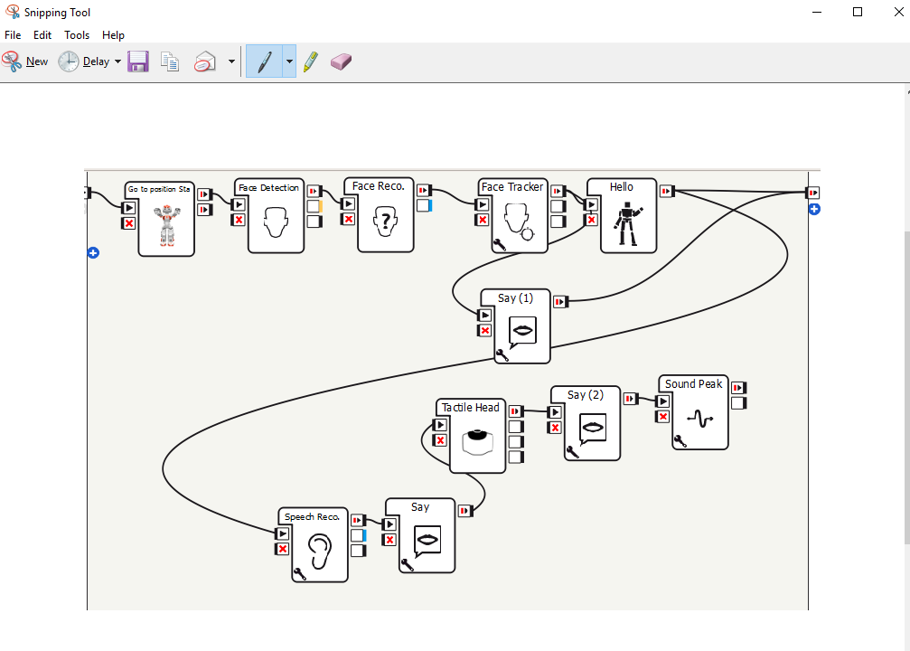
Select File, Save As, and use HERO as title

Slide 44
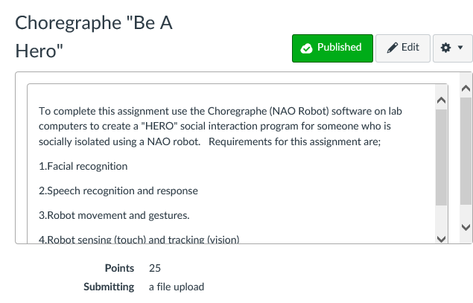
Submit screen capture in Canvas

