Slide 1
Little Bits Lab 1
Content-Objective:
Learn electronic circuit operation and connections.
Language-Objective:
Utilize Little Bits kits to learn circuit operation and control.

Slide 2
Do today’s Starter Quiz! (in Canvas)

Slide 3
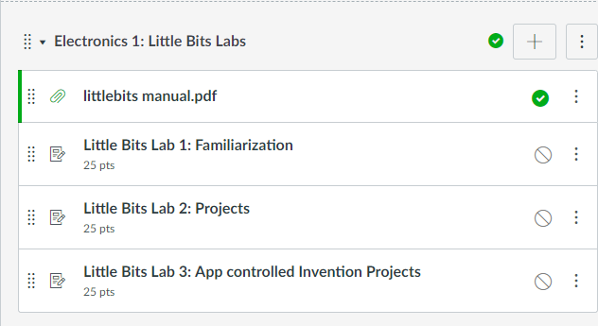
LittleBits Labs Little Bits Lab 1: Familiarization

Slide 4
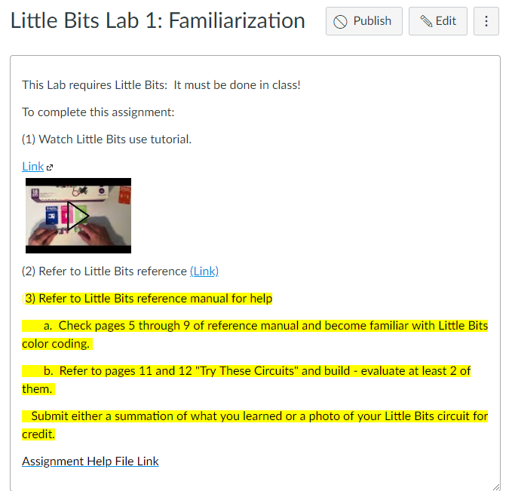
Step 1: Tutorial Video Little Bits Lab 1: Familiarization

Slide 5
Today’s Task Learn – practice connecting Little Bits circuit pieces to create electronic items.

Slide 6
Work with a partner Obtain Little Bits pieces from kits

Slide 7
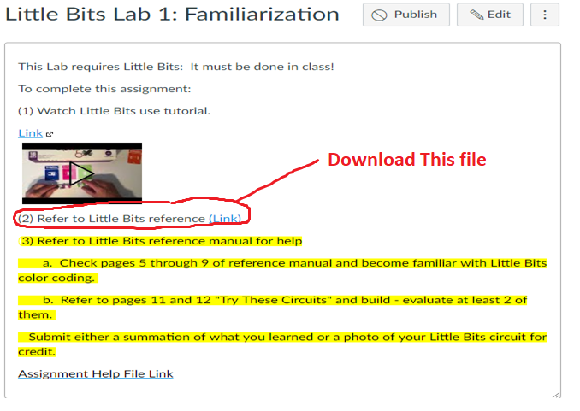
Step 1: Download reference manual in Canvas (on lab PC)

Slide 8
Step 2: Little Bits part reference (Pages 5-9)

Slide 9
Practice Building Little Bits Task 1: Build at one of the “Try These Circuits” located on pages 11-12 of reference manual.

Slide 10
Practice Building Little Bits Task 2: Build another “Try These Circuits” located on pages 11-12 of reference manual.

Slide 11
Report Success Level in Canvas: If possible submit photos of Little Bits circuit built.

