Slide 1
Robotics Project
Content-Objective:
Investigate and prioritize Robotics Project Options.
Language-Objective:
Utilize Ozobot, Choreograph, Easy PLC, or Scratch create a Robotics Project

Slide 2
Robotics Project 1 Project Investigation
Utah Robotics 1 Strand 4
Common Core High School Algebra Reasoning
Common Core High School Interpreting Functions

Slide 3
Do today’s Starter Quiz! (in Canvas)

Slide 4
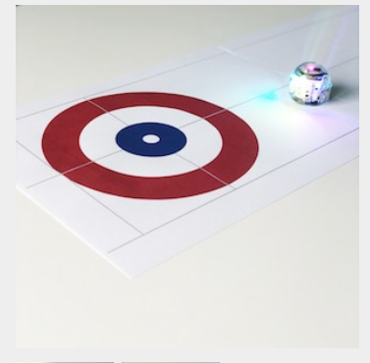
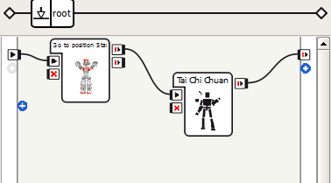
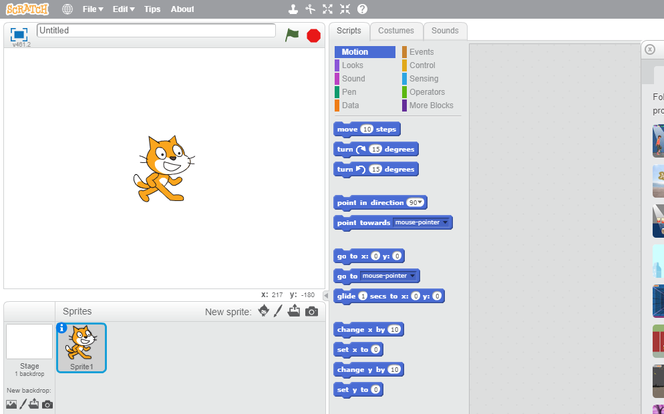
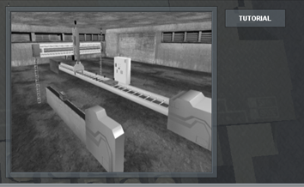
Step 1: Quick Investigation of Team Projects.

Slide 5
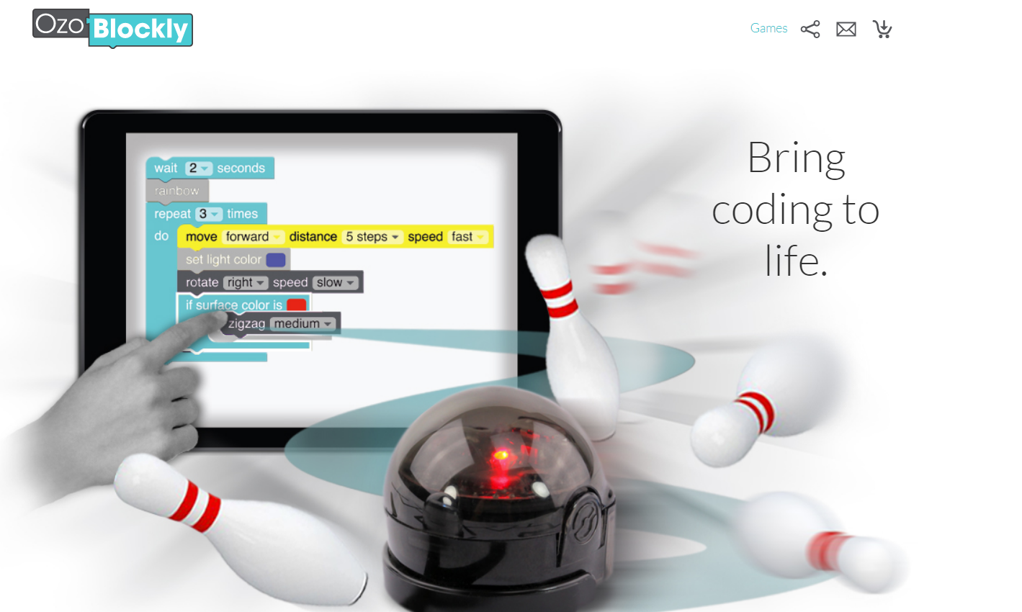
Option 1: OzoBlockly.com Ozobot Robot Program

Slide 6
Option 2: Alice animation

Slide 7
Option 3: Choregraph Create a NAO robot program using Choregraphe

Slide 8
Option 4: Scratch: Game Program

Slide 9
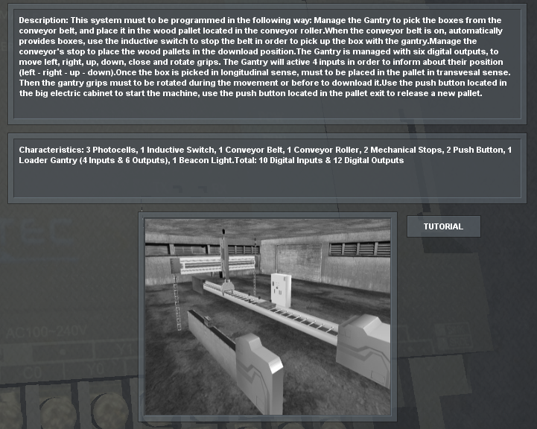
Option 5: Debug Easy PLC Program

Slide 10
Assignment: Investigate the options given for a robot project and prioritize your selections. .

Slide 11
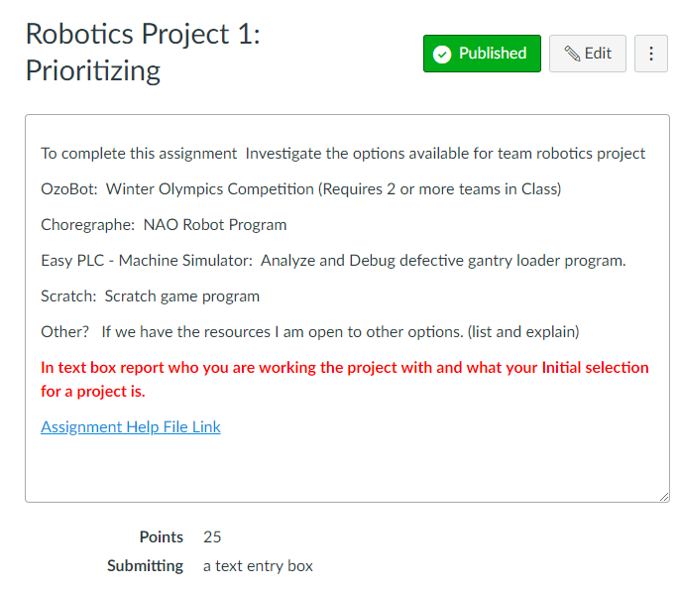
For credit:
Canvas Assignment: Robotics Project 1:
Text Entry Box

